Slide 1
Item Origin Investigation
Starting with Sustainability

Slide 2
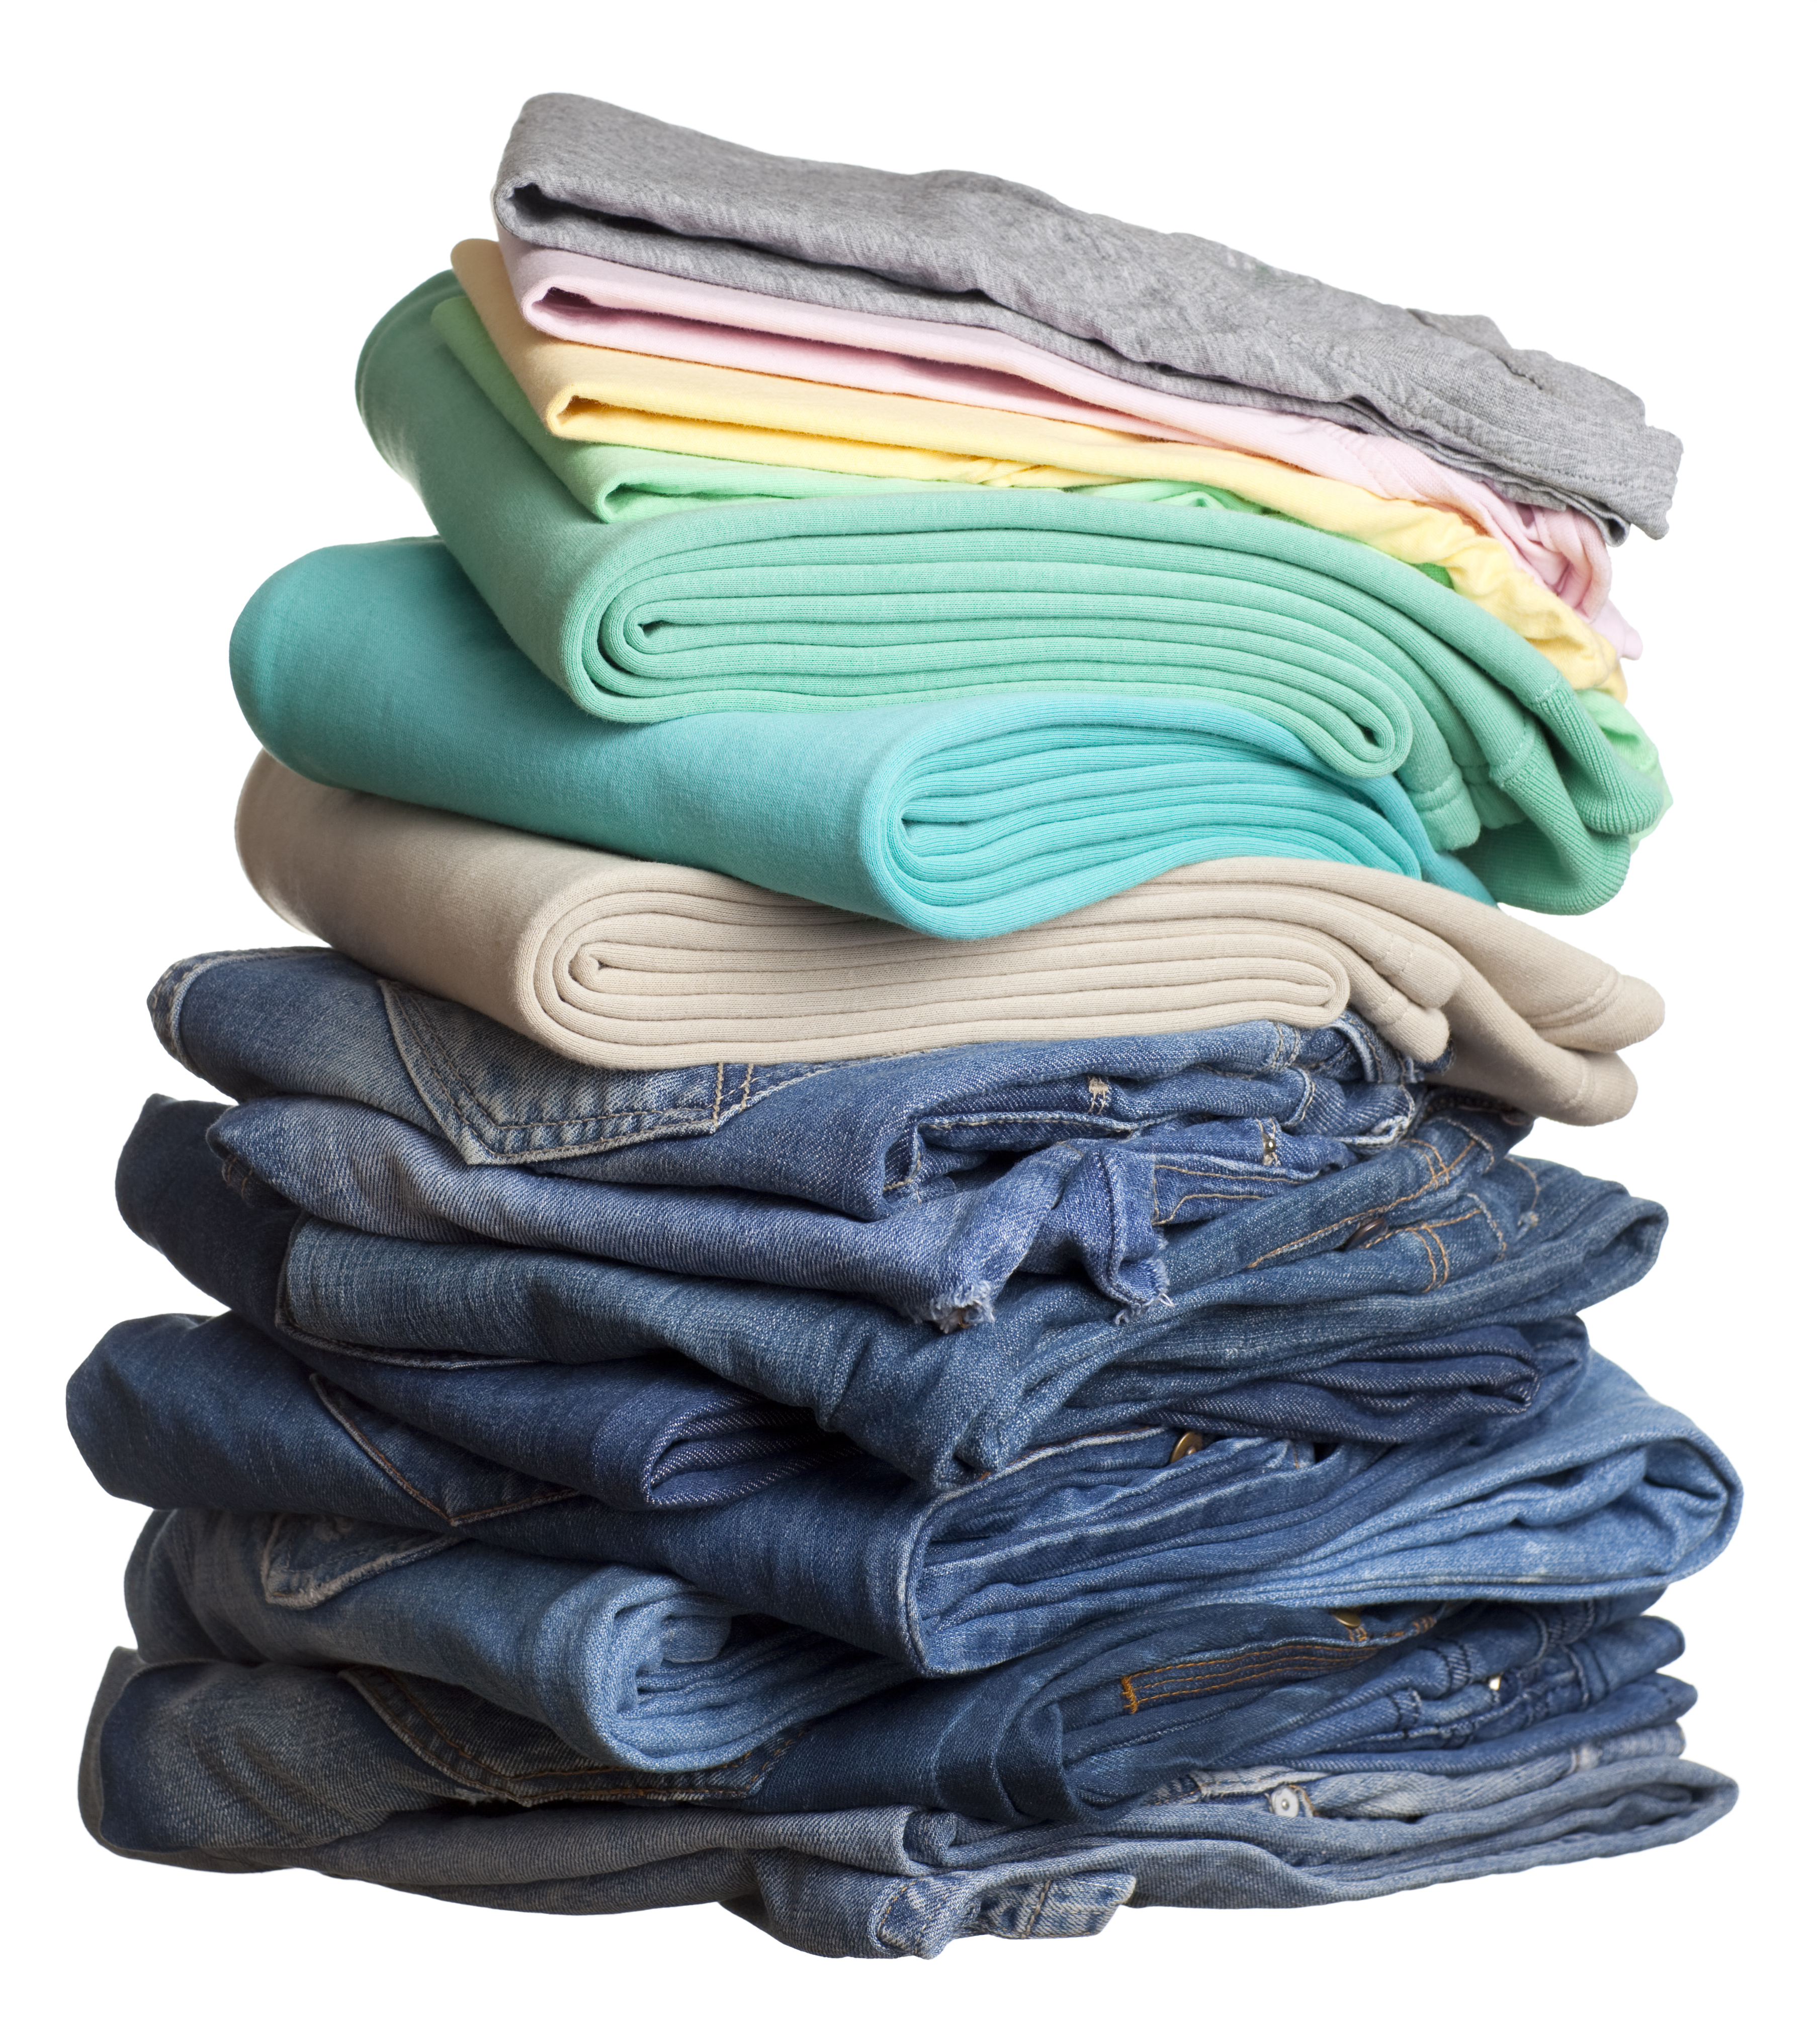
Product Origins
Think about the things you use every day, like food, clothing, furniture, and other items in your home. Pick one type of item to investigate. You may want to do this investigation individually and then compare your results with the rest of your team.
You will be investigating the origins of these items. Origin means where something comes from.

Slide 3
Where to Investigate
Decide Where You Will Investigate
You may decide to investigate in a shop or other place in your community where you can buy things.
You may decide to investigate in your home, for example, by looking at where all your clothes come from.

Slide 4
Manufacturing or Growing Origin
Examine each item closely for a tag, label, or other indication of where it was made or grown. Tags and labels often say “Made in . . .” and then a country name.
If you cannot find a tag or label, you could ask a worker or search for further information at the shop where you bought the item.
Record the origin of each item.
An example of a clothing tag

Slide 5
Transport
Examine a map of the world.
Where did the item come from?
How do you think it may have gotten to you? For example, maybe it was first sent by ship and then put on a train and finally put in a truck to get to the store where you bought it.

Slide 6
Reflection
Share what you found out with your teammates and compare your results.
Consider:
Do certain items, like food, travel shorter distances than other items, like clothing?
How does using items from different places affect you and your community?
How could you make different choices so things do not travel as far to reach you?

