Slide 1
Energy and Daily Choices Understand
How can I use less energy?

Slide 2
Understand Overview
Learning Objective:
We will be able identify opportunities to change energy use in their community and propose strategies to reduce consumption.
Understand Reading (optional): A 1-page reading on how transportation contributes to greenhouse gas emissions and how different choices can help reduce carbon dioxide output.
Understand Investigation: Students investigate energy use within the community by identifying areas of waste and exploring practical strategies for reducing it.
Understand Research Extension (optional): Students can extend their learning by researching energy use habits, identifying barriers to reducing waste, and developing creative solutions to promote reducing energy use in their community.

Slide 3
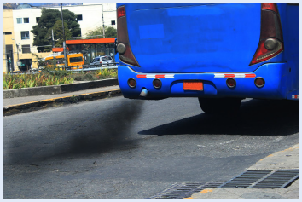
Understand Reading
Transportation and Emissions
We use energy every day. We each could make different choices to use less. While many of our energy decisions happen at home, another major area where we have control over energy use is transportation. The types of transportation we choose have a big impact on how much energy we consume and the greenhouse gases we produce.

Slide 4
Understand Reading, slide 2
Several main types of transportation use fossil fuels, such as oil or natural gas, that are taken out of the Earth. When these fossil fuels are burned for energy, greenhouse gases are released (or emitted) into the atmosphere. These greenhouse gases trap heat, causing the global atmosphere to warm and the climate to change. Globally, transportation is responsible for 14% of greenhouse gases that are released. But in many countries, it is an even higher percentage. For example, transportation creates 28% of the greenhouse gases released in the United States. The most common greenhouse gas is carbon dioxide (CO2).

Slide 5
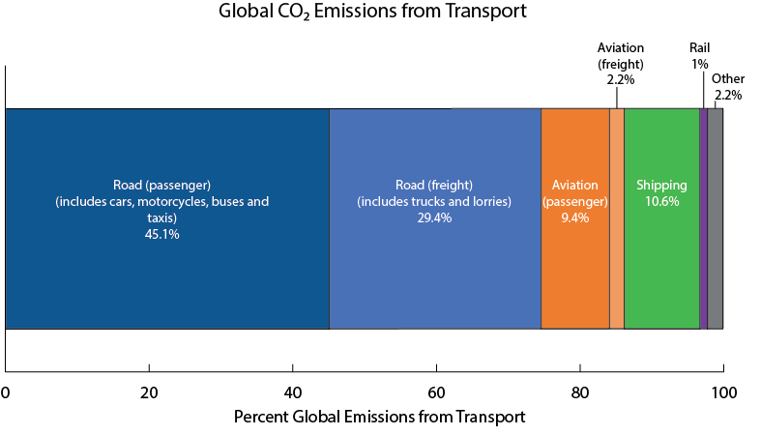
Understand Reading, slide 3
Examine this graph of Global CO2 Emissions from Transport. Discuss with your team:
Notice: What do you notice about the graph? For example, which categories are the largest?
Think: What do you think is important about the graph? For example, if you wanted to decrease global CO2 emissions from transportation, what might you try to do?
Wonder: What do you wonder about global emissions and transportation that is not answered in the graph?

Slide 6
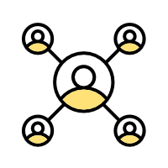
Understand Reading, slide 4
Community connection: Which parts of this graph might relate to decisions that you can help make? Which types of transportation do you think you might be able to use to decrease the greenhouse gases related to transportation?

Slide 7
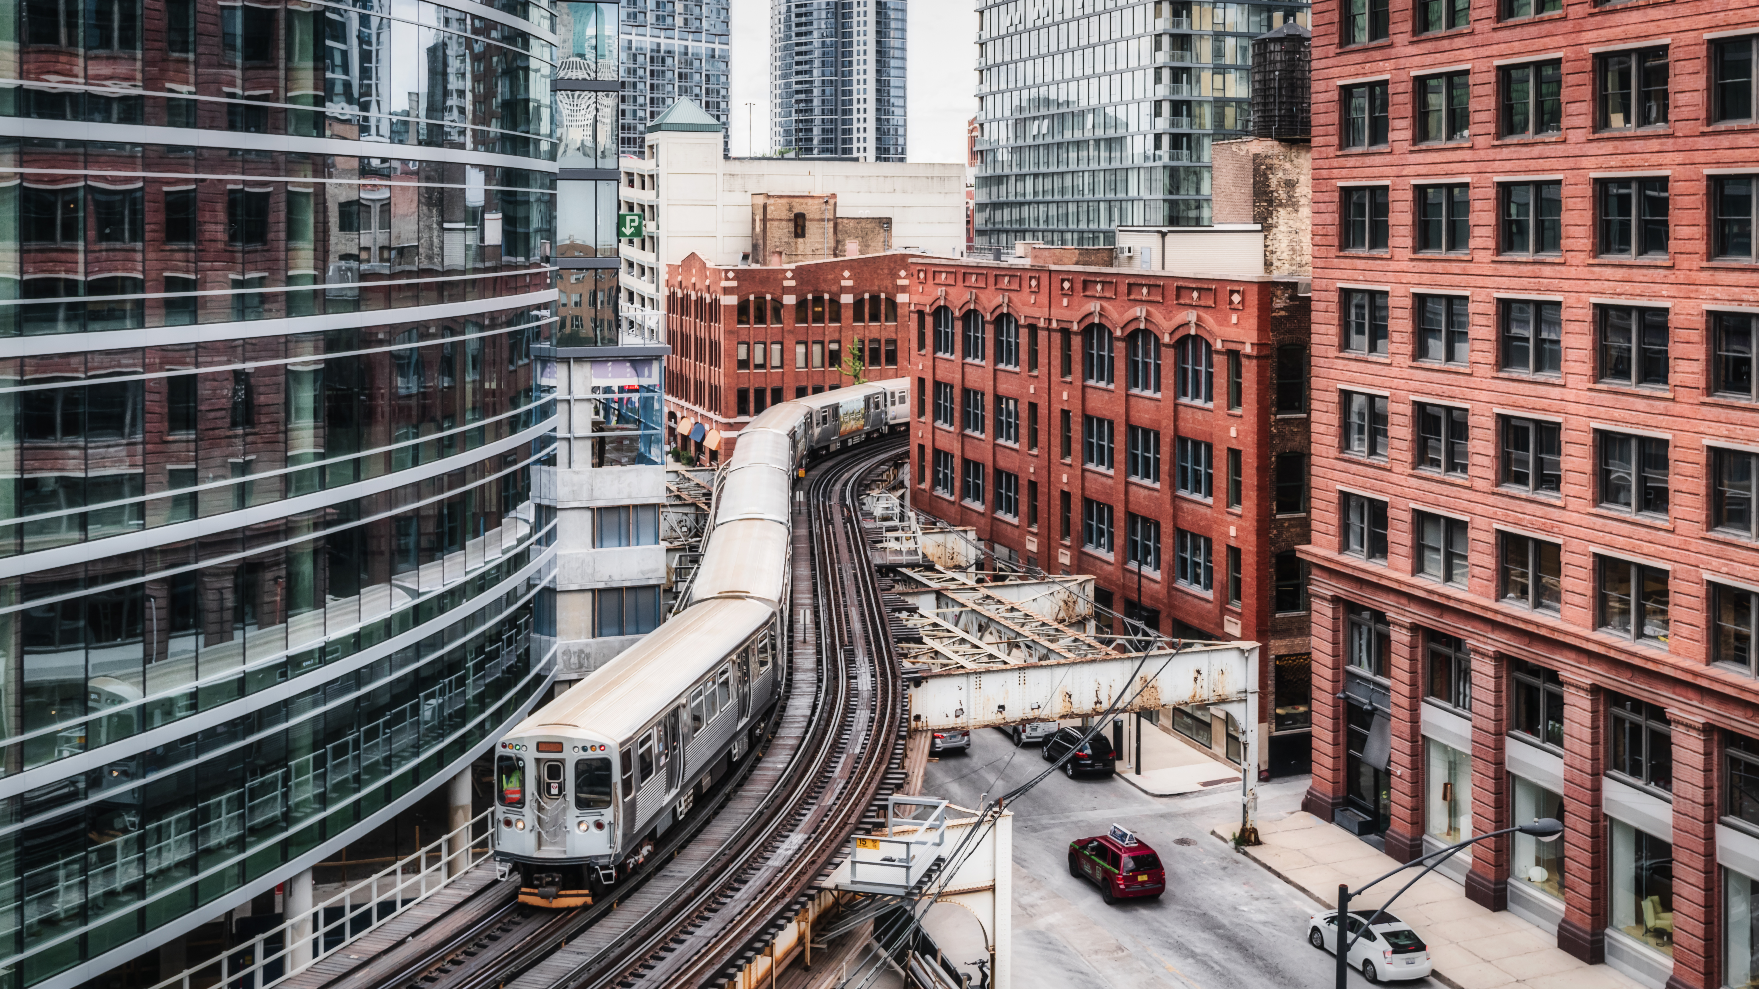
Understand Investigation
How can I use less energy?
Communities use energy every day for a variety of activities. Transportation is one of those activities that requires a lot of energy—but there are ways to use less of it. By exploring how energy is used in the community, we can find ways to reduce waste and make smarter choices for a more sustainable future.

Slide 8
Understand Investigation, slide 2
Discuss with your group:
What types of transportation are used in your community? Think about how people and goods move from place to place.
Where do you think energy is wasted in transportation? Consider things like driving habits, vehicle choices, and shipping distances.

Slide 9
Understand Investigation, slide 3
Transportation is a major way communities use energy. Your group will explore different aspects of transportation energy use and their impact. Your group can divide into three smaller teams, set up stations and rotate, or choose just one area to investigate.
Personal transportation: Explore the carbon footprint of the transportation you use. Resource: Personal Transportation Worksheet
Shared transportation: Compare how many people share vehicles or drive together. Resource: Shared Transportation Investigation Worksheet
Freight transportation: Investigate how far items you use have traveled before they reach you. Item Origin Investigation slides

Slide 10
Understand Investigation, slide 4
Review the results of your investigations. Identify where energy is wasted, such as when people drive alone instead of sharing rides or products travel long distances instead of coming from local sources. Discuss potential alternatives that could reduce energy waste, such as increasing shared transportation, walking or biking for short trips, or choosing products made or grown nearby.
Using your findings, create a list of strategies that could work in your community. Then select one energy-saving habit to adopt and explain how it can make an impact.

Slide 11
Understand Research Extension
Research More!
Two of the main ways people use energy are activities at home and transportation. Some energy use is efficient, while other habits waste resources. Reducing waste takes creativity and problem-solving. Small changes, like adjusting lighting or using different transportation methods, can have a big impact. Understanding barriers such as cost, convenience, or infrastructure can help uncover solutions that make sustainable energy use more accessible.
Choose whether you want to focus on changes to energy use at home that you explored in the Discover activity or energy use in transportation that you explored in the Understand activity.

Slide 12
Understand Research Extension, slide 2
Think quietly to yourself about the following questions and record your answers on the Avoid, Shift, Improve Worksheet.
How could you help your community avoid energy use habits that are not sustainable?
How could you help your community shift to energy use habits that are more sustainable?
How could you help improve energy use habits in your community?
Resource: Avoid, Shift, Improve Worksheet
Avoid: Think about how your community uses energy at home or through transportation. Identify one place or situation where energy use could be avoided or reduced.
Shift: Review your investigations. Where did you see energy being wasted? Research or brainstorm ways to reduce energy use in these areas. Identify one habit that could be changed immediately.
Improve: Research or observe barriers that prevent people from using less energy at home or through their transportation choices.

