Slide 1
Energy and Renewables Act
How will we act to improve our community’s use of renewables?

Slide 2
Act Overview
Learning Objective:
We will apply what we have learned by choosing and implementing actions to move towards more renewable energy sources.
Act Reading (optional): A 1-page reading from field expert Dr. Kiron Neale sharing information about communities and the shift to sustainable energy sources.
Act Investigation: An activity where students build consensus around a group action and complete a detailed Action Plan.
Act Investigation Extension (optional): Students implement their Action Plan and evaluate which Smithsonian Science for Global Goals guide might best support their additional areas of interest.

Slide 3
Act Reading
Transition to Sustainable Energy
Meet Dr. Kiron Neale. Kiron (pronounced KY-ron) is a solutions engineer for a company that specializes in sustainable energy. He is one of many experts around the world working with communities to make decisions about their energy futures. Here are his thoughts.
“You have some things that are basic needs, like food, clothing, and shelter. Energy is another one of those basic needs. Using sustainable energy sources can help reduce the emissions that cause climate change. But it’s not only about emissions.”

Slide 4
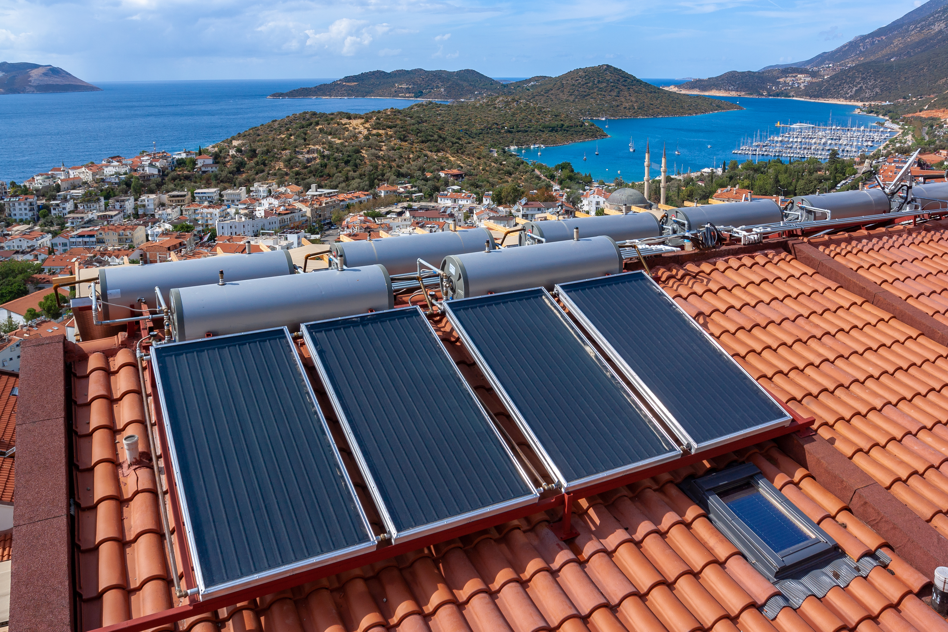
Act Reading, slide 2
“In thinking about a transition to sustainable energy, it’s not just about switching to renewables. It’s really thinking about, What are the energy sources we use? What does that mean for our community? How can we take steps at a local level to make sure we use energy responsibly, efficiently, and sustainably in the long term?”

Slide 5
Act Reading, slide 3
“What I’m interested in at the end of the day is people’s individual perspective. If someone is sharing their lived experience within a culture with me, I like to listen and empathize with their experience, because it’s not necessarily my cultural life or outlook.”
“When people think about switching to sustainable energy, most people are concerned about economics. They might ask, ‘What is this transition going to look like for my wallet?’ But people also want more information to understand what this new technology actually does. It’s important to give people the information they need about sustainable energy like solar. You want to move people from just being aware of sustainable energy to being comfortable enough to invest in it.”

Slide 6
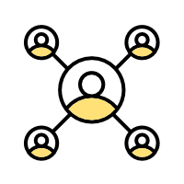
Act Reading, slide 4
Community Connection: What kind of information do you think your community would need before they would be comfortable enough to invest in renewable energy?

Slide 7
Act Investigation
How will we act to improve our community’s use of renewables?
Now you will get ready to act. The first step toward action is deciding what problem you want to solve and the action you want to take to solve it. Then you can plan when and how you will act.
With your group, decide on the problem you want to help solve. This might be a problem such as lack of knowledge about the renewable energy options that might be a good fit for your community. Or it might be a problem about how to shift to more renewable energy sources. Or it could be another problem you noticed. Write down the problem either on the Action Planner Worksheet or on a separate piece of paper. Resource: Action Planner Worksheet
Using the worksheet or paper, list any actions you can think of that might help solve the problem. For example, maybe you want to start a renewable energy education campaign in your community. Maybe you want to meet with a decision-maker to discuss shifting to renewable energy sources.

Slide 8
Act Investigation, slide 2
Write down the strengths your group has and how they could be used to improve the energy situation of your community. For example:
Are members of your group part of any groups that you could communicate with?
Do members of your group have any special talents, such as art or music, that might be useful to capture people’s attention?
Are members of your group interested in science and engineering or other ways to try to find innovative solutions?
Do group members have good planning or organization skills?

Slide 9
Act Investigation, slide 3
Pick an action based on the strengths of your group.
Write down your ideas to plan for your action. Be sure to think about:
What will you need to do?
How can you make sure everyone in your group is included?
Are there other people you need to help you or give you permission?
Where will your action take place?
What materials will you need?
What challenges should you be prepared for?

Slide 10
Act Investigation, slide 4
List each step you need to do in order to complete this action.
Assign each person in your group to one or more steps.
Congratulations, you have planned your action!

Slide 11
Act Research Extension
Choose Your Path!
The time has come to act! You can use everything you have learned to take the first step toward making your community’s energy use more sustainable.
With your teammates, implement your Action Plan. This may take some time. When you are finished, come back and complete this activity.
Think quietly about the action you took.
What went well?
What do you think could have gone better?
How would you change your action if you had to do it again?

Slide 12
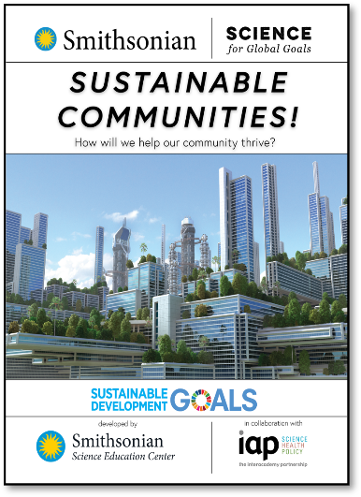
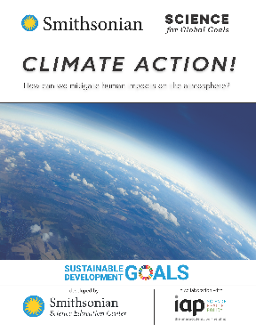
Act Research Extension, slide 2
Decide on how you want to learn more! The community research guides listed here can help you explore different topics. Which topics interest you most?
Explore more about different energy sources and uses.
Explore more about the ways energy is used in a sustainable community.
Explore how renewable energy can play a role in climate action.
As a group, pick a guide that you would like to use and start to explore together.

Slide 13
Act Research Extension, slide 3
Moodboard
How do you feel about a sustainable energy future for your community?

Slide 14
Glossary
Biofuel energy: An energy source that uses the energy found in living things, such as wood, algae, or animal poop, to generate electricity or produce heat
Emissions: Greenhouse gases released into the atmosphere from burning fossil fuels
Fossil fuel: An energy source such as coal, oil, or natural gas that comes from the fossilized remains of plants and animals
Geothermal energy: An energy source that uses heat from underground to produce electricity or heat

Slide 15
Glossary, slide 2
Hydropower and ocean energy: An energy source that converts energy from moving water, such as a river or the tides of the ocean, into electricity
Priorities: What is important to you and the place you live
Renewable energy: Electricity produced from materials that are easily replenished or ongoing natural systems
Solar energy: An energy source that converts light energy from the sun into electricity using solar panels

Slide 16
Glossary, slide 3
Sustainable: An approach that balances different perspectives and can keep working for a long time
Wind energy: An energy source that converts wind, or the movement of air, into electricity using a windmill or turbine

