Slide 1
Solar Energy Invesitgation
Starting with Sustainability

Slide 2
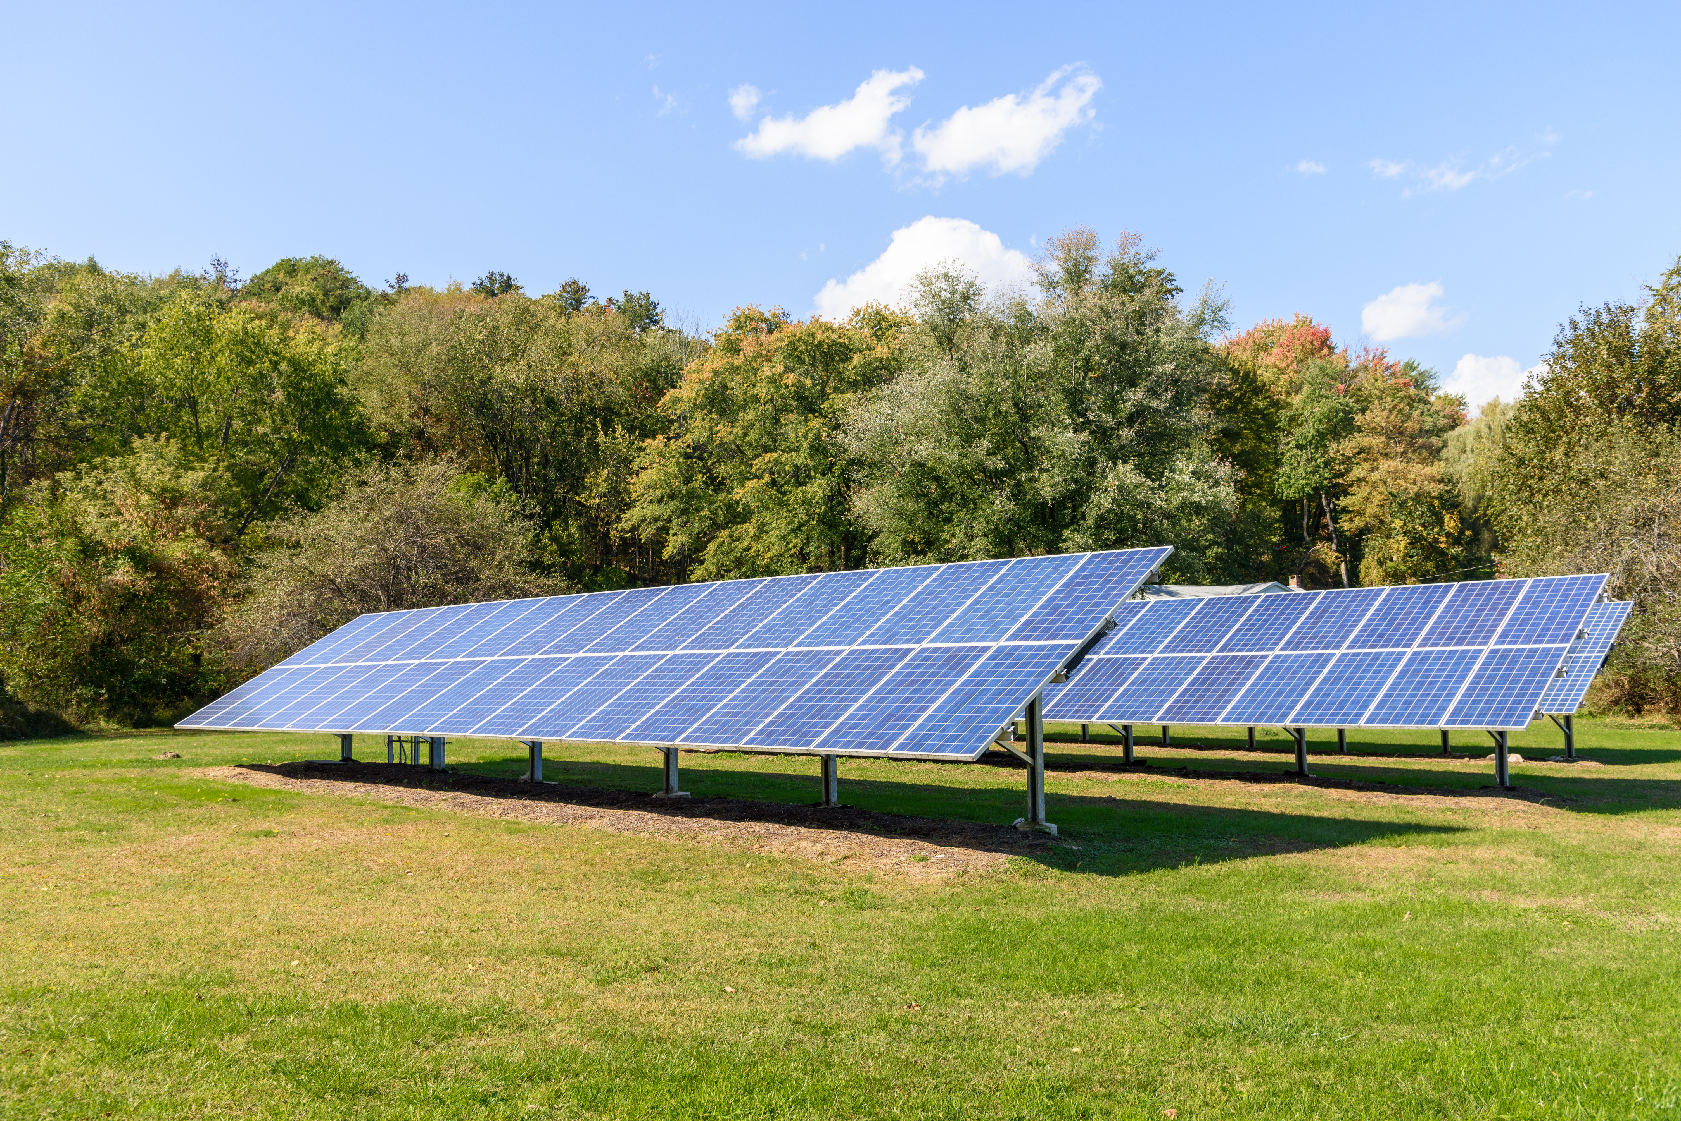
Solar Energy Overview
Solar power captures energy from sunlight to generate electricity or to heat water. You may have noticed large solar farms with many solar panels. But individuals, small groups of people, and communities can also use smaller, local micro-solar power that uses fewer solar panels.

Slide 3
Micro-Solar Power: Start to Observe
This investigation will help you investigate whether there are any sites in your community, such as your school or home, that are a good match for micro-solar power.
Use paper or another way to record your observations and information.
Observe the site you want to investigate to make sure it gets at least four hours of direct sunlight per day. Direct sunlight means light from the sun lands directly on a site without being blocked by an object or material.

Slide 4
Micro-Solar Power: Examine Placement
Check the site to see if there are nearby objects that might create shade, such as tall buildings, tall trees, or hills and mountains.
If you live in the northern hemisphere, figure out if you can place your solar panel on a high surface facing south, such as a roof. If you live in the southern hemisphere, figure out if you can place your solar panel facing north.

Slide 5
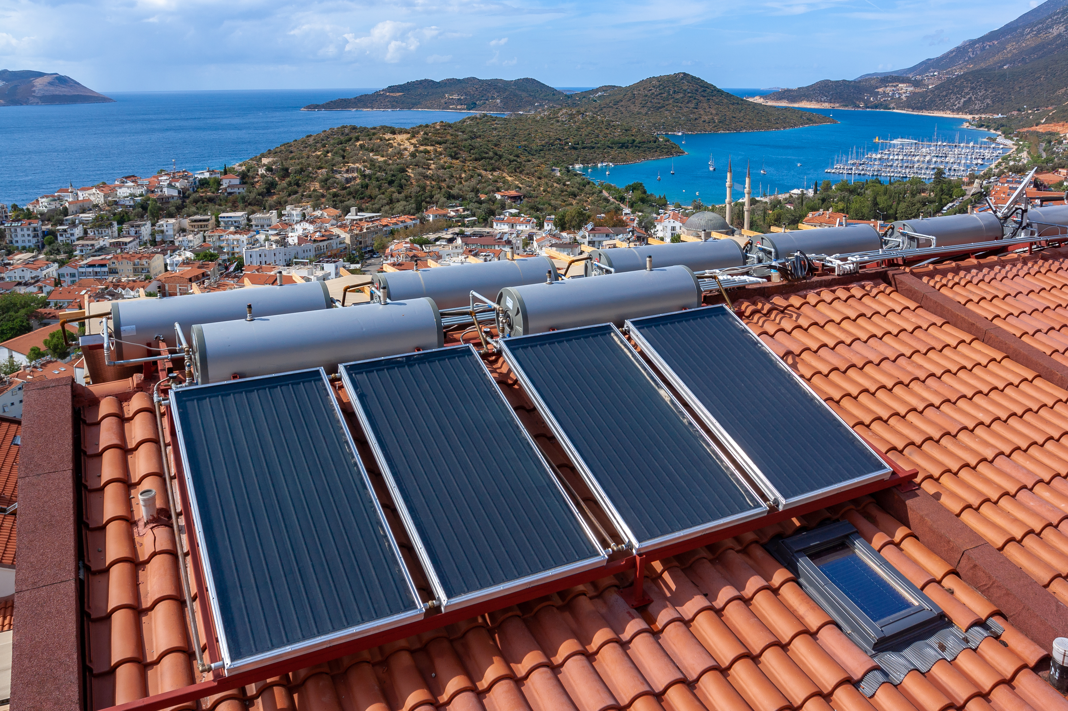
Micro-Solar Power: Learn More
Move around your neighborhood to see if any nearby homes or buildings use solar power. If you are able, contact the owners of those homes or buildings and ask them about the sun conditions in the area and how much hot water or power they are able to generate.

