Slide 1
Energy and Renewables Understand
What are the best renewable options for my place?

Slide 2
Understand Overview
Learning Objective:
We will be able to identify, investigate, and analyze a renewable source of energy that would be a good fit for our community.
Understand Reading (optional): A 1-page reading on different renewable sources of energy.
Understand Investigation: Students decide on a possible renewable source of energy for their community and then choose between solar, wind, and hydropower investigations to understand the energy source further.
Understand Research Extension (optional): Students can extend their learning through perspective-taking on the social, environmental, economic, and ethical perspectives related to their chosen renewable energy source.

Slide 3
Understand Reading
Choosing a More Sustainable Energy Source
Choosing an energy source can depend on a lot of things. It is often a combination of your priorities (that is, what is important to you) and where you are.
Priorities are often different among people. Priorities related to energy often include some of the following characteristics of energy sources: dependable (able to be used at all times), affordable, accessible (able to be used by everyone), low carbon (doesn’t add a lot of carbon dioxide to the air), clean (doesn’t create pollution when it is accessed or used), renewable (cannot be used up), and safe.

Slide 4
Understand Reading, slide 2
Location also affects people’s energy choices. If a place is near many coal reserves, people might think about the opportunity to use those resources. If a place is near a powerful water source, people might think about the opportunity for hydropower. The best renewable energy sources often depend on the characteristics of a place and what is available there. Here are brief descriptions of some possible renewable energy sources.

Slide 5
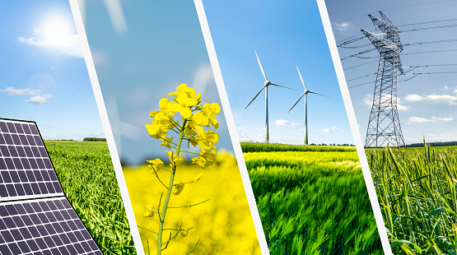
Understand Reading, slide 3
Solar energy: converts light energy from the sun into electricity using solar panels
Wind energy: converts wind, or the movement of air, into electricity using a windmill or turbine
Hydropower and ocean energy: converts energy from moving water, such as a river or the tides of the ocean, into electricity
Geothermal energy: uses heat from underground to produce electricity or heat
Biofuel energy: uses the energy found in living things, such as wood, algae, or animal fat or poop, to generate electricity or produce heat

Slide 6
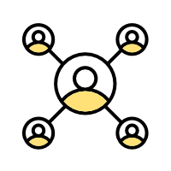
Understand Reading, slide 4
Community connection: Think about energy priorities. What are your top three priorities?
Think about the renewable energy sources that might work best in your place. Which ones do you think might be possible?

Slide 7
Understand Investigation
What are the best renewable options for my place?
Not all renewable energy sources work well in all places. If your place is sunny most days, then solar energy might work well. If your place is often very windy, then wind energy might work well. If your place has moving water, then hydropower or ocean energy might work well. If you live near a geothermal hot spot, such as places near hot springs or volcanoes, then geothermal energy might work well. If you have many biofuel resources, such as wood waste, algae, or animal poop, then biofuel energy might work well.

Slide 8
Understand Investigation, slide 2
As a group, think about the place you live. What are the characteristics of the environment around you? For example, does it have a lot of sun, wind, running water, an ocean, volcanoes, or other features?
Discuss each type of renewable energy: solar, wind, hydropower or ocean, geothermal, and biofuel.
How do you think each renewable would fit or not fit with the characteristics and resources of your place?

Slide 9
Understand Investigation, slide 3
Make a choice. Pick one or more of these investigations to explore different renewable energy options.
a. Solar power investigation
Resource: Solar Energy Investigation slides
b. Wind power investigation
Resource: Wind Energy Investigation slides
c. Hydropower investigation
Resource: Hydropower Energy Investigation slides

Slide 10
Understand Investigation, slide 4
After your investigation, discuss as a group:
Based on what you learned, which renewables might work in your area?
Are there other things you think people should think about when deciding on a renewable energy source?
If you have your SWOT Analysis Worksheet from the Discover activity, take it out and examine it. How do you think the renewables you identified might help your community take advantage of some opportunities or minimize some threats?

Slide 11
Understand Research Extension
Research More!
When a community or group decides to start using a different energy source, there are many points of view, or perspectives, to balance. The perspectives you will explore now are social, environmental, economic, and ethical. People using different perspectives believe different parts of the community system are most important to consider. The four perspectives you will be thinking about are social, environmental, economic, and ethical. Balancing these perspectives is important if you want something to be sustainable, or able to work for a long time.

Slide 12
Understand Research Extension, slide 2
As a group, pick the renewable energy source you think might be the best option for your community.
Divide your group into four smaller groups and assign each small group a perspective: social, environmental, economic, or ethical.
As a small group, take out a piece of paper or use a part of a class board to record your ideas.

Slide 13
Understand Research Extension, slide 3
As a small group, use your own knowledge to answer the questions from your perspective. If you have time, you can also do additional research.
Resource: Perspective Research slides
Social: How does this renewable energy source help or harm the health, well-being, education, or social interactions among people? For example, does it make people healthier by decreasing air pollution or take away community spaces?
Environmental: How does this renewable energy source help or harm the natural world? For example, does it protect habitats or hurt living things?
Economic: How does this renewable energy source help or harm the economic situation? For example, does it create jobs or cost a lot of money?
Ethical: How does this renewable energy source make your community fairer or less fair? For example, does it help provide energy access to more people or does it increase inequality between people?

Slide 14
Understand Research Extension, slide 4
Post your papers around your learning space and examine them.
Discuss as a team. Sustainable means an approach that balances the different perspectives and can keep working for a long time. Do you think this renewable energy source could be sustainable for your community?

