Slide 1
Wind Energy Investigation
Starting with Sustainability

Slide 2
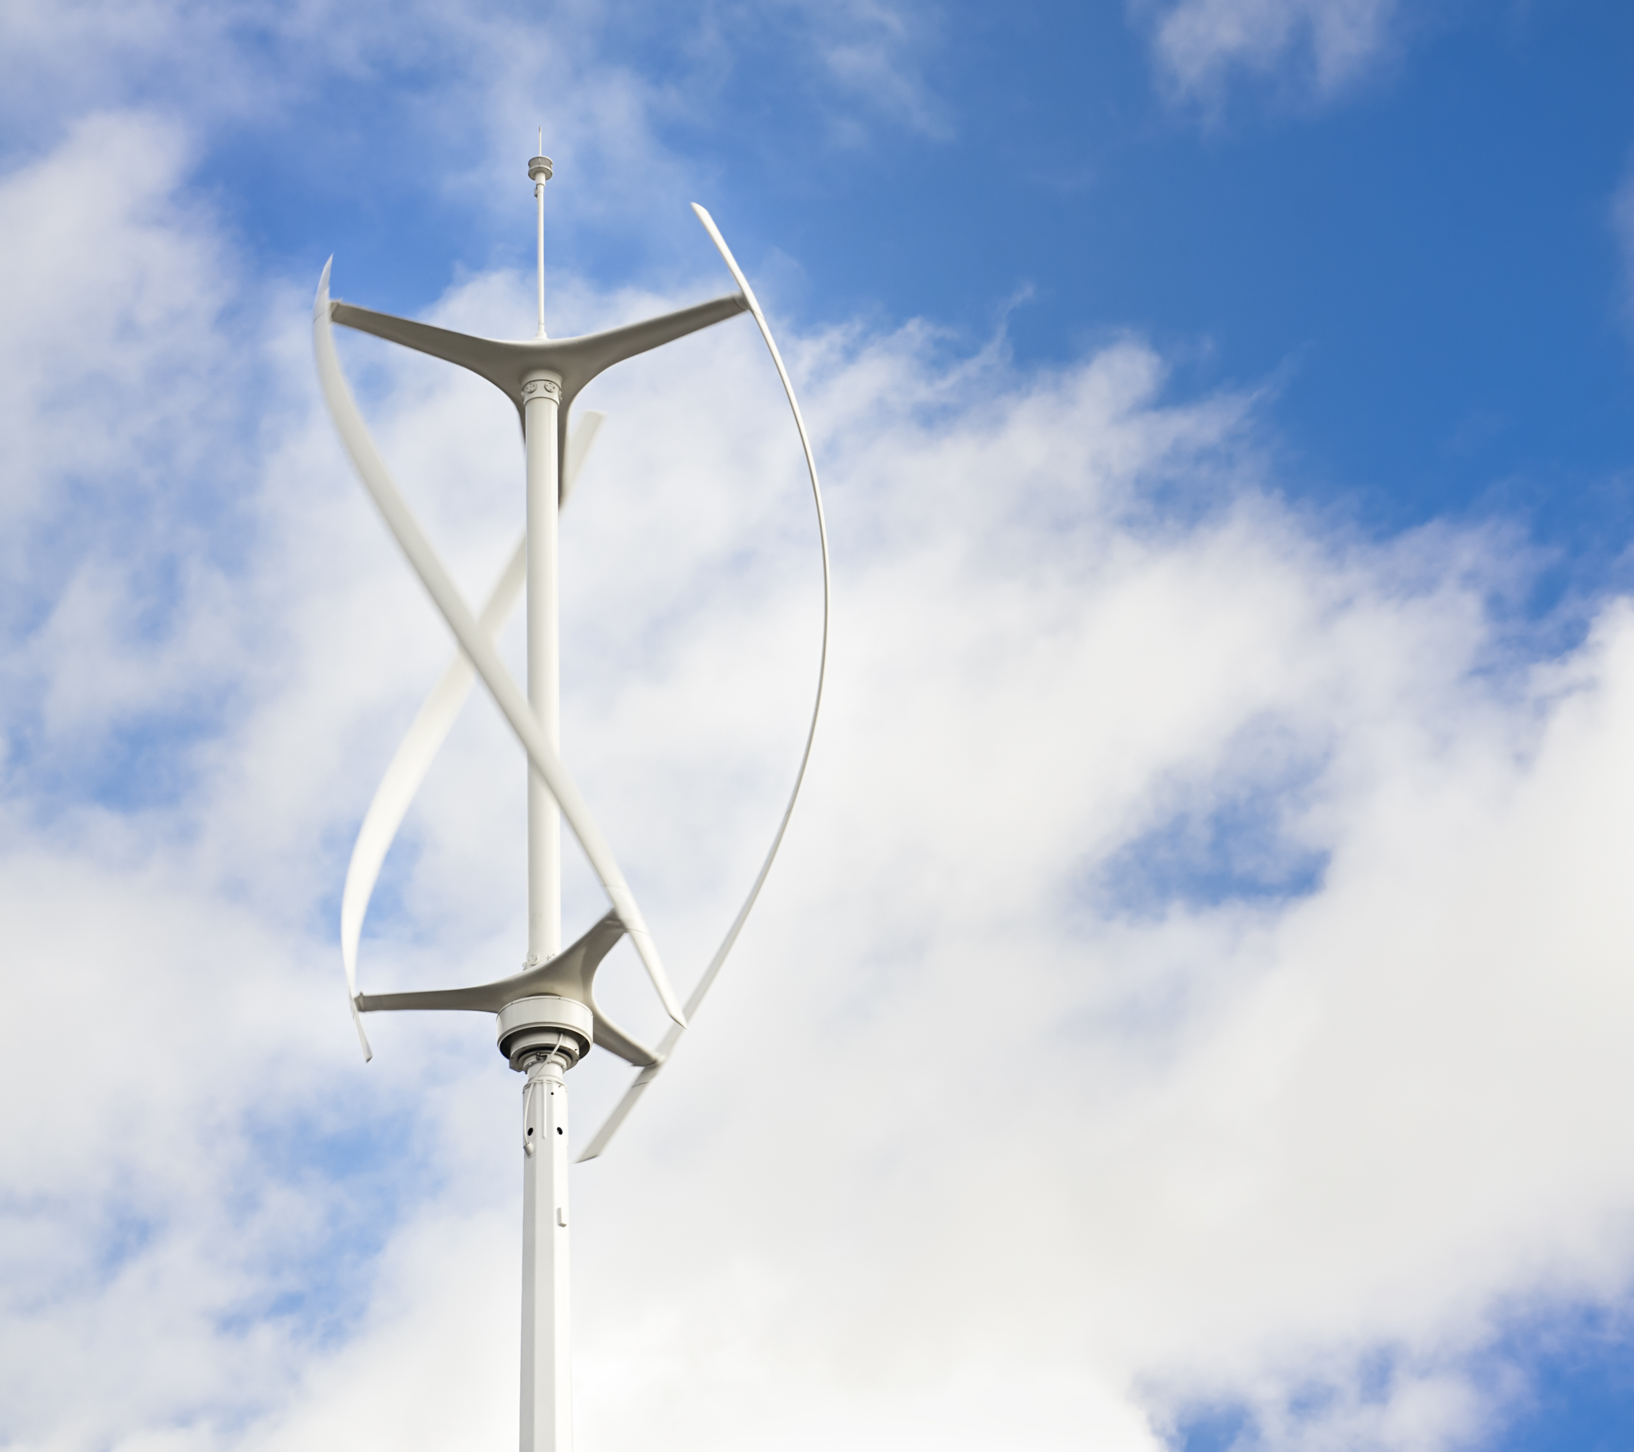
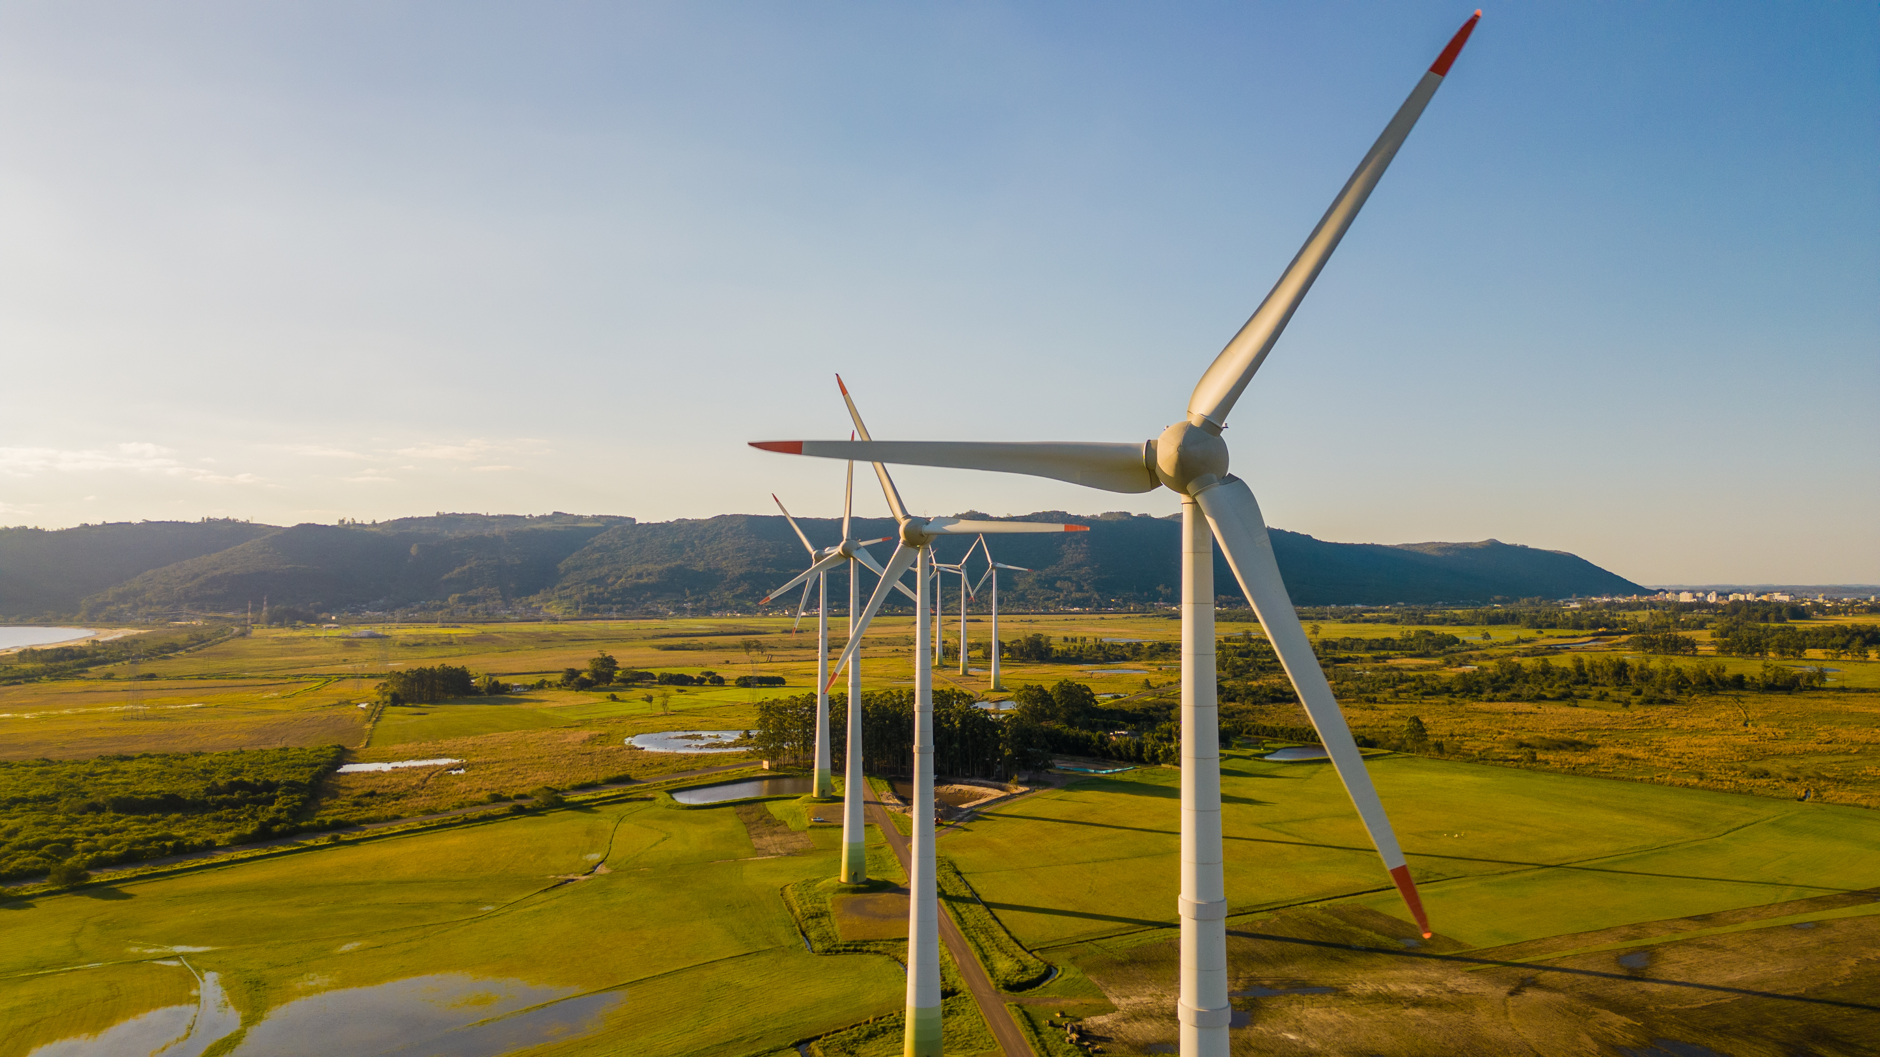
Wind Energy Overview
Wind energy captures energy from moving air, or wind, to turn a turbine, which connects to a generator. You may have noticed wind farms with many wind turbines. But individuals or small communities can also use fewer or smaller turbines to create wind power.

Slide 3
Searching for Wind Power Sites
This investigation will help you investigate whether there are any sites in your community, such as your school or home, that are a good match for wind power.
Use paper or another way to record your observations and information.
A good site for wind power usually has an average wind speed of at least 14 kilometers (9 miles) per hour.

Slide 4
Wind Power: Measure Wind Speed
Measure the average wind speed at a site in one of the following ways.
Use the average wind speed data from a nearby airport. Keep in mind that wind speed can vary based on the height at which it is measured and on the surrounding objects. But the airport data is a good start.
Check to see if your community, state, or country has wind maps. These maps display the average wind speed.

Slide 5
Wind Power: Observe trees
Observe tall trees near the site for signs of flagging. Flagging is when a tree changes shape because of long periods of wind. This picture shows an example. Higher average wind speeds cause more flagging in local trees.
If you notice flagging in the trees near your site, it might be a good site for wind power. You can also use the Griggs-Putnam Index of Deformity to help you.

Slide 6
Wind Power: Observe the Site
Observe the site for any tall objects that might get in the way of wind flow. These objects might be tall buildings, hills, tall trees, or young trees that will grow larger over time. If your site is surrounded by a large area of flat, smooth land, it might be a good fit for wind power.
Move around your neighborhood to see if any nearby homes or buildings use wind power. If you are able, contact the owners of those homes or buildings and ask them about the wind conditions in the area and how much power they are able to generate.

