Slide 1
Starting with Sustainability Lesson Slides
Good Health and the Environment

Slide 2
Lesson Overview:
Essential Understanding: Disease affects individuals and communities. We can each take actions to protect our own health and the health of others in our community.
Discover: What diseases affect my community now and in the past?
Understand: How can we stop disease from spreading in our community?
Act: How will we act to improve our community’s health?

Slide 3
Good Health and Disease Act
How will we act to improve our environmental health?

Slide 4
Act Overview
Learning Objective:
We will apply what we have learned by choosing and implementing actions to solve a problem related to disease in our community.
Act Reading (optional): A 1-page reading from field expert Leila Carvalho sharing details of how everyday actions can lead to an increase in personal and community health.
Act Investigation: Students build consensus around a group action and complete a detailed action plan.
Act Investigation Extension (optional): Students implement their action plan and evaluate which Smithsonian Science for Global Goals community research guide might best support their additional areas of interest.

Slide 5
Act Reading
Pathways to Everyday Health
Meet Dr. Leila Carvalho. Leila (pronounced LAY-la) is the head of Medical and Safety Sciences for Kenvue in Latin America. Leila is a medical doctor and an expert on health education based in Brazil. She thinks youth have an important role to play in creating a healthy individuals and communities:
“Our understanding about health, prevention and good habits could increase our quality of life. People who understand the basic concepts of health tend to be healthier themselves. These basic concepts are fairly simple. The concept of hygiene—such as washing your hands properly before eating and cleaning your teeth for oral health. The concepts of food and water safety—such as safely preparing meals and using only clean water. The concepts of good daily habits—such as being active during the day, eating healthy food, and having a good night of sleep.”

Slide 6
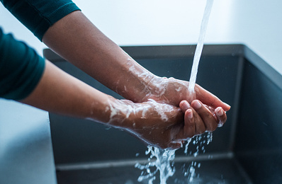
Act Reading, slide 2
“There are many things you can do to prevent infectious disease. Use the basic health concepts. Vaccines can also prevent a lot of diseases. When we feel unwell with diseases such as the common cold keep a distance and try to avoid direct contact with others. And if you continue feeling unwell, seek medical care. Actions such as washing your hands, disposing of waste properly, and seeking treatment can not only help you, they can help others.”

Slide 7
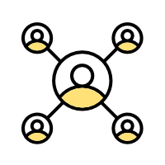
Act Reading, slide 3
“You can also help educate others to increase their understanding of
health concepts. Promote a simple message and spread knowledge
about basic health concepts, without judgement. You can help your
friends and older adults by sharing health information and showing
an example of healthy behaviors.”
Community Connection:
What is one type of health information you might like to share with your community?

Slide 8
Act Investigation
How will we act to improve our community’s health?
Now you will get ready to act. The first step toward action is deciding what problem you want to solve and the action you want to take to solve it. Then you can plan when and how you will act.
With your group, decide on the problem you want to help solve. This might be a problem such as lack of knowledge about the way disease spreads or what actions people can take. Or it might be a problem about how easy it is to put healthy behaviors, such as washing your hands, into practice. Or it could be another problem you noticed. Write down the problem either on the Action Planner Worksheet or on a separate piece of paper. Resource: Action Planner Worksheet
Using the worksheet or paper, list any actions you can think of that might help solve the problem. For example, maybe you want to communicate information to children in your community. Maybe you want to set up a handwashing station. List any actions that will help to solve your problem.

Slide 9
Act Investigation, slide 2
Write down the strengths your group has and how they could be used to improve the health of your community. For example:
Are members of your group part of any groups that you could communicate with?
Do members of your group have any special talents, such as art or music, that might be useful to capture people’s attention?
Are members of your group interested in science and engineering or other ways to try to find innovative solutions?
Do group members have good planning or organization skills?

Slide 10
Act Investigation, slide 3
Pick an action based on the strengths of your group.
Write down your ideas to plan for your action. Be sure to think about:
What will you need to do?
How can you make sure everyone in your group is included?
Are there other people you need to help you or give you permission?
Where will your action take place?
What materials will you need?
What challenges should you be prepared for?

Slide 11
Act Investigation, slide 4
List each step you need to do to complete this action.
Assign one or more steps to each person in your group.
Congratulations, you have planned your action!

Slide 12
Act Research Extension
Choose Your Path!
The time has come to act! You can use everything you have learned to take the first step toward making your community more environmentally healthy.
With your teammates, implement your action plan. This may take some time. When you are finished, come back and complete this activity.
Think quietly about the action you took.
What went well?
What do you think could have gone better?
How would you change your action if you had to do it again?

Slide 13
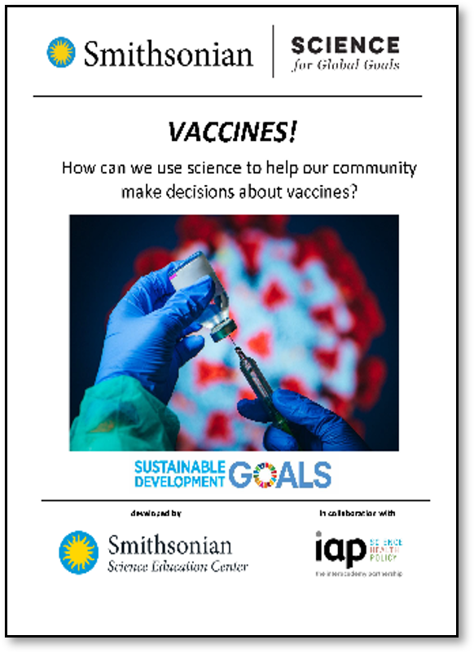
Act Research Extension, slide 2
Decide on how you want to learn more! The community research guides listed here can help you explore different topics. Which topics interest you most?
Explore ways biotechnology can be used to improve human health.
Explore more about how vaccines can help reduce disease and improve health.
Explore how the environment affects health in your community.
As a group, pick a guide that you would like to use and start to explore together.

Slide 14
Act Research Extension, slide 3
Moodboard
How do you feel about your ability to make your community healthier?

Slide 15
Glossary
Herd immunity: When a large part of the community (the herd) can no longer be infected or spread a disease
Immune: When you cannot be infected by a disease
Infectious: Diseases that are spread between people
Vaccine: Something that helps your body protect itself against disease

