Slide 1
Starting with Sustainability Lesson Slides
Good Health and the Environment

Slide 2
Lesson Overview:
Essential Understanding: Disease affects individuals and communities. We can each take actions to protect our own health and the health of others in our community.
Discover: What diseases affect my community now and in the past?
Understand: How can we stop disease from spreading in our community?
Act: How will we act to improve our community’s health?

Slide 3
Good Health and Disease Discover
What diseases affect my community now and in the past?

Slide 4
Discover Overview
Learning Objective:
We will be able to compare and explain changes in disease prevalence over time and link these changes to personal or community experiences.
Discover Reading (optional): A 1-page reading and data analysis activity detailing the change in countries where polio was found in 1988 compared to 2018.
Discover Investigation: Students identify familiar diseases and then conduct a community oral history to understand how community disease prevalence has changed over time.
Discover Investigation Extension (optional): Students can extend their learning by exploring how their communities and behaviors can help them be healthy and happy, followed by a futures-thinking exercise to apply their learning and envision a healthier community in the future. They have the option to use art or other means to share that vision.

Slide 5
Discover Reading
Changes in Disease Patterns
There are many illnesses, or diseases, that can be spread between people. These diseases are called infectious. Sometimes the infectious diseases found in a community change over time. Even since older members of your community were young, the common diseases may have changed. One example is polio. Polio is a life-threatening disease that spreads easily.

Slide 6
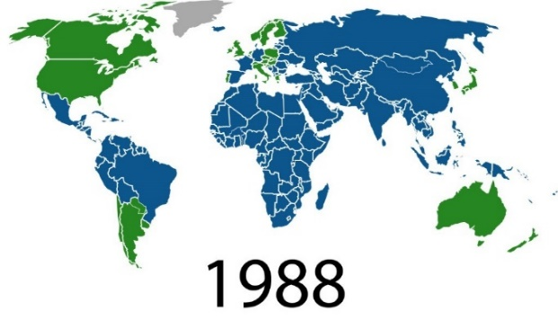
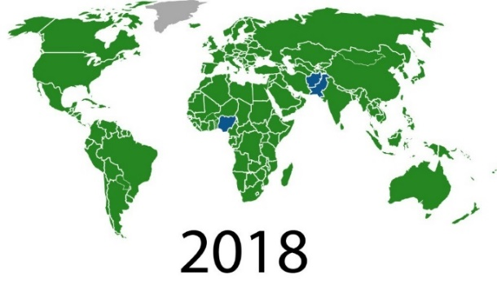
Discover Reading, slide 2
Examine the 1988 and 2018 world maps. In those years, polio was spreading in the countries marked in blue. Answer these questions.
Notice: What changes do you notice between the maps from 1988 and 2018?
Think: What do you think may have happened to create this change?
Wonder: What do you wonder about people’s ability to change the diseases found in their communities?

Slide 7
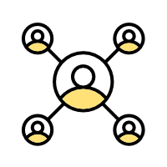
Discover Reading, slide 3
People have learned a lot about diseases over the last hundred years. We now know more about how diseases are spread. For example, you may have learned to wash your hands to help prevent you from getting sick. There are many behaviors people can change to help stop the spread of disease. There are also medicines, such as vaccines, that can help our bodies become better at fighting diseases. The main reason for the change in the polio maps between 1988 and 2018 was a massive global effort to vaccinate people against polio.
Community Connection: Discuss with a partner:
What are some behaviors you use to stop the spread of disease?
What have you noticed people around you doing to stop the spread of disease?

Slide 8
Discover Investigation
What diseases affect my community now and in the past?
Infectious diseases spread among people. But the diseases that are found in a community often change over time.
Examine this list of diseases. Do you notice any names of any diseases you recognize or that you have had? What diseases do you know about that are missing?
Influenza (the flu)
Malaria
Measles
Mumps
Varicella (chicken pox)
Polio
COVID-19
Tetanus
Pertussis (whooping cough)
Smallpox
Tuberculosis (TB)
Turn to a partner and discuss: Do you think the common diseases in your community have changed over time?

Slide 9
Discover Investigation, slide 2
Find an older adult to conduct an oral history with. This could be an adult in your household or your school. Ask this adult about the diseases that were common when they were young. Resource: Oral History Instructions slides
Discuss with a partner or the rest of your group.
Are there some diseases that you are very grateful are no longer common in your community?
Which diseases would you most want to get rid of in the future?

Slide 10
Discover Extension
Apply Your Learning to Your Community!
Every day people are affected by the people, places, and things in their community. People are also affected by their own behaviors. Some of these effects help keep you healthy and happy. Some of these effects may harm your physical or mental health.
Discuss with a partner some of the things you do related to your health almost every day. For example, maybe you wash your hands or exercise.
With others in your group, create a chart like this one: Resource: Health and Happiness Chart
 | Helps Health | Harms Health
Personal Behaviors
Community Behaviors

Slide 11
Discover Extension, slide 2
What would your community be like if it always did things to help people’s health and happiness?
Make a poster, put on a performance, or use another method to share with others your ideas about a healthy and happy community for the future.

Slide 12
Discover Extension, slide 3
Share your ideas about a happier and healthier community with someone else in your community.
Examine the mood board below.
When you think about the way your community helps or harms your
health and happiness right now, which of the mood board symbols best shows how you feel?
When you think about a healthy and happy community for the future, which of the mood board symbols best shows how you feel?
Moodboard

Slide 13
Glossary
Herd immunity: When a large part of the community (the herd) can no longer be infected or spread a disease
Immune: When you cannot be infected by a disease
Infectious: Diseases that are spread between people
Vaccine: Something that helps your body protect itself against disease

