Slide 1
Herd Immunity Modeling Instructions
Starting with Sustainability

Slide 2
Materials
8.5-inch X 11-inch or A4 paper
Pencil or pen
Ruler or straight edge

Slide 3
Setup
Take the piece of paper and draw 9 evenly spaced vertical lines to create 10 columns that cover the entire paper. Then draw 9 evenly spaced horizontal lines to create 10 rows that cover the entire paper. Your paper should now have 100 boxes on it.

Slide 4
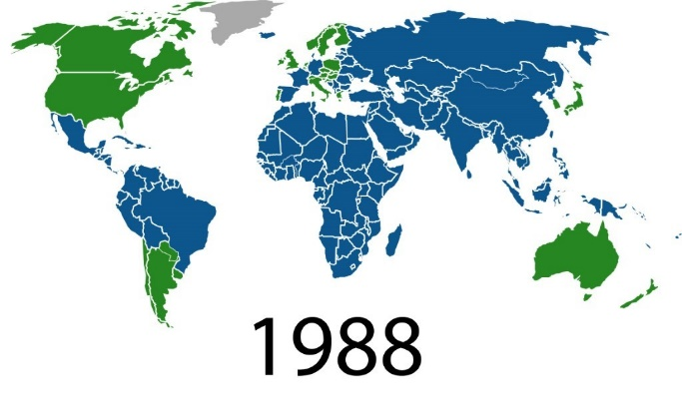
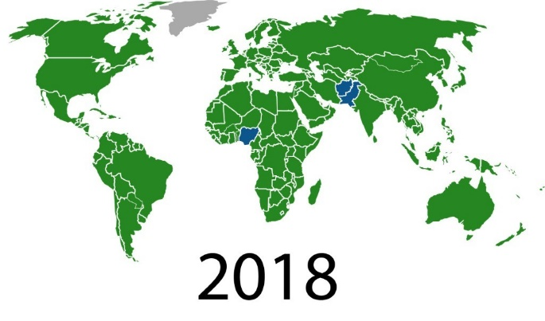
What is herd immunity?
The disease these maps show is called polio. Polio is a life-threatening disease that spreads easily. In 1988, the World Health Organization decided to try to wipe out polio around the world using the polio vaccine. Vaccines can make you immune to the disease. Being immune means you can no longer be infected. It also means you are very unlikely to infect others.
These maps show which countries had polio in 1988 and 2018. Countries with polio are in blue. Countries without polio in green. Countries with no data are in gray.

Slide 5
What is herd immunity? (continued)
By 2018, polio was no longer spreading in most countries. This is because of something called herd immunity. Herd immunity, or community immunity, is when a large part of the community (the herd) can no longer be infected or spread a disease. Did you notice how many countries in the world no longer have polio? This is thanks to herd immunity from vaccinations. After a community reaches herd immunity, the disease is stopped from spreading in the community. This protects the whole community. Some people who are too young or have certain health conditions cannot be vaccinated. Herd immunity protects these people too. The disease is no longer spreading, so these people are less likely to be exposed.

Slide 6
Modeling herd immunity
You are going to create a model to help you better understand how herd immunity works. You will model herd immunity with a disease called measles. This model will help you think about and share how vaccines can keep the people in your community healthy.

Slide 7
Modeling 95 percent herd immunity
First you will model 95 percent herd immunity for a disease called measles. This means 95 out of 100 people in the community are immune to the disease.
Take out your paper with 100 boxes. Each box represents one person.
Take your pencil or pen and color in five boxes scattered around the paper. These colored-in boxes represent the 5 out of 100 people in the community who are not vaccinated. These people are not immune.

Slide 8
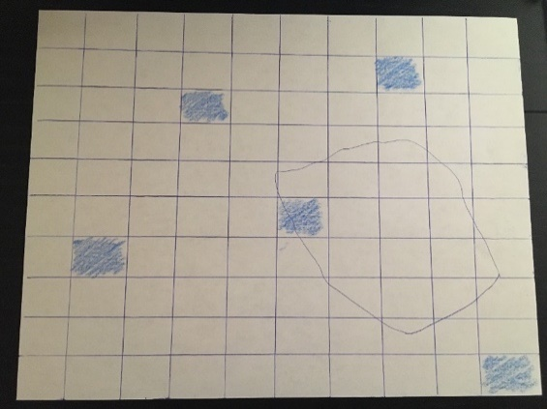
Modeling 95 percent herd immunity (continued)
Take your hand and make a fist. Close your eyes and place your fist on your paper. If you are doing this activity with others, you can use someone else’s paper. Your fist represents one infected person who comes into the community.
Trace around your fist. Remove your hand from the paper and examine the outline. Each box inside or touching the outline of your fist represents a person living in the community who came into contact with an infected person. These people have now been exposed to measles.

Slide 9
Modeling the spread of measles
Examine your paper.
Are there colored-in boxes inside or touching the tracing of your fist? Remember that the colored-in boxes represent people who are not immune to measles. If these people are exposed to measles, they will get infected.
Count how many colored-in boxes are inside or touching the outline. This number shows how many people have now been infected with measles.
Record your number.

Slide 10
Continuing to model the spread of measles
Measles can spread very easily from person to person in a community. Scientists know that 95 percent herd immunity can help keep measles from spreading. All the empty boxes in your model are immune people who can’t spread the disease. Maybe someone in your community was infected with measles. But if they are surrounded by people who are immune, the spread stops.
What do you think happens when a community does not reach 95 percent herd immunity?

Slide 11
Modeling 80 percent herd immunity
This time you will be modeling 80 percent herd immunity. This means only 80 out of 100 people in the community are immune.
Take out a new piece of paper and draw lines to create another set of 100 boxes.
On your paper, color in 20 random boxes. These represent the 20 people in the community who are not immune to measles.
As you did before, place your fist on the paper and trace it.
Count how many colored-in boxes are inside or touching the outline of your fist. This number shows how many people have now been infected with measles.
Record your number.

Slide 12
Comparing 95 percent and 80 percent herd immunity
Compare the number of new infections in your 80 percent herd immunity model to the number in your 95 percent model.
Discuss with your group:
Are there more infections with 95 percent or 80 percent herd immunity?
Do you think measles would be more likely to keep spreading in a community with 95 percent or 80 percent herd immunity?

