Slide 1
Starting with Sustainability Lesson Slides
Good Health and the Environment

Slide 2
Lesson Overview:
Essential Understanding: Disease affects individuals and communities. We can each take actions to protect our own health and the health of others in our community.
Discover: What diseases affect my community now and in the past?
Understand: How can we stop disease from spreading in our community?
Act: How will we act to improve our community’s health?

Slide 3
Good Health and Disease Discover
What diseases affect my community now and in the past?

Slide 4
Discover Overview
Learning Objective:
We will be able to compare and explain changes in disease prevalence over time and link these changes to personal or community experiences.
Discover Reading (optional): A 1-page reading and data analysis activity detailing the change in countries where polio was found in 1988 compared to 2018.
Discover Investigation: Students identify familiar diseases and then conduct a community oral history to understand how community disease prevalence has changed over time.
Discover Investigation Extension (optional): Students can extend their learning by exploring how their communities and behaviors can help them be healthy and happy, followed by a futures-thinking exercise to apply their learning and envision a healthier community in the future. They have the option to use art or other means to share that vision.

Slide 5
Discover Reading
Changes in Disease Patterns
There are many illnesses, or diseases, that can be spread between people. These diseases are called infectious. Sometimes the infectious diseases found in a community change over time. Even since older members of your community were young, the common diseases may have changed. One example is polio. Polio is a life-threatening disease that spreads easily.

Slide 6
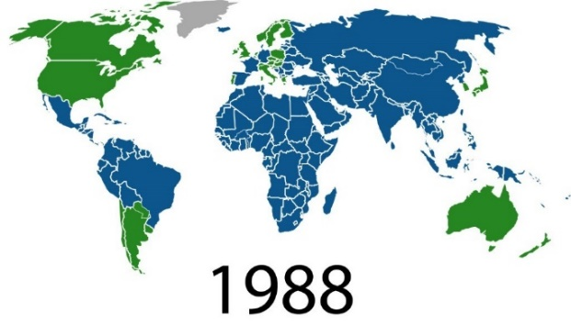
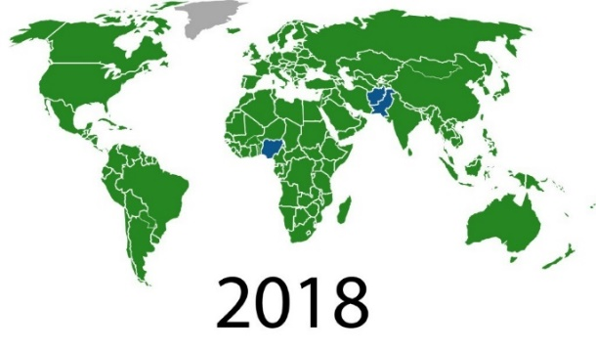
Discover Reading, slide 2
Examine the 1988 and 2018 world maps. In those years, polio was spreading in the countries marked in blue. Answer these questions.
Notice: What changes do you notice between the maps from 1988 and 2018?
Think: What do you think may have happened to create this change?
Wonder: What do you wonder about people’s ability to change the diseases found in their communities?

Slide 7
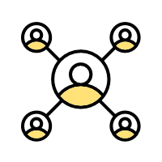
Discover Reading, slide 3
People have learned a lot about diseases over the last hundred years. We now know more about how diseases are spread. For example, you may have learned to wash your hands to help prevent you from getting sick. There are many behaviors people can change to help stop the spread of disease. There are also medicines, such as vaccines, that can help our bodies become better at fighting diseases. The main reason for the change in the polio maps between 1988 and 2018 was a massive global effort to vaccinate people against polio.
Community Connection: Discuss with a partner:
What are some behaviors you use to stop the spread of disease?
What have you noticed people around you doing to stop the spread of disease?

Slide 8
Discover Investigation
What diseases affect my community now and in the past?
Infectious diseases spread among people. But the diseases that are found in a community often change over time.
Examine this list of diseases. Do you notice any names of any diseases you recognize or that you have had? What diseases do you know about that are missing?
Influenza (the flu)
Malaria
Measles
Mumps
Varicella (chicken pox)
Polio
COVID-19
Tetanus
Pertussis (whooping cough)
Smallpox
Tuberculosis (TB)
Turn to a partner and discuss: Do you think the common diseases in your community have changed over time?

Slide 9
Discover Investigation, slide 2
Find an older adult to conduct an oral history with. This could be an adult in your household or your school. Ask this adult about the diseases that were common when they were young. Resource: Oral History Instructions slides
Discuss with a partner or the rest of your group.
Are there some diseases that you are very grateful are no longer common in your community?
Which diseases would you most want to get rid of in the future?

Slide 10
Discover Extension
Apply Your Learning to Your Community!
Every day people are affected by the people, places, and things in their community. People are also affected by their own behaviors. Some of these effects help keep you healthy and happy. Some of these effects may harm your physical or mental health.
Discuss with a partner some of the things you do related to your health almost every day. For example, maybe you wash your hands or exercise.
With others in your group, create a chart like this one: Resource: Health and Happiness Chart
 | Helps Health | Harms Health
Personal Behaviors
Community Behaviors

Slide 11
Discover Extension, slide 2
What would your community be like if it always did things to help people’s health and happiness?
Make a poster, put on a performance, or use another method to share with others your ideas about a healthy and happy community for the future.

Slide 12
Discover Extension, slide 3
Share your ideas about a happier and healthier community with someone else in your community.
Examine the mood board below.
When you think about the way your community helps or harms your
health and happiness right now, which of the mood board symbols best shows how you feel?
When you think about a healthy and happy community for the future, which of the mood board symbols best shows how you feel?
Moodboard

Slide 13
Good Health and Disease Understand
How can stop disease from spreading in our community?

Slide 14
Understand Overview
Learning Objective:
We will be able to describe and analyze how infectious disease spreads in a community and identify methods and actions to limit infection.
Understand Reading (optional): A 1-page reading detailing how infectious disease is spread and reflection on ways that spread can be limited.
Understand Investigation: Students can choose to create a hands-on model of herd immunity or analyze a case study on disease-monitoring through wastewater analysis.
Understand Investigation Extension (optional): Students can extend their learning by researching health statistics for their local area and creatively communicating those statistics to their community.

Slide 15
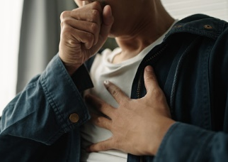
Understand Reading
Spreading Disease
Have you ever caught a ball? Maybe someone threw it to you and then you had it. Disease can be similar in the way it moves between people. Have you ever “caught” a cold? Colds and other diseases can start with one person and be “caught” by another.
Some infectious diseases are caused by the spread of viruses. For example, when someone who is infected with a virus coughs, sometimes that cough pushes small pieces of virus out of their body and into the air, and someone else can be infected by breathing in those small pieces.

Slide 16
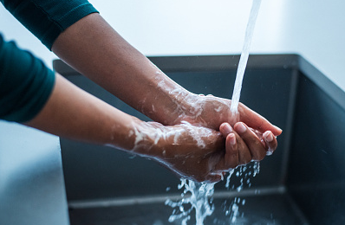
Understand Reading, slide 2
There are some everyday behaviors that can help people stop spreading diseases. Some examples are washing your hands, covering a cough, and not sharing cups. Also, you usually cannot spread a disease if you haven’t caught it yourself. So when you stay healthy, you are also keeping others in your community healthy.

Slide 17
Understand Reading, slide 3
For some diseases, your body can remember them if you have either had the disease or had a vaccine to teach your body how to recognize and fight the disease. If your body remembers a disease and can fight it off, you are immune to that disease. That means you cannot be infected with it. As more and more people become immune, fewer people can be infected and the disease spreads less and less. If enough people are immune, the disease stops spreading completely.
Community connection: Discuss as a group:
• What are some things you or others in your community
do to stay healthy?
• Do you think everyone in your community knows how to
stay healthy?

Slide 18
Understand Investigation
How can we stop disease from spreading in our community?
You may think understanding the spread of disease is something only doctors do, but really, many of us notice the spread of common diseases all the time.
By yourself, think about ways you know what might have caused an illness. Imagine your friend has a runny nose. A few days later the noses of the people who were sitting next to your friend also start running. Would you have an idea of how those people “caught” a runny nose? If so, congratulations! You just identified the spread of disease.
Turn to a partner and discuss:
When is the last time you “caught” a cold?
Did others around you “catch” a cold at the same time?

Slide 19
Understand Investigation, slide 2
As a group, discuss how you think these different people might help keep your community healthy:
An individual
A doctor
A researcher
A community leader
Other people or groups

Slide 20
Understand Investigation, slide 3
Make a choice: Now you will investigate more about how individuals and researchers work to keep communities healthy. Your whole group can do one or both of these investigations, or you can split into two smaller groups and have each smaller group do one. Choose whether you are interested in:
Modeling how herd immunity works to understand how communities can work to limit the spread of disease
Resource: Herd Immunity Modeling slides
Using data from a case study to understand how technology can help monitor the spread of disease
Resource: Disease Monitoring Instructions slides

Slide 21
Understand Investigation, slide 4
Come back together with your team and discuss:
How could the information you examined help your community make decisions to limit the spread of disease?
Is there other information you would want to help you make that decision? If so, what else would you like to know?

Slide 22
Understand Research Extension
Research More!
There are many ways to think about the health of your community. Often people collect data, or pieces of information, about people in the community to better understand the health of the community as a whole. Data might include information about people, their habits and behaviors, the diseases they have, and many other things.
Think about what you would need to understand the overall health of people in your community. Discuss with your team:
What types of data could be gathered that could tell you about the health of people in your community?
Can you think of any ways to measure whether the people in your community are healthy?

Slide 23
Understand Research Extension, slide 2
You can find out more about the health of people in your community by researching health statistics. You can use health statistics to investigate the most common causes of health issues for your community.
Resource: Health Statistics Investigation slides
Examine the statistics you gathered. With your group, discuss:
Were there statistics that surprised you?
Are there ways you would like to change the health statistics in your community?

Slide 24
Understand Research Extension, slide 3
Design a way to share with other people in your community the statistics you think are important. You could consider creating:
An infographic using the health statistics you collected
A story about someone with this problem
A podcast interviewing an expert
Another communication method
If you have time, put your communication strategy into action and share information about health problems in your community with others in your class, school, or larger community.

Slide 25
Good Health and Disease Act
How will we act to improve our environmental health?

Slide 26
Act Overview
Learning Objective:
We will apply what we have learned by choosing and implementing actions to solve a problem related to disease in our community.
Act Reading (optional): A 1-page reading from field expert Leila Carvalho sharing details of how everyday actions can lead to an increase in personal and community health.
Act Investigation: Students build consensus around a group action and complete a detailed action plan.
Act Investigation Extension (optional): Students implement their action plan and evaluate which Smithsonian Science for Global Goals community research guide might best support their additional areas of interest.

Slide 27
Act Reading
Pathways to Everyday Health
Meet Dr. Leila Carvalho. Leila (pronounced LAY-la) is the head of Medical and Safety Sciences for Kenvue in Latin America. Leila is a medical doctor and an expert on health education based in Brazil. She thinks youth have an important role to play in creating a healthy individuals and communities:
“Our understanding about health, prevention and good habits could increase our quality of life. People who understand the basic concepts of health tend to be healthier themselves. These basic concepts are fairly simple. The concept of hygiene—such as washing your hands properly before eating and cleaning your teeth for oral health. The concepts of food and water safety—such as safely preparing meals and using only clean water. The concepts of good daily habits—such as being active during the day, eating healthy food, and having a good night of sleep.”

Slide 28
Act Reading, slide 2
“There are many things you can do to prevent infectious disease. Use the basic health concepts. Vaccines can also prevent a lot of diseases. When we feel unwell with diseases such as the common cold keep a distance and try to avoid direct contact with others. And if you continue feeling unwell, seek medical care. Actions such as washing your hands, disposing of waste properly, and seeking treatment can not only help you, they can help others.”

Slide 29
Act Reading, slide 3
“You can also help educate others to increase their understanding of
health concepts. Promote a simple message and spread knowledge
about basic health concepts, without judgement. You can help your
friends and older adults by sharing health information and showing
an example of healthy behaviors.”
Community Connection:
What is one type of health information you might like to share with your community?

Slide 30
Act Investigation
How will we act to improve our community’s health?
Now you will get ready to act. The first step toward action is deciding what problem you want to solve and the action you want to take to solve it. Then you can plan when and how you will act.
With your group, decide on the problem you want to help solve. This might be a problem such as lack of knowledge about the way disease spreads or what actions people can take. Or it might be a problem about how easy it is to put healthy behaviors, such as washing your hands, into practice. Or it could be another problem you noticed. Write down the problem either on the Action Planner Worksheet or on a separate piece of paper. Resource: Action Planner Worksheet
Using the worksheet or paper, list any actions you can think of that might help solve the problem. For example, maybe you want to communicate information to children in your community. Maybe you want to set up a handwashing station. List any actions that will help to solve your problem.

Slide 31
Act Investigation, slide 2
Write down the strengths your group has and how they could be used to improve the health of your community. For example:
Are members of your group part of any groups that you could communicate with?
Do members of your group have any special talents, such as art or music, that might be useful to capture people’s attention?
Are members of your group interested in science and engineering or other ways to try to find innovative solutions?
Do group members have good planning or organization skills?

Slide 32
Act Investigation, slide 3
Pick an action based on the strengths of your group.
Write down your ideas to plan for your action. Be sure to think about:
What will you need to do?
How can you make sure everyone in your group is included?
Are there other people you need to help you or give you permission?
Where will your action take place?
What materials will you need?
What challenges should you be prepared for?

Slide 33
Act Investigation, slide 4
List each step you need to do to complete this action.
Assign one or more steps to each person in your group.
Congratulations, you have planned your action!

Slide 34
Act Research Extension
Choose Your Path!
The time has come to act! You can use everything you have learned to take the first step toward making your community more environmentally healthy.
With your teammates, implement your action plan. This may take some time. When you are finished, come back and complete this activity.
Think quietly about the action you took.
What went well?
What do you think could have gone better?
How would you change your action if you had to do it again?

Slide 35
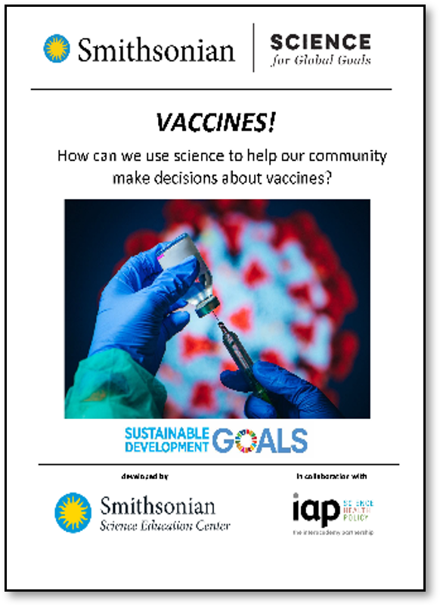
Act Research Extension, slide 2
Decide on how you want to learn more! The community research guides listed here can help you explore different topics. Which topics interest you most?
Explore ways biotechnology can be used to improve human health.
Explore more about how vaccines can help reduce disease and improve health.
Explore how the environment affects health in your community.
As a group, pick a guide that you would like to use and start to explore together.

Slide 36
Act Research Extension, slide 3
Moodboard
How do you feel about your ability to make your community healthier?

Slide 37
Glossary
Herd immunity: When a large part of the community (the herd) can no longer be infected or spread a disease
Immune: When you cannot be infected by a disease
Infectious: Diseases that are spread between people
Vaccine: Something that helps your body protect itself against disease

