Slide 1
Bioplastic Engineering Activity
Starting with Sustainability

Slide 2
Why do we need alternatives to plastics?
Every day we are all using different materials. Some materials are natural, like wood, stone, and sand. Some materials, such as plastic, steel, and concrete, are created by people. Scientists believe the mass of human-made materials is now greater than the mass of all living things on Earth.
One material that creates a lot of waste is plastic. Plastic solves a problem for people. It is quite affordable, or inexpensive. It also can be quite durable and can be used multiple times. However, it also creates some problems.

Slide 3
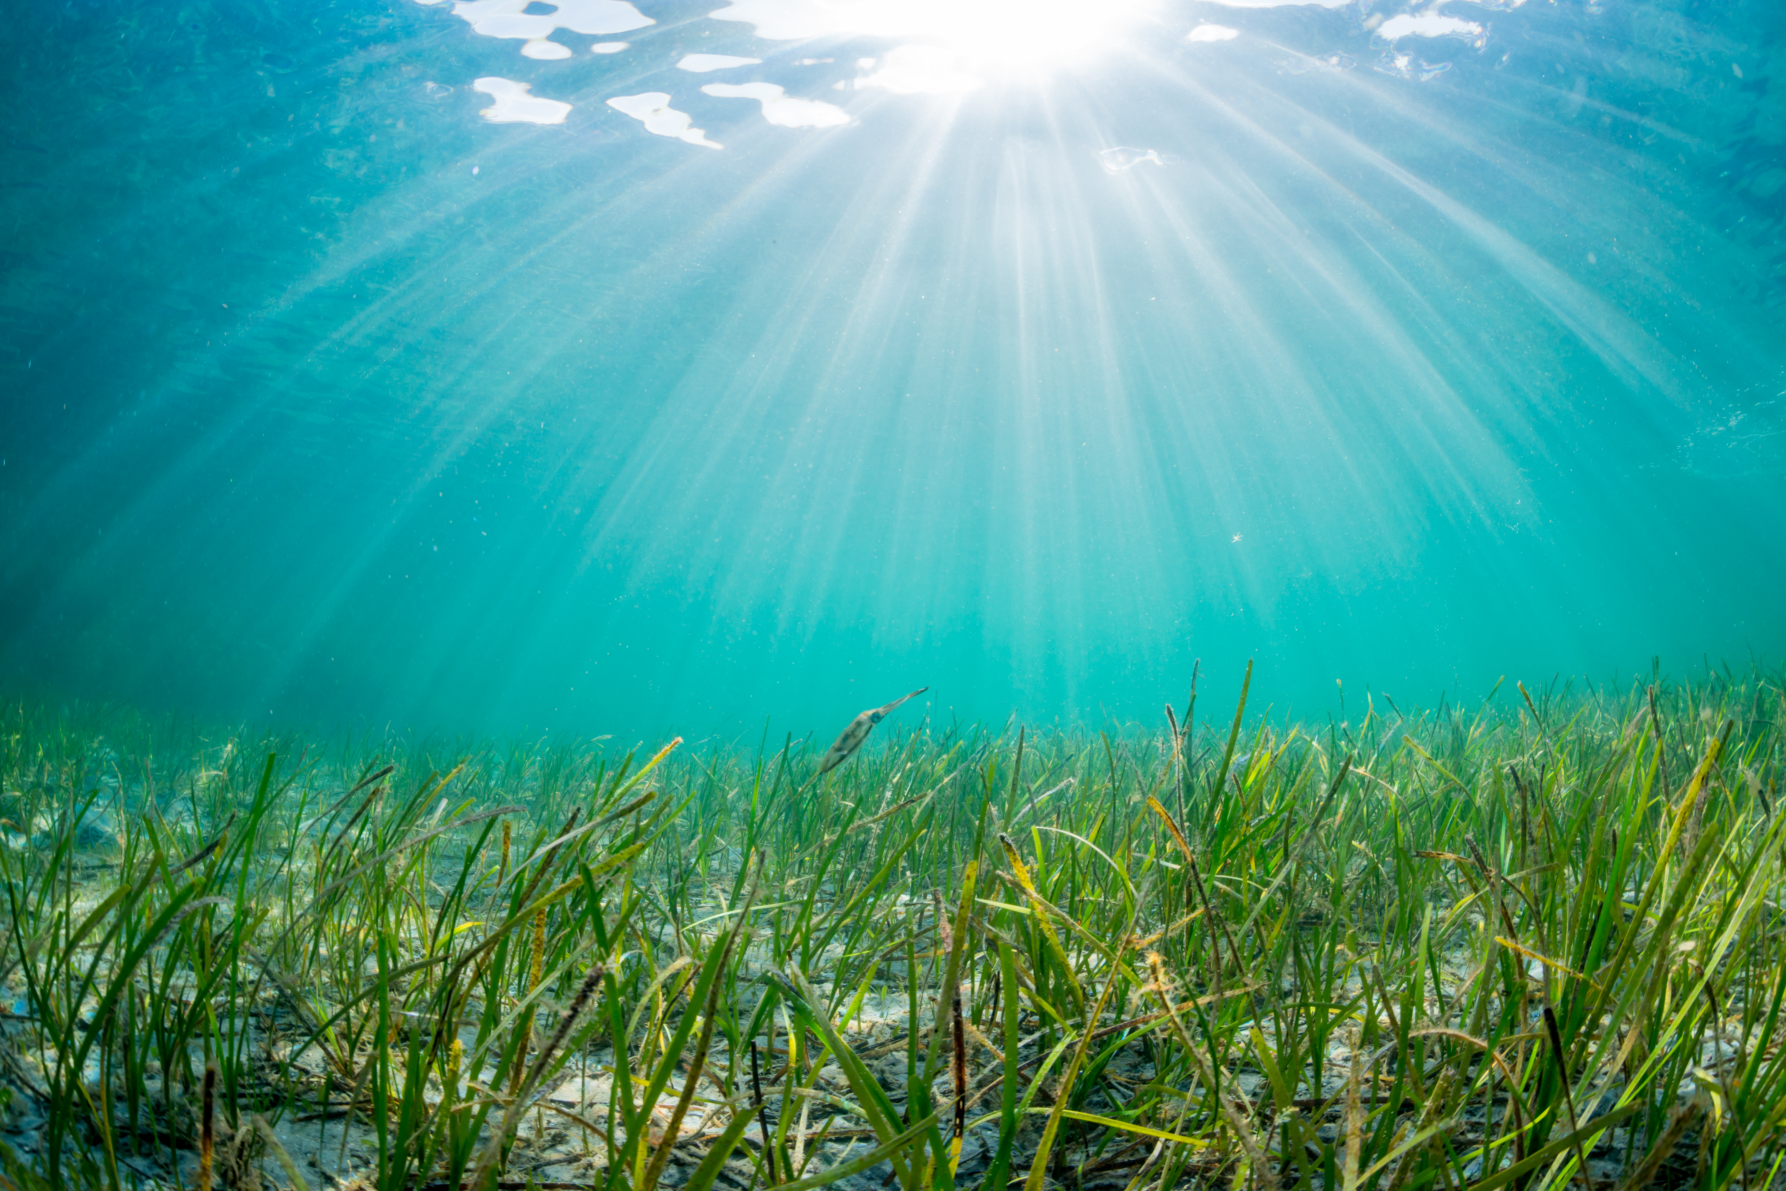
The Life Cycle of a Water Bottle
Read The Life Cycle of a Plastic Water Bottle and discuss with a partner any problems you notice.
The Life Cycle of a Plastic Water Bottle
Millions of years ago, living things in the ocean, such as algae and zooplankton, died, sank to the sea floor, and were buried in sediment. Over time, the bodies of these living things were compressed deep into the Earth. That compression changed them into a fossil fuel known as crude oil.

Slide 4
The Life Cycle of a Water Bottle (continued)
In recent times workers drilled deep into the Earth to reach the crude oil. They pumped the oil out of the Earth and sent it through a pipeline to be refined. At the refinery, other workers heated and distilled the crude oil to separate it into different parts. One part was heated at high temperatures to break it into short molecules. Some of these molecules were combined into long strings called polymers using a process that uses heat, water, and other chemicals. The resulting plastic is called PET. The PET was formed into small pellets and shipped to a plastic bottle factory.
At the factory, the PET pellets were melted down and had air blown inside them while pushing the molten PET against a mold to form a bottle. The bottles were filled with water, capped, packed, and shipped to a store.
At the store, the bottle of water was inexpensive. A person bought it, drank the water, and got rid of the bottle.

Slide 5
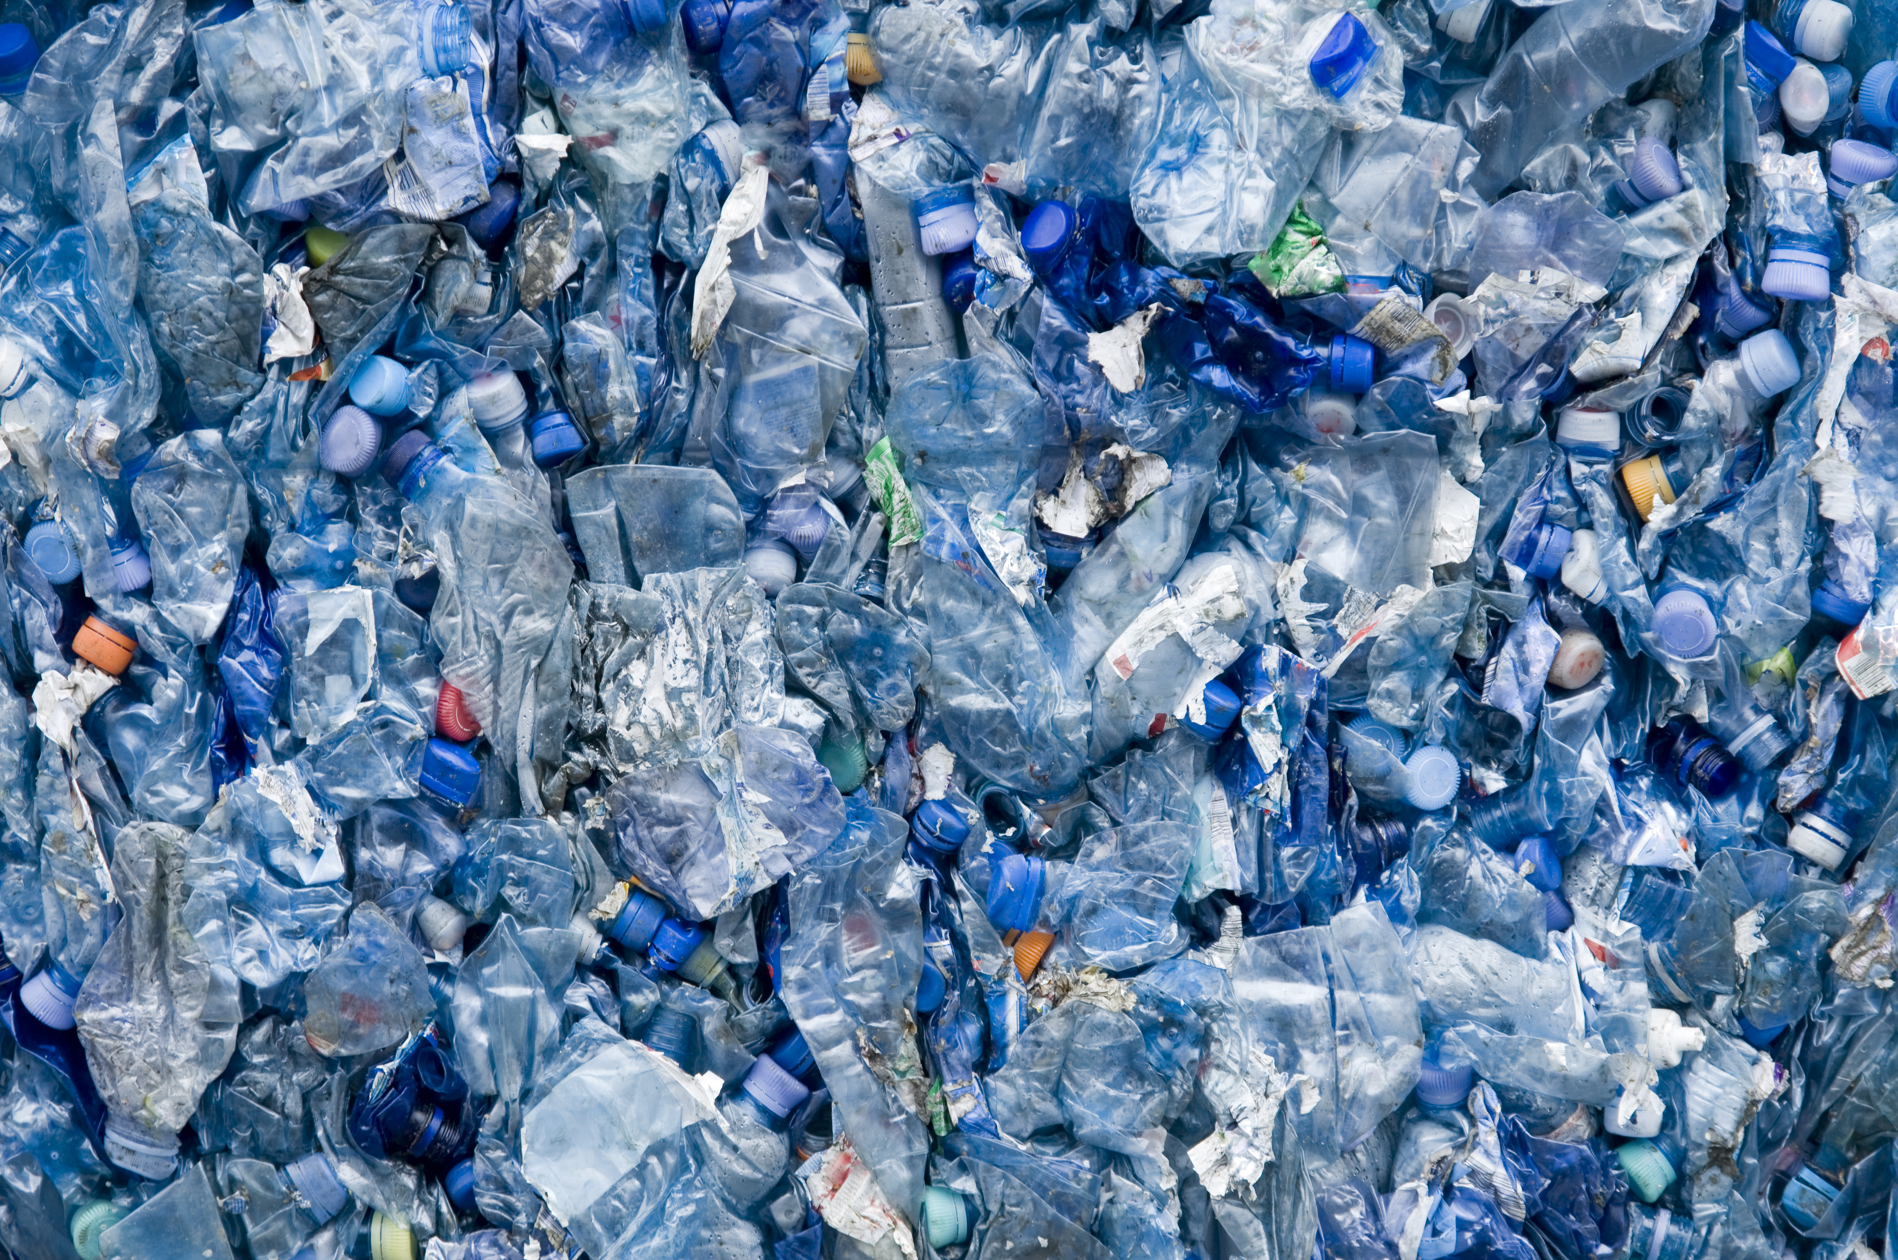
Conclusion of the Life Cycle of a Water Bottle
The rest of the story could go in many different directions.
Sometimes the bottle is thrown away and ends up in a landfill, where it will remain unchanged for hundreds of years.
Or the bottle could be burned with other trash for fuel, releasing carbon into the atmosphere.
Or the bottle could be recycled into other products, such as another bottle or a T-shirt. But plastic is usually only recycled a few times before the quality decreases, and it is no longer usable.
Or someone could litter or bottles could be washed out of a landfill. Then a bottle could enter the waterway and make its way to the ocean, where it will float, slowly breaking into smaller pieces for hundreds of years. These plastics and microplastics can cause problems for sea life and human health. In fact, by weight, plastic bottles are the most littered items on beaches around the world.

Slide 6
A plastic alternative
Creating more sustainable or planet-friendly materials is important. Imagine a material that is just as affordable and durable as plastic, but is also:
Made from resources that are renewable, meaning easily replenished. Often this means they’re based on something that could grow back quickly, like a fast-growing plant, fungus, or bacteria. This is sometimes called biobased.
Biodegradable, meaning able to break down relatively quickly in a natural environment. For example, would they decompose quickly in a compost heap or if they reached a waterway?
Scientists have created polymers using materials such as cornstarch and the waste from sugarcane. These are sometimes called bioplastics. The most useful bioplastics are biobased and fully biodegradable, even in the ocean!

Slide 7
Bioplastic engineering: Gathering your materials
Now you will create bioplastic yourself!
Materials to gather
Microwave-safe or heat-safe container
15 g (1 tablespoon) cornstarch (also called corn flour)
4 drops cooking oil
Pipette or eyedropper (optional, you can also use your finger)
22 g (1.5 tablespoons) water
Food coloring (optional)
Spoon
Microwave or other heat source, such as a stovetop

Slide 8
Bioplastic engineering: Steps to follow
Put the cornstarch in a microwave-safe or heat-safe container.
Add 4 drops of cooking oil using a pipette or eyedropper, or letting the drops fall off the tip of your finger.
Add the water.
Add the food coloring (optional).
Use the spoon to stir until the mixture is smooth.
Heat in the microwave on medium heat for 30 to 90 seconds. Check it every 30 seconds. Your bioplastic should be clearer and dry to the touch. The thicker the bioplastic, the longer it will take in the microwave.
If you are using a stovetop, stir the bioplastic over low heat until it turns clearer and becomes thick.

Slide 9
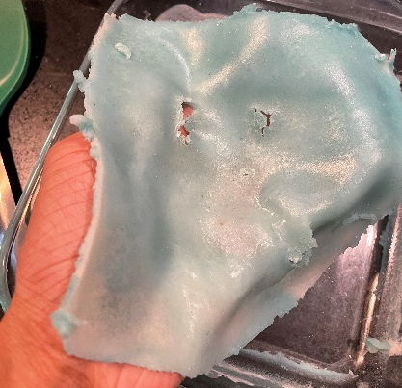
Bioplastic engineering: Steps to follow (continued)
Physical Safety Tip: Materials heated in the microwave can be hot! Be careful as you remove your bioplastic from the microwave and wait for it to cool before you touch it.
Your container now has a flexible bioplastic! Wait until it cools a little bit and then remove it from the container. If you want it in a particular shape, mold it into that shape and leave it to cool completely.
If you want more plastic, use the same proportions and increase the amount of each ingredient.

Slide 10
More about bioplastics
Your bioplastic can be molded into many different shapes.
It is biodegradable; if you buried it in the soil or put it in a composter, it would decompose.
Although your homemade bioplastic may be fragile, scientists are able to make bioplastic that is quite durable, just like the plastic you are used to.
Discuss as a group:
What went well with making bioplastic?
What was a challenge?
What types of things would need to change for bioplastics to be used more commonly?

