Slide 1
Starting with Sustainability Lesson Slides
Good Health and the Environment

Slide 2
Lesson Overview:
Essential Understanding: The environment affects people’s health. Each person can take action to improve the health of people and the environment.
Discover: How do environmental problems affect the health of my community?
Understand: How can we find solutions for plastic waste?
Act: How will we act to improve our environmental health?

Slide 3
Good Health and the Environment Understand
How can we find solutions for plastic waste?

Slide 4
Understand Overview
Learning Objective:
We will be able to analyze the scope of the plastic waste problem and identify actionable solutions for our own community through research and engineering activities.
Understand Reading (optional): A 1-page reading on the increase in plastic production, and a community connection activity.
Understand Investigation: Investigate three strategies for plastic waste management: reducing, upcycling, and creating alternatives such as bioplastic.
Understand Research Extension (optional): Students can extend their learning by researching health statistics for their local area and creatively communicating those statistics to their community.

Slide 5
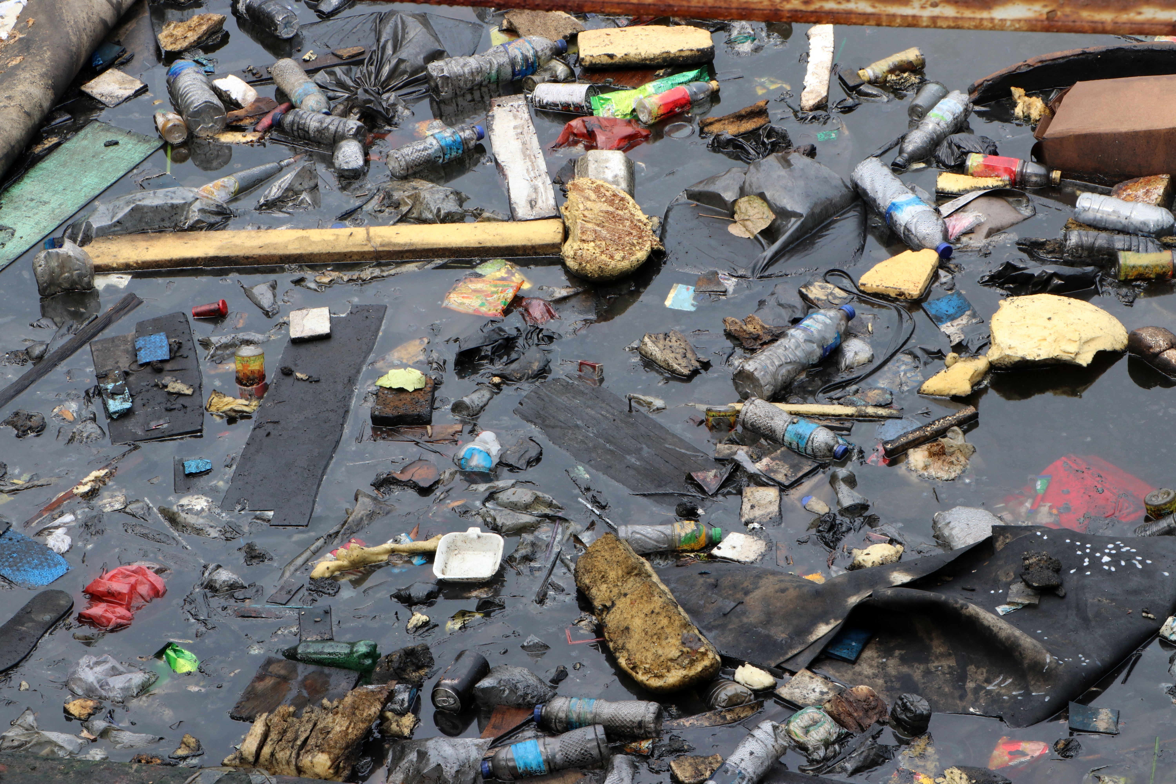
Understand Reading
The Plastic Waste We Create
One problem you may have noticed in your community is litter or pollution. People can help the health of the environment by thinking about how we manage the waste we create. Waste is materials that we throw away or get rid of. One waste problem that has changed a lot over the last few decades is plastic.

Slide 6
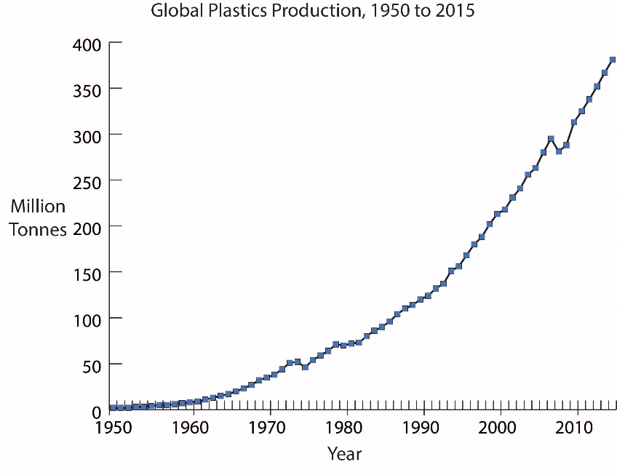
Understand Reading, slide 2
Examine the graph on how plastic production has changed over time and answer the questions
Notice: How would you describe the change in plastic production since 1950?
Think: What problems do you think this increased use of plastic creates?
Wonder: Are there things you think you could do to decrease plastic waste?

Slide 7
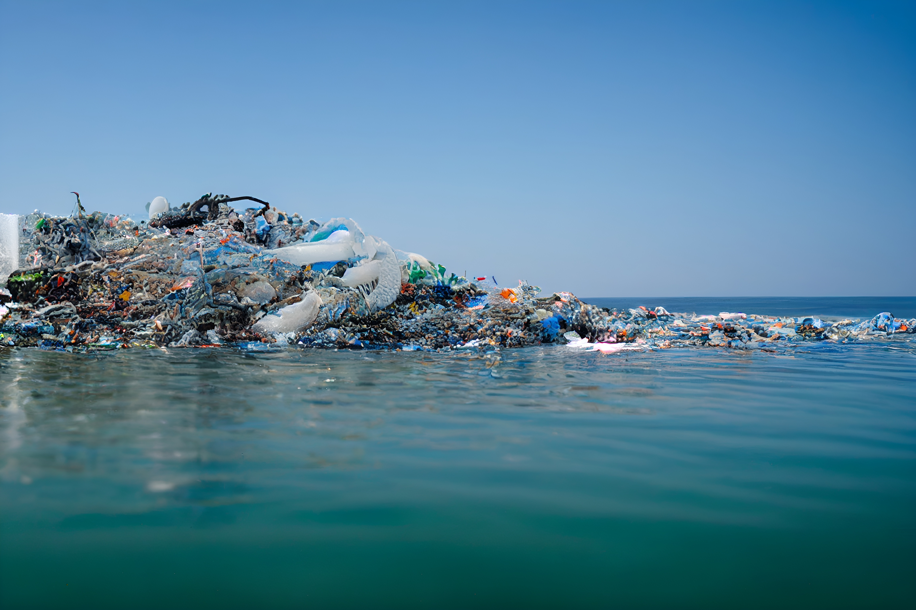
Understand Reading, slide 3
Plastic litter can create a lot of problems for people. Plastics can clog waterways, creating problems for humans and other living things. Plastic litter can allow standing water, which can be linked to a number of mosquito-borne diseases, such as malaria. Plastics can break down into very small pieces called microplastics, which are found in the ocean, in soil, and even in human bodies! Some scientists think the chemicals in plastics can hurt people as well.

Slide 8
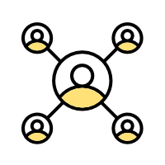
Understand Reading, slide 4
Community connection: Move around the room you are in and search for as many items as you can find that contain plastic. Be sure to notice plastics used for different purposes. We use plastic for many things other than containers. How many can you find?

Slide 9
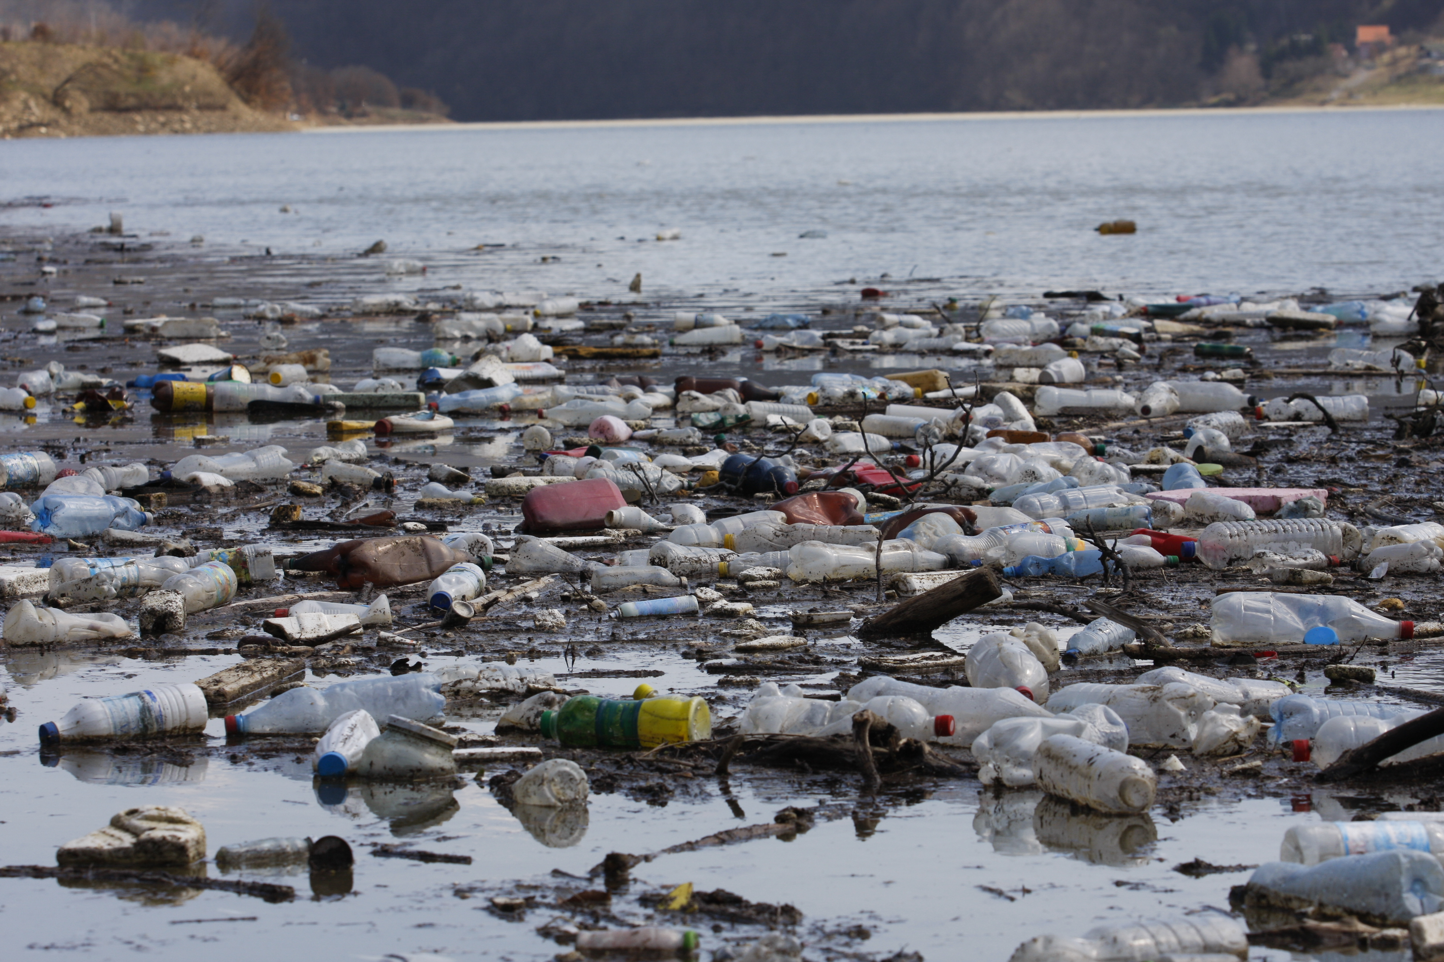
Understand Investigation
How can we find solutions for plastic waste?
Discuss with your group: Are there any environmental or health problems related to the plastics you use? Can you think of any strategies to try to solve those problems?

Slide 10
Understand Investigation, slide 2
You will now investigate three strategies to reduce plastic waste. You can divide your group into three smaller teams and each team can investigate one, or create stations and rotate, or just choose one strategy to investigate.
Use less plastic strategy: Identify situations where you could use less plastic. Resource: Plastic Waste Investigation Worksheet
Throw away less plastic strategy: Repurpose previously used plastic. Resource: Plastic Waste Makerspace Activity slides
Make plastic less harmful to the environment strategy: Create a new type of biodegradable plastic. Resource: Bioplastic Engineering Activity slides

Slide 11
Understand Investigation, slide 3
Come back together and discuss with a partner: What do you think are the advantages or disadvantages of each strategy?
With your partner, pick one piece of plastic waste you have noticed in the past. Choose the strategy you think might work best to reduce this plastic waste.
Discuss as a group:
Which strategies for creating less plastic waste would be best to use in your community?
How could you share these strategies with your community?
Is there one strategy that you could start using on your own right now?

Slide 12
Understand Research Extension
Research More!
Examine the results of your plastic waste investigation on your Plastic Waste Investigation Worksheet. If you did not complete the investigation, do so now.
Calculate how much plastic you waste over time and record your answer.
Count the number of pieces of plastic waste you threw away (this was recorded in the Amount of Plastic column on the worksheet).
Depending on how long you collected plastic, multiply that number to figure out how much plastic you use in a year and record your answer.
For example, if you collected plastic for:
• One day, multiply the amount of plastic you use in a day by 365 days in a year
• One week, multiply the amount of plastic you used in a week by 52 weeks in a year

Slide 13
Understand Research Extension, slide 2
Take your answer and imagine yourself at age 70. How much plastic waste will you have made by then, if you continue making the same amount? To find out, figure out how many years between your current age and age 70. Then multiply this number by the number of pieces of plastic you use a year.
Discuss, write, draw or act out your answers to the following questions. Share your reflection with your group.
Do you think people in your community understand how much plastic many people are using?
How do you think you could share what you have learned?

Slide 14
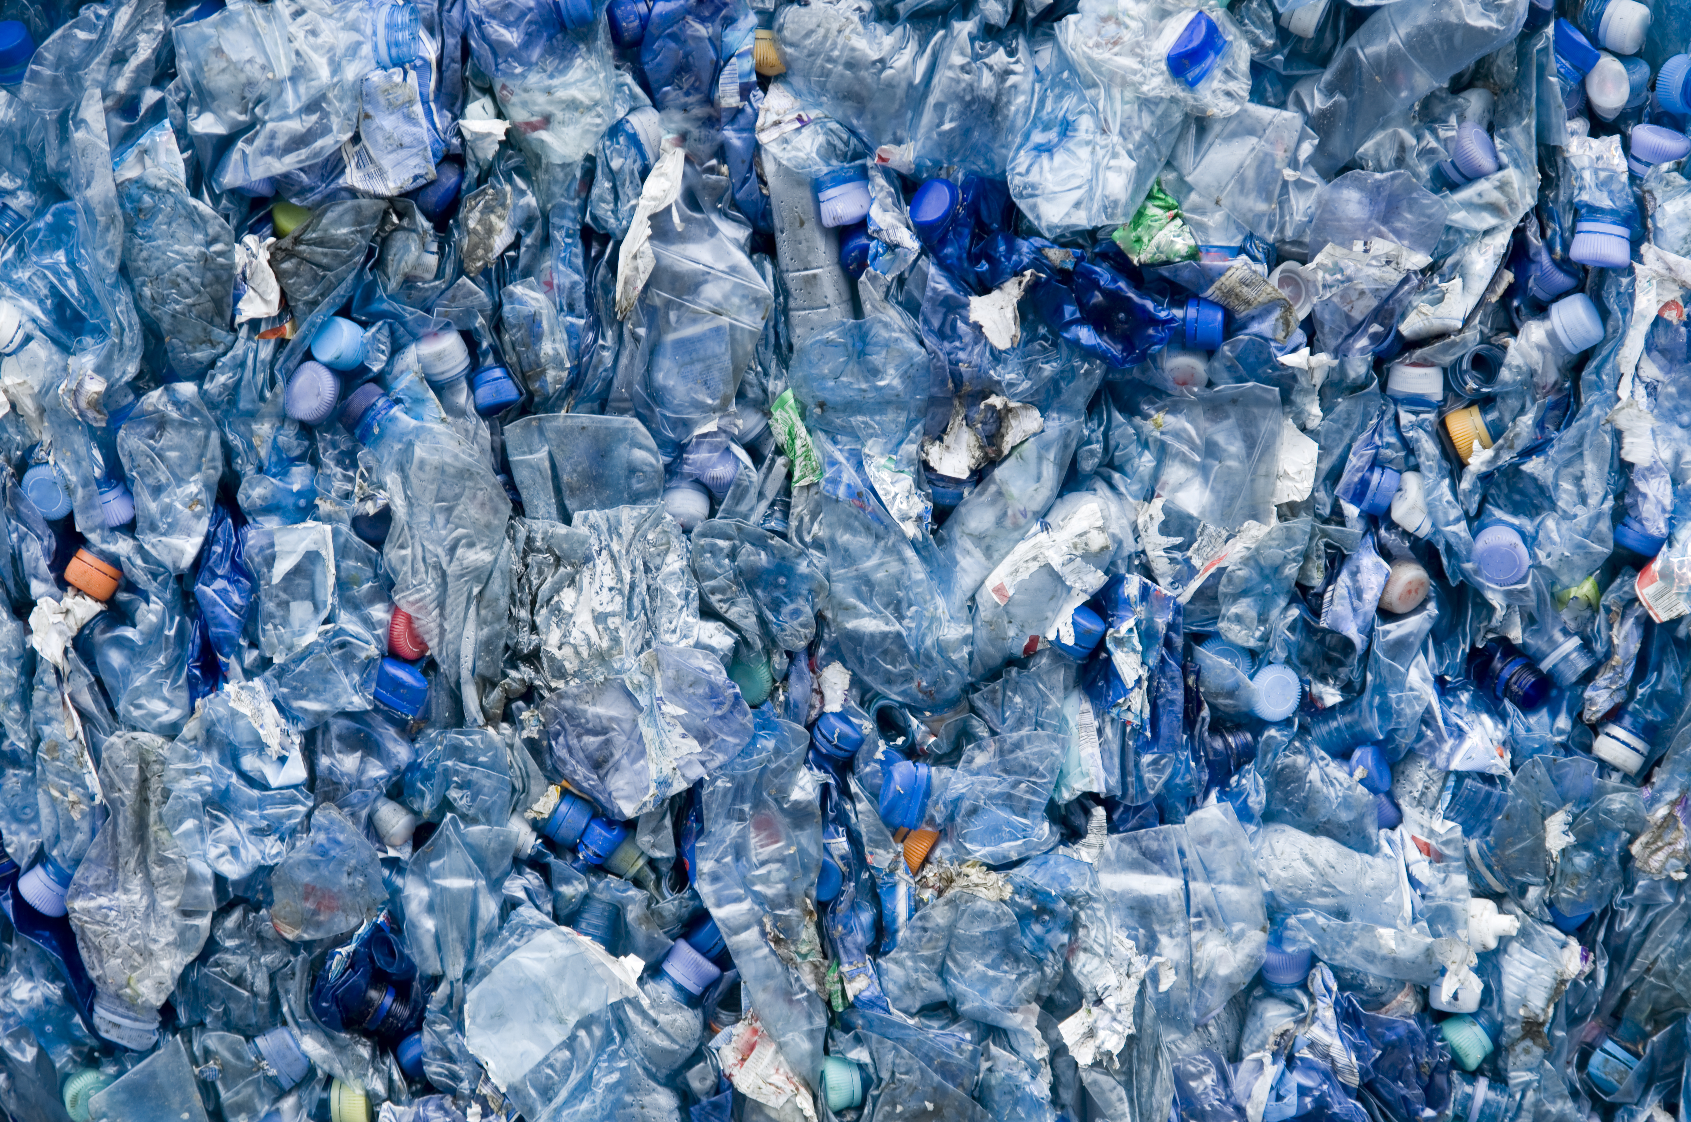
Understand Research Extension, slide 3
Discuss as a group:
What steps can you take to educate your community about the plastic waste they create?
How can you gather community support for implementing a strategy to reduce plastic waste?

Slide 15
Glossary
Environment: The conditions and things that surround us
Microplastics: Very small pieces of plastic
Waste: Materials we throw away or get rid of

