Slide 1
Starting with Sustainability Lesson Slides
Good Health and the Environment

Slide 2
Lesson Overview:
Essential Understanding: The environment affects people’s health. Each person can take action to improve the health of people and the environment.
Discover: How do environmental problems affect the health of my community?
Understand: How can we find solutions for plastic waste?
Act: How will we act to improve our environmental health?

Slide 3
Good Health and the Environment Discover
How do environmental problems affect the health of my community?

Slide 4
Discover Overview
Learning Objective:
We will be able to explain the relationship between the environment and human health, research community environmental problems, and reimagine a healthier community.
Discover Reading (optional): A 1-page reading on the relationship between the environment and human health, and a community connection activity.
Discover Investigation: Students investigate community environmental problems and their impact on community health.
Discover Investigation Extension (optional): Students can extend their Discover investigation by reimagining their community to remove environmental problems.

Slide 5
Discover Reading
Health and the Environment
The environment is the conditions and things that surround us. Living things, the weather, and nonliving things such as rocks are all a part of the natural environment. Many parts of the environment have been created by people. Roads, houses, and conditions created by people, like a feeling of love or social belonging, are all parts of the human-created environment.
Your environment affects your health. You get many important things from your environment, such as water, air, and food. Some things in your environment may help you to be healthy and happy and some things may not

Slide 6
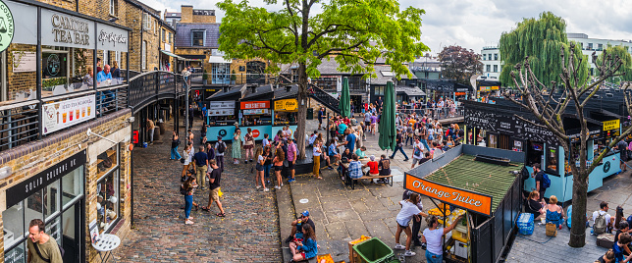
Discover Reading, slide 2
Examine this picture. Can you find at least two things that would help people feel healthy or happy? Can you find two things that might make it more difficult to be healthy and happy? Discuss with a partner.

Slide 7
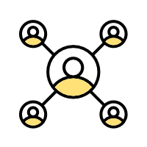
Discover Reading, slide 3
Your community has its own unique environment. The environment in your community includes the conditions and things very near to you, like the conditions found in your home, school, and neighborhood.
Community Connection: Find a picture of the area around you. You can take a picture or use a picture someone else has taken. What things in the photo might help or harm your health?

Slide 8
Discover Investigation
How do environmental problems affect the health of my community?
Print a copy of the Environmental Problems Worksheet for your group or create a table like the one below. Resource: Environmental Problems Worksheet
Think about your community. A community can be the area right around you—your school, for example. Or it can be larger, like your neighborhood or your town. You can decide which area you want to investigate.

Slide 9
Discover Investigation, slide 2
Are there any environmental problems you have noticed in your community? For example, does your community have problems related to litter or air pollution? With your group, list any problems you can think of under the Problem column.
If you have time, you can use existing data to help you identify problems. Resource: Identify Environmental Problems Using Data slides

Slide 10
Discover Investigation, Slide 3
For each environmental problem, write down your experience with that problem under Research. For example, if you listed a problem like littering, you could put some details about trash in your community, such where its often left.
If you have time, research more about the experiences of others with environmental problems through community interviews. Resource: Community Interview Instructions Slides

Slide 11
Discover Investigation continued, final
Discover Investigation, slide 4
For each environmental problem, write what you know about its effects on human health in the Impact column. For example, one impact of air pollution is people developing asthma. If you do not know the impact, you can use Internet searches, books, or conversations with members of your community to better understand how environmental problems in your community affect people’s health.

Slide 12
Discover Extension
Apply Your Learning to Your Community!
Examine the photo you took or used of your community for the Community Connection activity. What would need to change about the photo for your community to have a happier and healthier environment?
Create a way to record and share these changes. For example, you could:
Mark directly on the photo to show how it would need to change.
Make a drawing to show a happier or healthier version of your community.
Use many pictures to create a collage showing things that would make your community better.
Use another art form, such as song, poetry, drama, or dance, to show how you imagine a better community.

Slide 13
Discover Investigation Extension: Apply your Learning to Your Community, final slide
Discover Extension, slide 2
Share your ideas about a happier and healthier community with someone else in your community.
Examine the mood board below.
When you think about how things are now in your community, which of the mood board symbols best shows how you feel?
When you think about how you would like things to be in your community, which of the mood board symbols best shows how you feel?

Slide 14
Good Health and the Environment Understand
How can we find solutions for plastic waste?

Slide 15
Understand Overview
Learning Objective:
We will be able to analyze the scope of the plastic waste problem and identify actionable solutions for our own community through research and engineering activities.
Understand Reading (optional): A 1-page reading on the increase in plastic production, and a community connection activity.
Understand Investigation: Investigate three strategies for plastic waste management: reducing, upcycling, and creating alternatives such as bioplastic.
Understand Research Extension (optional): Students can extend their learning by researching health statistics for their local area and creatively communicating those statistics to their community.

Slide 16
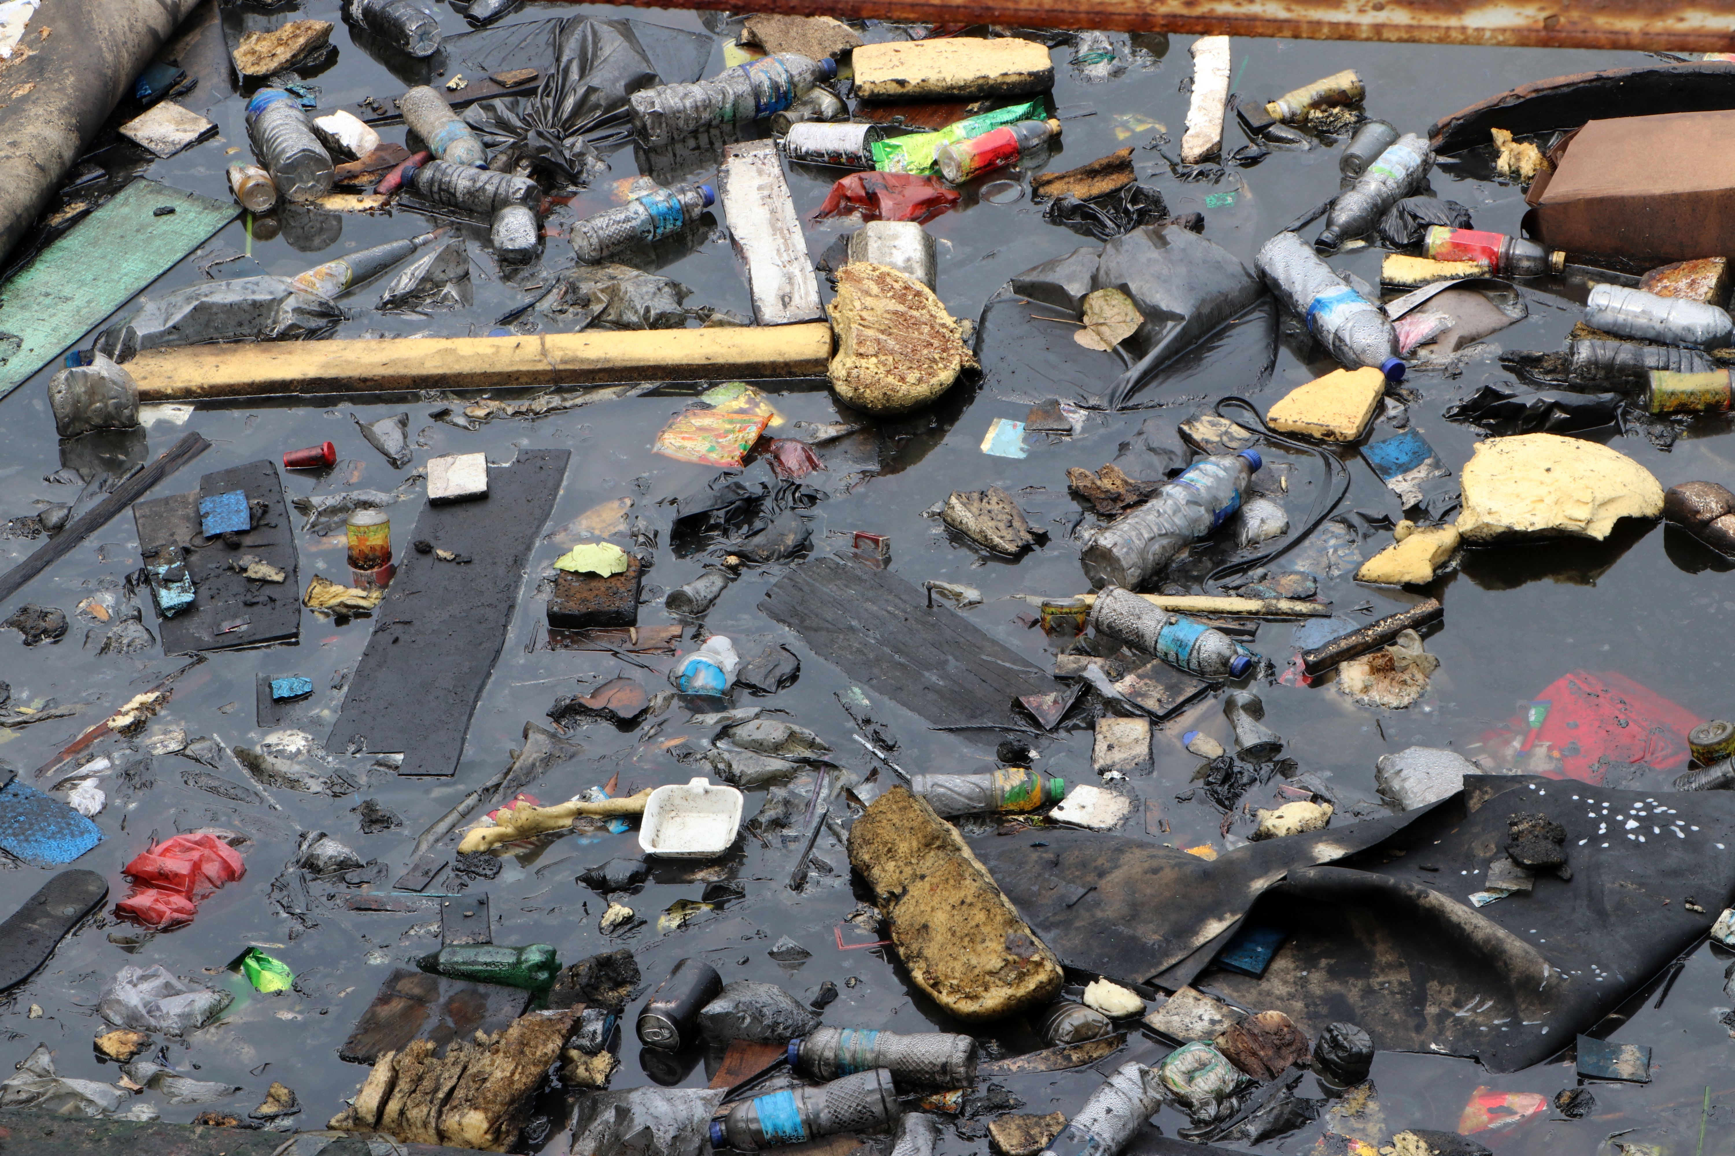
Understand Reading
The Plastic Waste We Create
One problem you may have noticed in your community is litter or pollution. People can help the health of the environment by thinking about how we manage the waste we create. Waste is materials that we throw away or get rid of. One waste problem that has changed a lot over the last few decades is plastic.

Slide 17
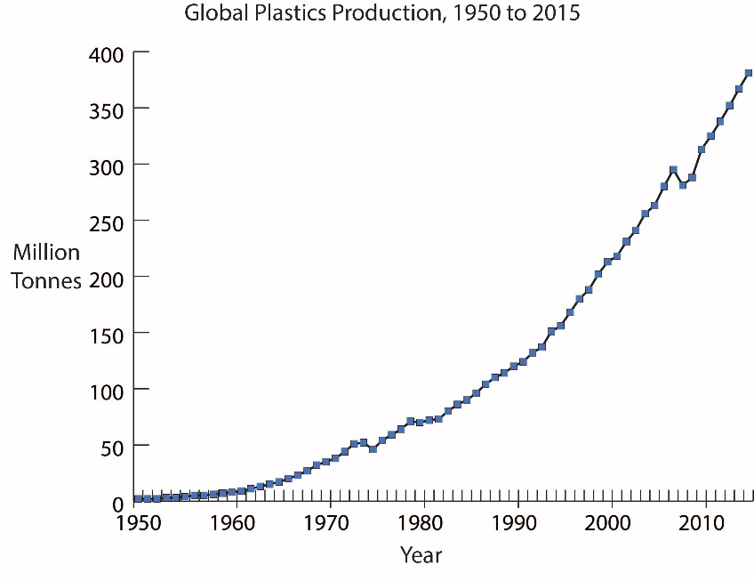
Understand Reading, slide 2
Examine the graph on how plastic production has changed over time and answer the questions
Notice: How would you describe the change in plastic production since 1950?
Think: What problems do you think this increased use of plastic creates?
Wonder: Are there things you think you could do to decrease plastic waste?

Slide 18
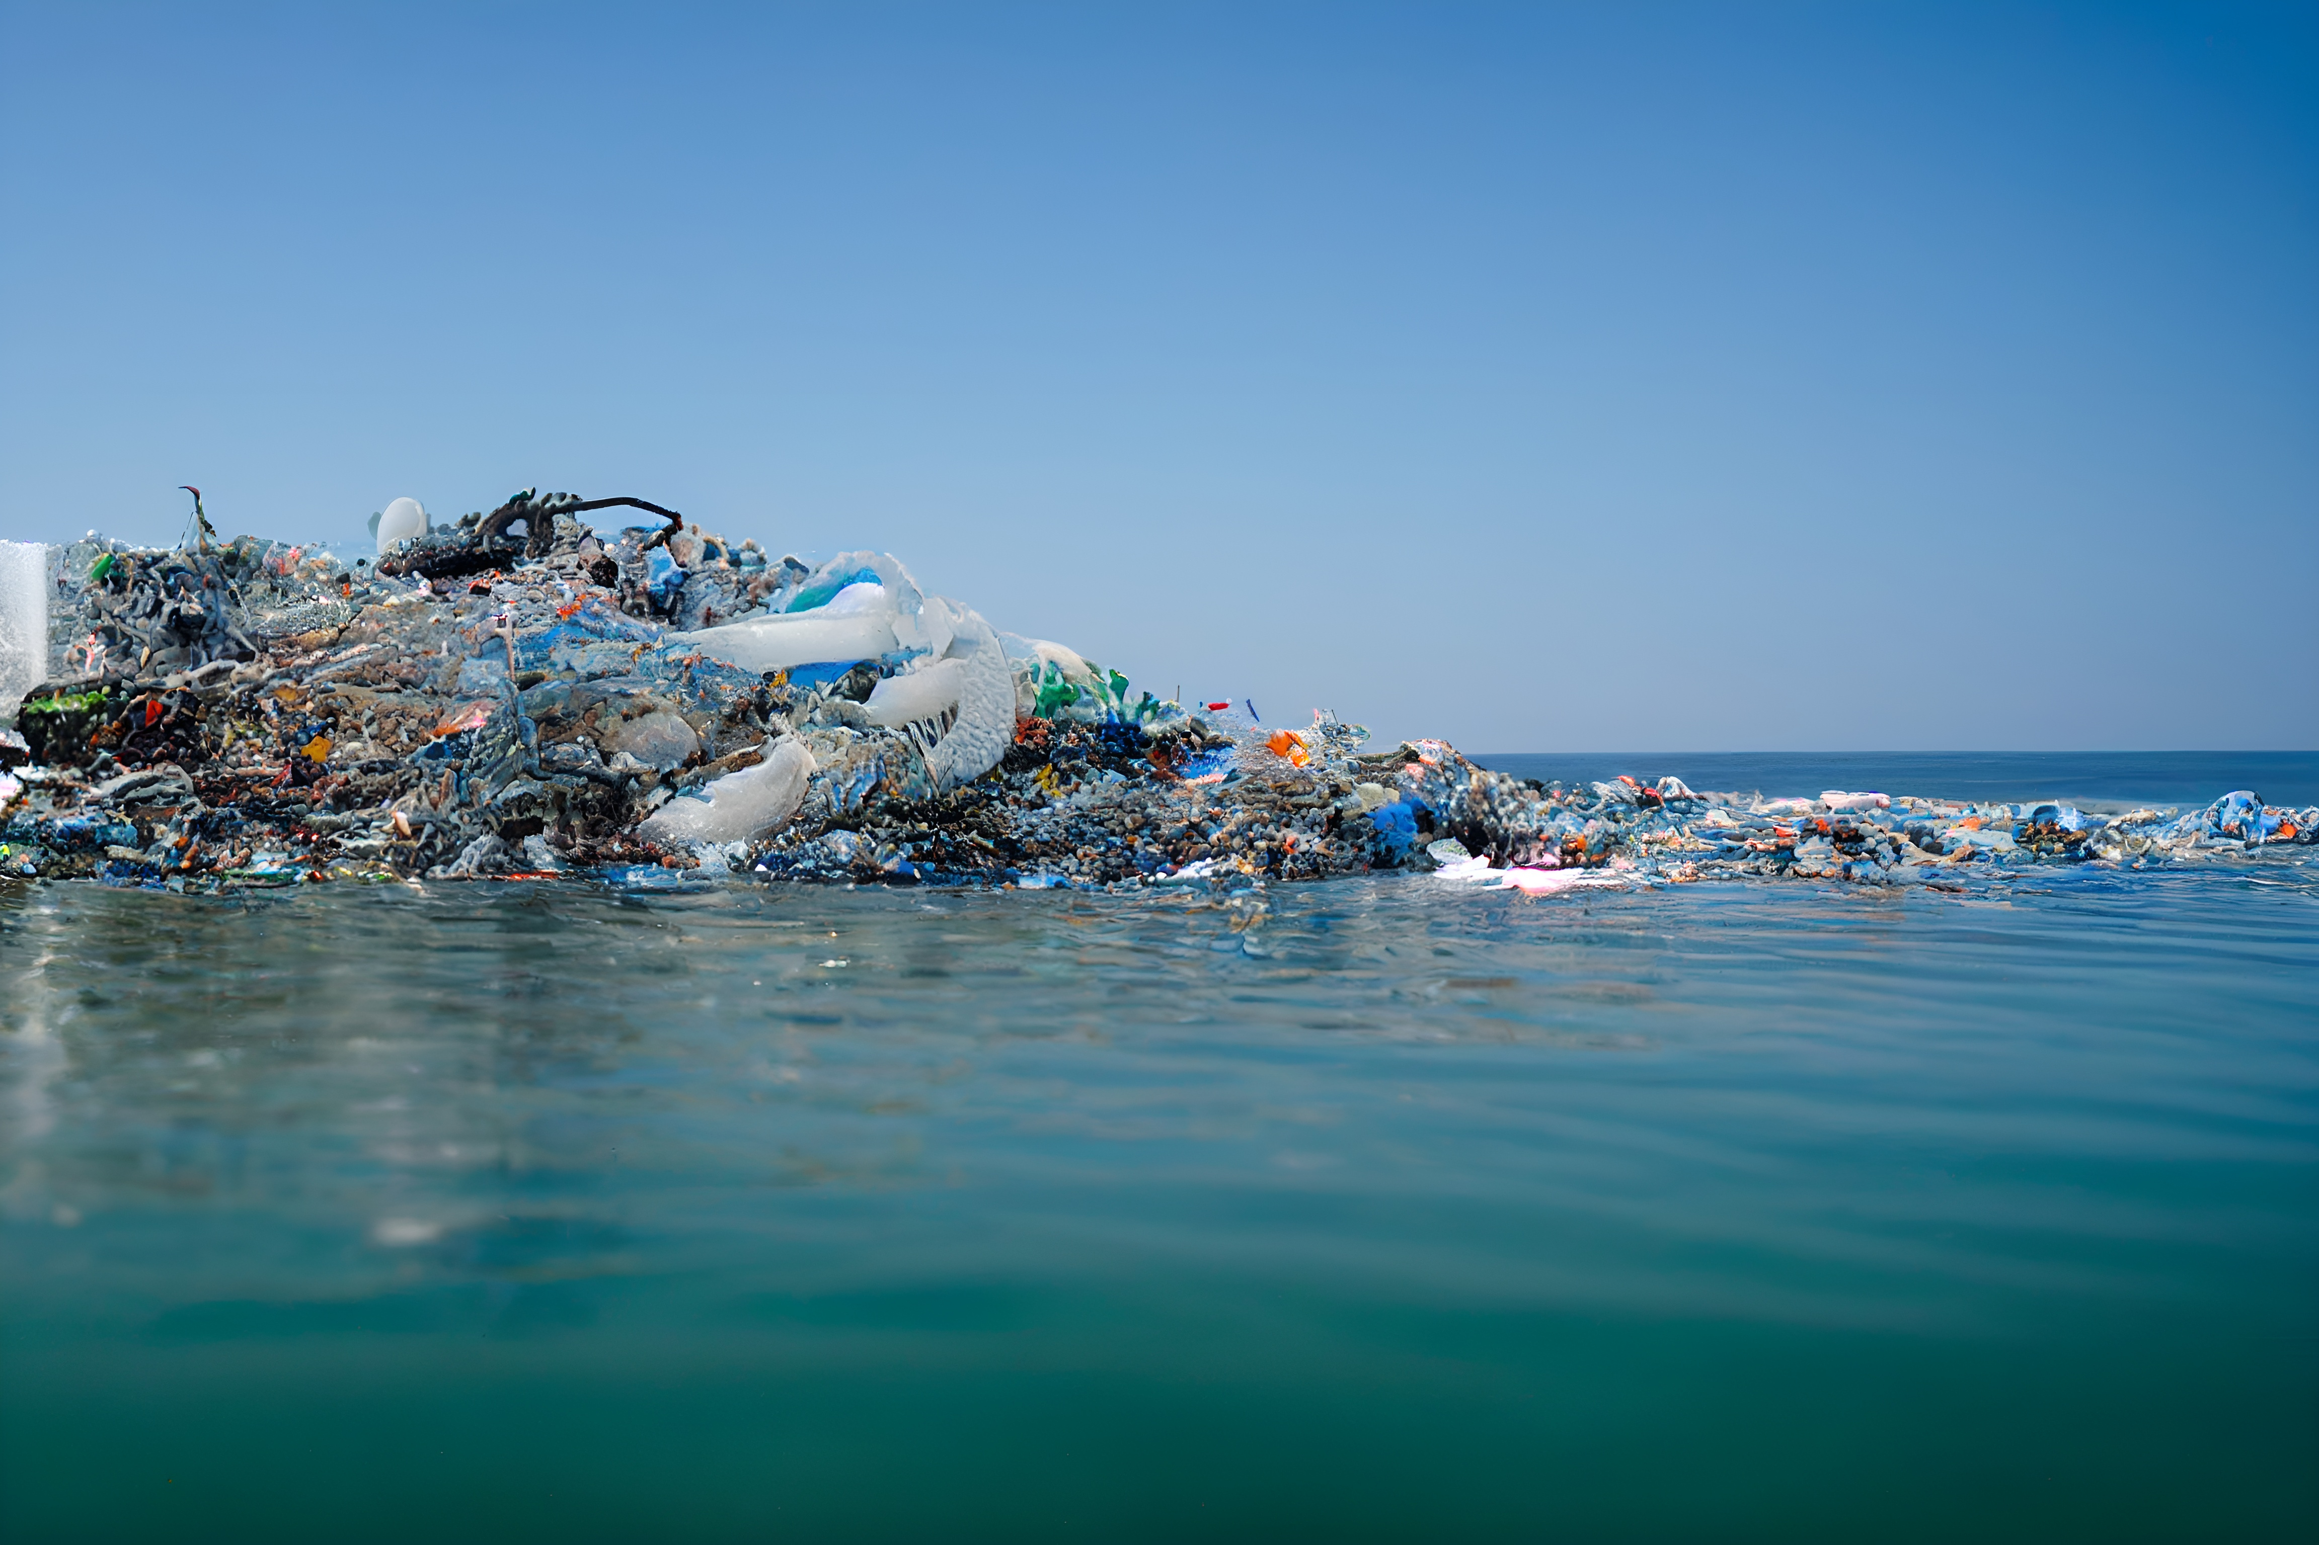
Understand Reading, slide 3
Plastic litter can create a lot of problems for people. Plastics can clog waterways, creating problems for humans and other living things. Plastic litter can allow standing water, which can be linked to a number of mosquito-borne diseases, such as malaria. Plastics can break down into very small pieces called microplastics, which are found in the ocean, in soil, and even in human bodies! Some scientists think the chemicals in plastics can hurt people as well.

Slide 19
Understand Reading, slide 4
Community connection: Move around the room you are in and search for as many items as you can find that contain plastic. Be sure to notice plastics used for different purposes. We use plastic for many things other than containers. How many can you find?

Slide 20
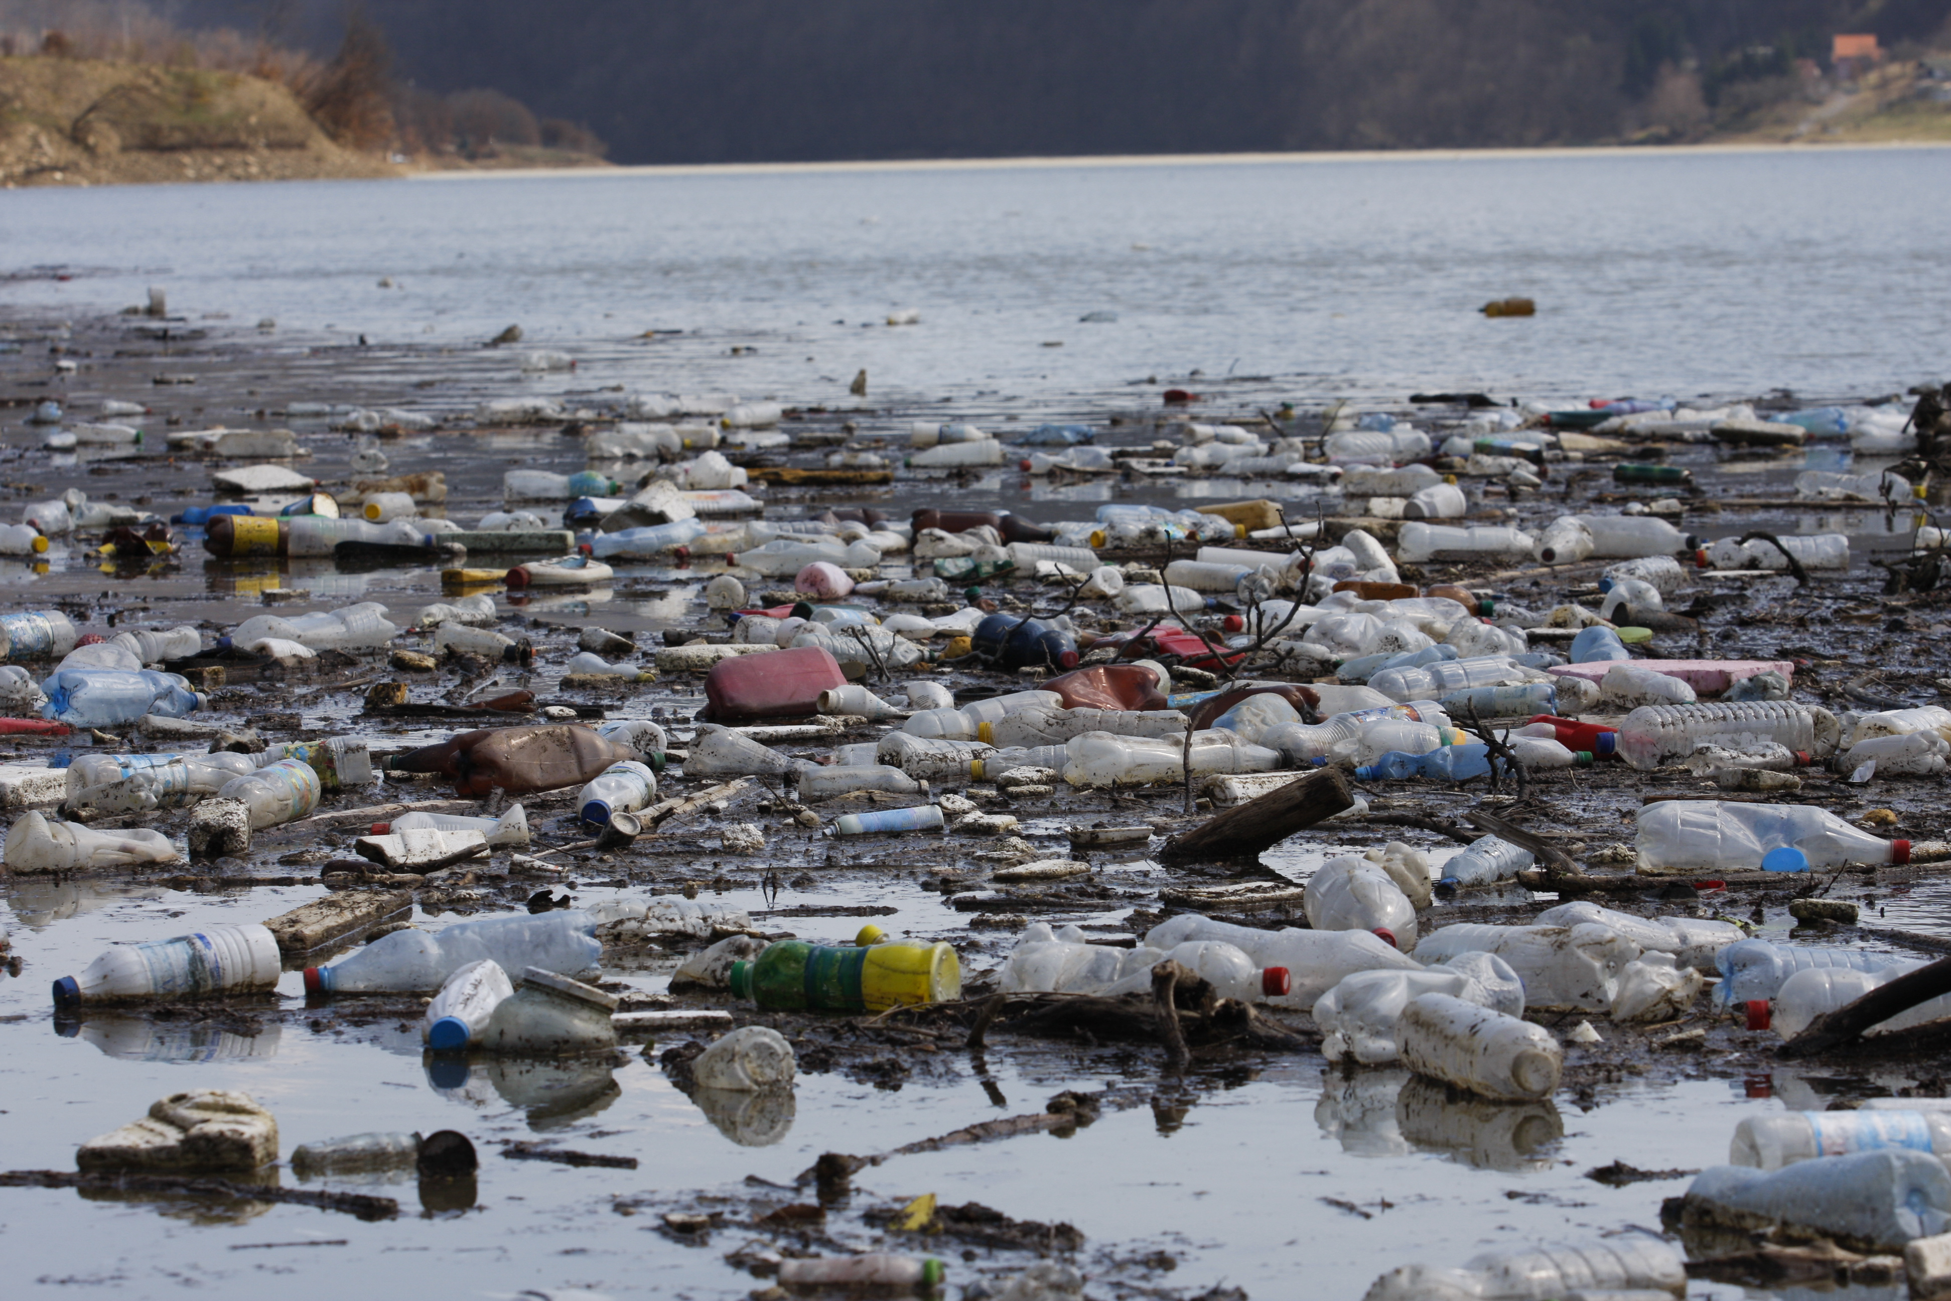
Understand Investigation
How can we find solutions for plastic waste?
Discuss with your group: Are there any environmental or health problems related to the plastics you use? Can you think of any strategies to try to solve those problems?

Slide 21
Understand Investigation, slide 2
You will now investigate three strategies to reduce plastic waste. You can divide your group into three smaller teams and each team can investigate one, or create stations and rotate, or just choose one strategy to investigate.
Use less plastic strategy: Identify situations where you could use less plastic. Resource: Plastic Waste Investigation Worksheet
Throw away less plastic strategy: Repurpose previously used plastic. Resource: Plastic Waste Makerspace Activity slides
Make plastic less harmful to the environment strategy: Create a new type of biodegradable plastic. Resource: Bioplastic Engineering Activity slides

Slide 22
Understand Investigation, slide 3
Come back together and discuss with a partner: What do you think are the advantages or disadvantages of each strategy?
With your partner, pick one piece of plastic waste you have noticed in the past. Choose the strategy you think might work best to reduce this plastic waste.
Discuss as a group:
Which strategies for creating less plastic waste would be best to use in your community?
How could you share these strategies with your community?
Is there one strategy that you could start using on your own right now?

Slide 23
Understand Research Extension
Research More!
Examine the results of your plastic waste investigation on your Plastic Waste Investigation Worksheet. If you did not complete the investigation, do so now.
Calculate how much plastic you waste over time and record your answer.
Count the number of pieces of plastic waste you threw away (this was recorded in the Amount of Plastic column on the worksheet).
Depending on how long you collected plastic, multiply that number to figure out how much plastic you use in a year and record your answer.
For example, if you collected plastic for:
• One day, multiply the amount of plastic you use in a day by 365 days in a year
• One week, multiply the amount of plastic you used in a week by 52 weeks in a year

Slide 24
Understand Research Extension, slide 2
Take your answer and imagine yourself at age 70. How much plastic waste will you have made by then, if you continue making the same amount? To find out, figure out how many years between your current age and age 70. Then multiply this number by the number of pieces of plastic you use a year.
Discuss, write, draw or act out your answers to the following questions. Share your reflection with your group.
Do you think people in your community understand how much plastic many people are using?
How do you think you could share what you have learned?

Slide 25
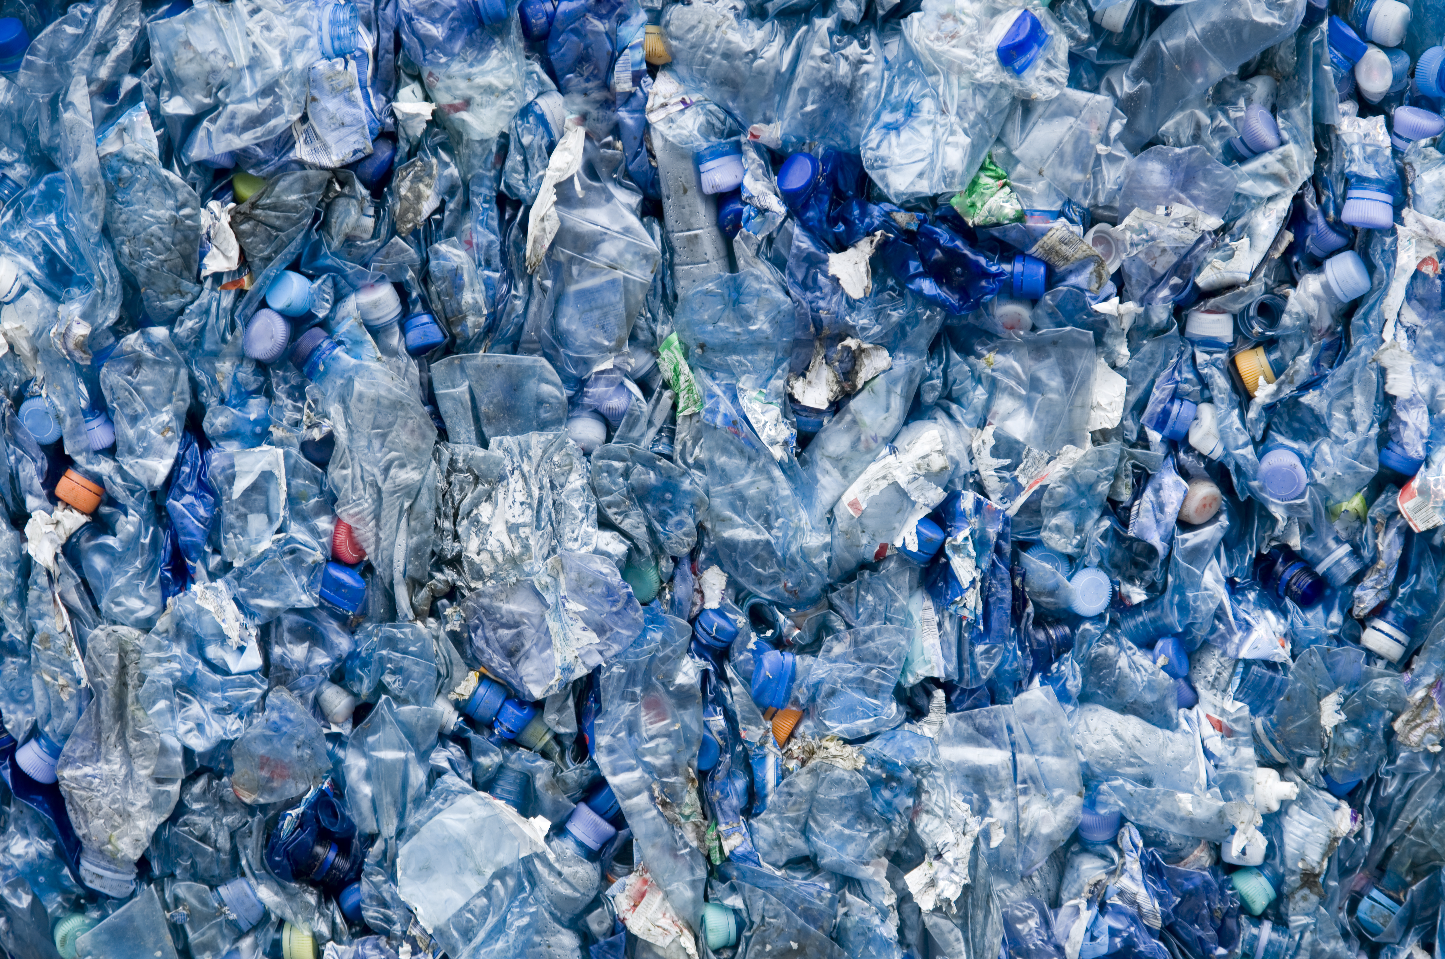
Understand Research Extension, slide 3
Discuss as a group:
What steps can you take to educate your community about the plastic waste they create?
How can you gather community support for implementing a strategy to reduce plastic waste?

Slide 26
Good Health and the Environment Act
How will we act to improve our environmental health?

Slide 27
Act Overview
Learning Objective:
We will apply what we have learned by choosing and implementing actions to solve a problem related to the health of people and the environment.
Act Reading (optional): A 1-page reading from Smithsonian expert Steve Nelson on actions individuals can take to help reduce waste, and a reflection on how to apply these concepts within the community.
Act Investigation: Students build consensus around a group action and complete a detailed action plan.
Act Investigation Extension (optional): Students implement their action plan and evaluate which Smithsonian Science for Global Goals community research guide might best support their additional areas of interest

Slide 28
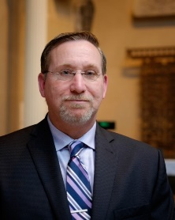
Act Reading
Community Choices and Environmental Health
Meet Steve Nelson, the zone manager for the Smithsonian’s National Zoo and Conservation Biology Institute. Steve (pronounced Steev) is in charge of the buildings and outdoor spaces. He also leads the Recycling Task Force for the Smithsonian. He wanted to share what he has learned with you:
“Your first goal on anything is waste reduction. If you don’t buy something, then you don’t have to worry about recycling or anything else. It is a huge deal if you don’t buy it in the first place. For example, with packaging, you have choices. You can choose between a brand that uses very minimal packaging or one that’s got the big fancy stuff to make it marketable.”

Slide 29
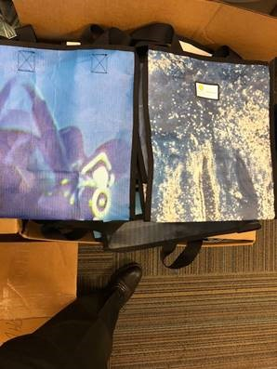
Act Reading, slide 2
“Consider everything that’s being wasted now with an open mind. At the Smithsonian we’ve got these huge display banners in the museums. They are up for a while and then the exhibit changes. They take the banners down and put up new ones. In the past those banners went to the landfill. Now we turn them into tote bags! By doing that, we’ve just removed all the banner waste from the landfill. We’ve also taken a bunch of single-use plastic bags out of the waste stream, because now people can reuse this tote bag instead”

Slide 30
Act Reading, slide 3
“We need to start thinking beyond what we are doing right now. We need to consider what is possible. I think the biggest message is that one person can make a difference. One person cannot change everything, but one person can change what they do. If that one person becomes a million people, they are going to make a big change. Collectively, you have power.”
Community Connection: What are some opportunities in your community to use your power to create less plastic waste or help solve other environmental problems?

Slide 31
Act Investigation
How will we act to improve our environmental health?
Now you will get ready to act. The first step toward action is deciding what problem you want to solve and the action you want to take to solve it. Then you can plan when and how you will act.
With your group, decide on the problem you want to help solve. This might be a problem such as too much plastic waste or a lack of knowledge about alternatives. Or it could be another problem you noticed. Write down the problem either on the Action Planner Worksheet or on a separate piece of paper. Resource: Action Planner Worksheet
Using the worksheet or paper, list any actions you can think of that might help solve the problem. For example, maybe you want to communicate information to children in your community. Maybe you want to help people switch to alternatives to plastic to reduce their waste. List any actions that will help to solve your problem.

Slide 32
Act Investigation, slide 2
Write down the strengths your group has and how they could be used to improve the health of your community. For example:
Are members of your group part of any groups that you could communicate with?
Do members of your group have any special talents, such as art or music, that might be useful to capture people’s attention?
Are members of your group interested in science and engineering or other ways to try to find innovative solutions?
Do group members have good planning or organization skills?

Slide 33
Act Investigation, slide 3
Pick an action based on the strengths of your group.
Write down your ideas to plan for your action. Be sure to think about:
What will you need to do?
How can you make sure everyone in your group is included?
Are there other people you need to help you or give you permission?
Where will your action take place?
What materials will you need?
What challenges should you be prepared for?

Slide 34
Act Investigation, slide 4
List each step you need to do to complete this action.
Assign one or more steps to each person in your group.
Congratulations, you have planned your action!

Slide 35
Act Research Extension
Choose Your Path!
The time has come to act! You can use everything you have learned to take the first step toward making your community more environmentally healthy.
With your teammates, implement your action plan. This may take some time. When you are finished, come back and complete this activity.
Think quietly about the action you took.
What went well?
What do you think could have gone better?
How would you change your action if you had to do it again?

Slide 36
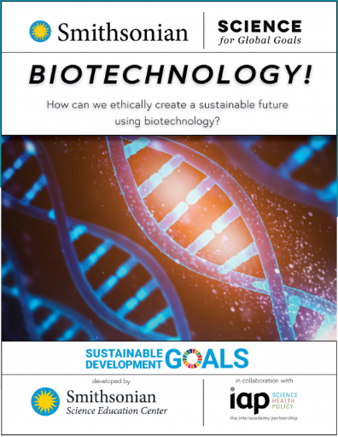
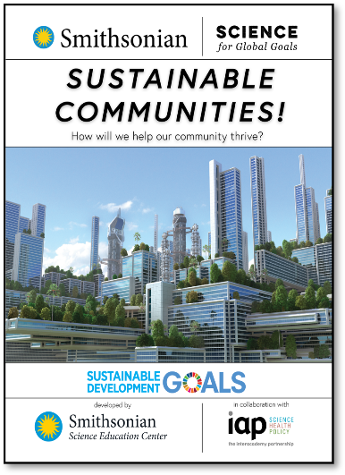
Act Research Extension, slide 2
Decide on how you want to learn more! The community research guides listed here can help you explore different topics. Which topics interest you most?
Explore the fairness of environmental problems in your community and how they affect people.
Explore how communities can work together to improve their environment.
Explore ways biotechnology can be used to improve the environment.
As a group, pick a guide that you would like to use and start to explore together.

Slide 37
Act Research Extension, slide 3
Moodboard
How do you feel about your ability to help create a better future?

Slide 38
Glossary
Environment: The conditions and things that surround us
Microplastics: Very small pieces of plastic
Waste: Materials we throw away or get rid of

