Slide 1
Design a Vertical Farm
Starting with Sustainability

Slide 2
Why vertical farming?
If you have ever noticed a corn or soybean field, you might have observed that growing food in soil can take up a lot of space. How can people produce the same amount of food without using as much space? Vertical farming is a type of technology that might help solve that problem. Vertical farming grows plants in vertically stacked racks, often indoors. The racks take up less horizontal space than a field but can still produce a huge amount of food. The plants may grow in water, air, or in a material that provides a small amount of support, like gravel. Light is provided using either electric lights or natural sunlight (such as in a greenhouse).
The photo on the left shows the way crops are arranged on an industrial farm.
The photo on the right shows how crops are arranged in a vertical farm.

Slide 3
What are the possible benefits of vertical farming?
Farmers can reuse the water that flows through the racks, which allows them to use less water overall.
Crops can be grown in places that don’t have usable soil, such as a paved area or a row of buildings.
The racks help farmers deliver water and nutrients directly to each plant.
Controlling the temperature, light, and humidity inside the vertical farm allows crops to be grown all year long.
Crops can be grown directly in the communities that use them.

Slide 4
What are the possible challenges to vertical farming?
It can be expensive to set up and maintain.
It requires construction of the racks, a water connection, and lighting.
Farmers may need to pay for the use of the space, electricity, water, air conditioning or heat, and nutrients.
Because the racks share a water source, when one plant gets a disease it can spread very quickly from plant to plant.
Only certain crops can grow well in vertical racks. For example, corn is too tall to grow in racks.

Slide 5
Think about what you need for a vertical farm
Materials needed for a vertical farm:
Indoor space that you are allowed to use
A space that has climate control for temperature and humidity
Electricity
A source of water
Money for materials (or donated materials)
Tools to build the vertical growing rack
Seeds or seedlings of plants that grow well in vertical farm spaces

Slide 6
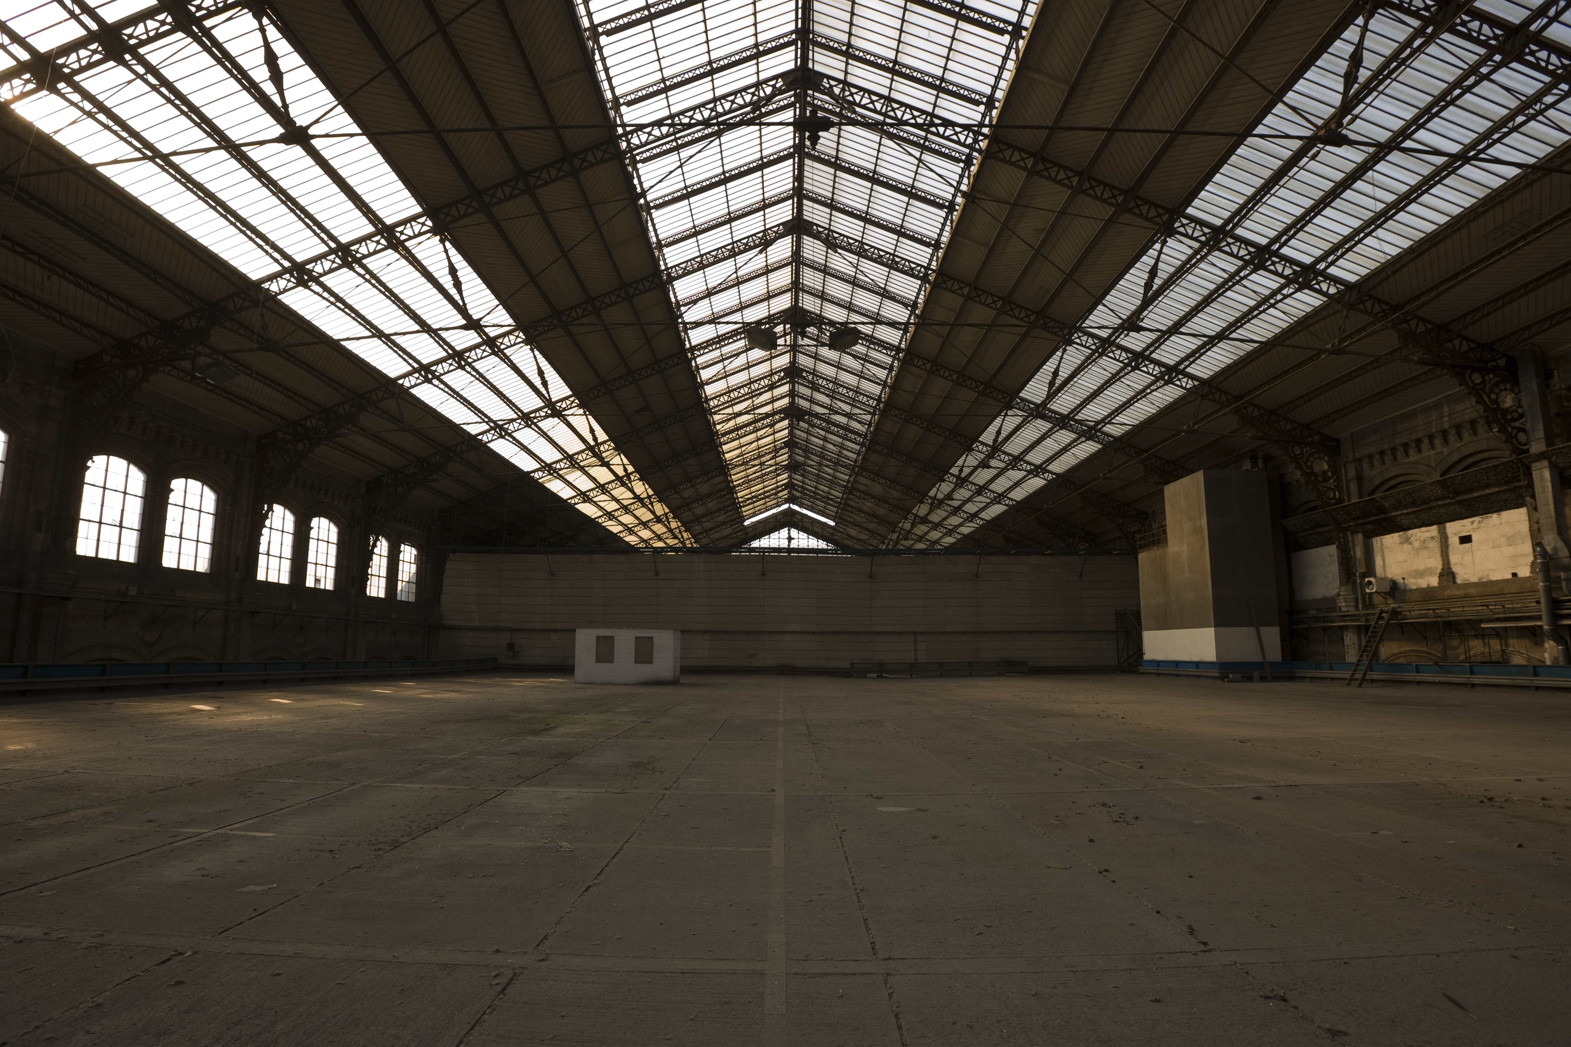
Picking a community space
Work with your team to think together about a space in your community that could be used for a vertical farm. To help you find a space that would work well, think about the materials needed for a vertical farm. For example, does the space you are considering have electricity and a source of water? To find a space you can:
Move around your community and search for buildings, warehouses, sheds, greenhouses, shipping containers, parking garages, or other spaces that are not being used.
Use an online mapping program (such as Google Maps) to find buildings and other spaces in your community.
Talk to the people in your household, friends, or elders and ask about spaces that might be good for vertical farming.

Slide 7
Design the farm
Once you have found a space that might work for vertical farming, work as a team to imagine what your vertical farm might be like. Create a drawing, physical model, written description, or use another format, like a video or audio recording, to record the design of your vertical farm.

