Slide 1
Food Mapping
Starting with Sustainability

Slide 2
Mapping Food Access
The food that is available for people to eat is called the food supply. People can access the food supply in different ways. For example, sometimes other people prepare food and you access it at a restaurant or their home. Other times you may access food at a grocery store or farmer’s market and take it home to prepare. Other times you might grow food yourself in a garden. In this activity you will map food access points in your community and analyze where they are.
Gather your materials:
Community map (online, paper, or draw your own)
Two different colored pencils, or find a way to make two different types of marks on the map

Slide 3
Get or create a community map
Choose a map that will work to analyze your community.
You can:
  Use an existing map: Maps can be found online, at libraries, at planning offices, or with community leaders. Ensure the map is accessible to all, including those who use tactile or Braille maps.
OR
  Create a new map: Use blank paper or grid paper, or a printed map for reference. Alternatively, create your map on a computer, or draw it in the dirt, sand, or other materials. You can also describe the map out loud with your team.

Slide 4
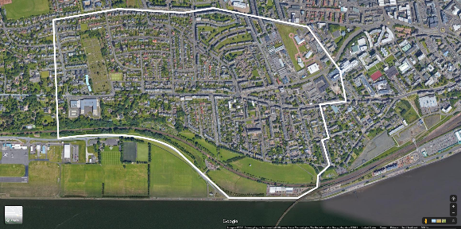
Create your boundaries
Decide how much of your community you want to analyze and then mark those boundaries on the map. You may choose to do just your local area or your whole city or town. Try to choose an area that has at least a few food access points for you to analyze.

Slide 5

Mark healthy food access points on your map
Use one color or a specific shape to mark places within the boundaries you chose that provide access to fresh, healthy food. They might include farmer’s markets, supermarkets, some restaurants, some food stalls, some food trucks, gardens, food pantries, and cafeterias.

Slide 6
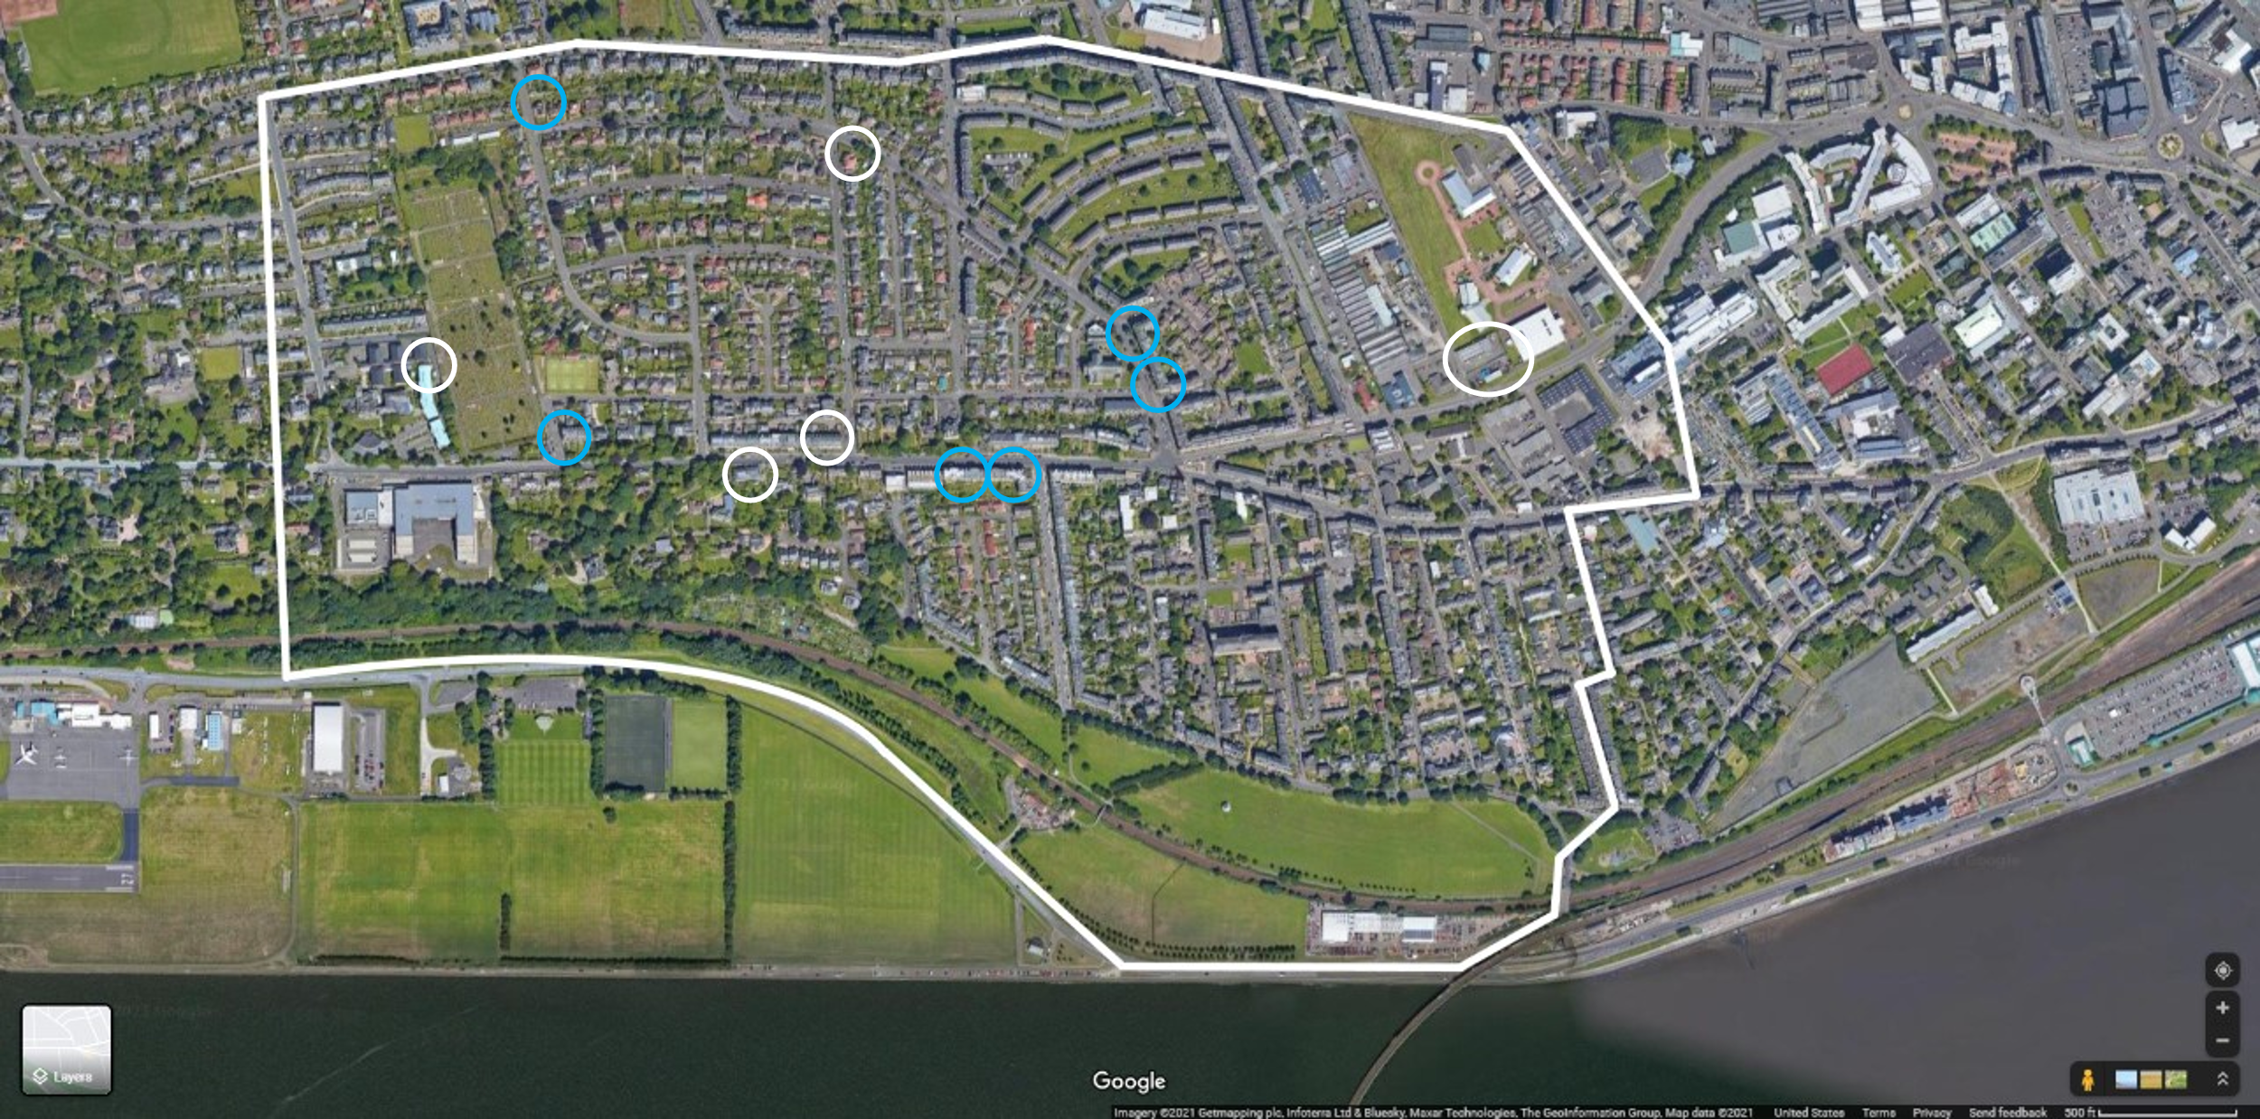
Mark food access points without fresh or healthy food on your map
Use a different color or a different shape to mark places within the boundaries you chose that provide access to food that is not fresh and healthy. They might include food vending machines, some convenience stores, gas stations, some restaurants, some food stalls, some food trucks, and some cafeterias.

Slide 7
Analyze your map
Search for houses, apartment buildings, or other places where people live where there are no healthy food access points nearby. These areas are called food deserts.
As a group, discuss:
• Where do we notice food deserts in our community?
• How do we think this affects the people living in these areas?

