Slide 1
Starting with Sustainability
Lesson Slides
Good Health and Food

Slide 2
Lesson Overview:
Essential Understanding: Healthy food is important for all people. I can be part of creating a local food system that ensures access to healthy, fresh food for all.
Discover: What is healthy eating like for my community?
Understand: How can we improve access to healthy food?
Act: How will we act to improve our community’s food system?

Slide 3
Good Health and Food
Discover
What is healthy eating like for my community?

Slide 4
Discover Overview
Learning Objective:
We will be able to describe characteristics of healthy food and compare these characteristics to personal and local food habits.
Discover Reading (optional): A 1-page reading with an overview of what healthy food is, and a data analysis activity showing fruit and vegetable intake in different regions compared to optimal and global averages.
Discover Investigation: Students explore more about how to create a healthier diet by playing a Food Group Card Game, playing a digital game about global nutrition, or doing a Community Food Survey.
Discover Investigation Extension (optional): Students can extend their learning about the connection between food and culture by creating a drawing of a special meal and analyzing what it means to them.

Slide 5
Discover Reading
Food and Health
Food is important to help us grow, keep us healthy, and prevent diseases. Healthy foods give our bodies essential vitamins, minerals, proteins, and healthy fats. These nutrients help our organs work well, give us energy, and boost our immune system.
For example, eating plenty of fruits, vegetables, whole grains, and lean proteins can lower the risk of serious illnesses like heart disease, diabetes, and obesity. Kids and teenagers need nutrient-rich foods to help them grow strong and develop their brain, making healthy eating crucial for a good life.
However, most people do not eat in the way that is healthiest for them. Fruits and vegetables are part of a healthy diet.

Slide 6

Discover Reading, slide 2
Global Fruit Intake
Global Vegetable Intake
Examine the two graphs. They show fruit and vegetable intake in areas around the world. Intake means how much you take in or eat of something.

Slide 7


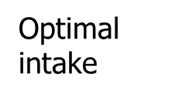
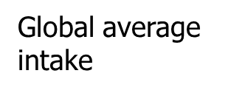
Discover Reading, slide 3
Analyze the graphs.
The solid green vertical line shows the amount experts think would be optimal, or best to eat. How many grams of fruit and vegetables do they think?
The dotted line shows the global average intake. How many grams of fruit and vegetables do people eat on average globally?
Find your region of the world and compare your region’s intake to optimal. Do you think people in your region are eating enough fruits and vegetables?

Slide 8
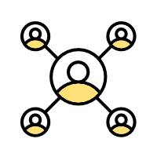
Discover Reading, slide 4
Community Connection: Discuss with a partner or your team:
Are there fruits and vegetables you really enjoy eating?
Where do you find these fruits and vegetables?
Do you think others in your community eat enough fruits and vegetables?

Slide 9
Discover Investigation
What is healthy eating like for my community?
There are many reasons people eat unhealthy foods. Sometimes it may feel more comfortable or familiar to eat other foods. Sometimes it can be difficult for people to get to places that sell healthy food or to afford that food. Understanding what the main problems are can help you consider how to make your or your community’s eating habits healthier.
Think quietly to yourself, do you think the foods you eat are generally healthy? If not, why not?
With a partner or as a group, discuss:
  Do you think the foods your community eats are generally healthy?
  Why or why not?

Slide 10

Discover Investigation, slide 2
Make a choice: You will now choose how to investigate ways to create a healthier diet for you or your community. You can either have your whole group pick one investigation or you can break into three smaller teams and do all the investigations. It is up to you. The three possible investigations are:
  Build your nutrition knowledge: Play a game to become familiar with five healthy food groups—dairy, fruits, grains, protein, and vegetables—plus unhealthy or junk food. Resource: Food Group Card Game Printable Instructions and Deck
  Understand nutritional standards: Use a digital game to explore nutritional standards from around the world. Resource: Pick Your Plate! game
  Gather data on community food knowledge: Survey other people about their nutritional knowledge and food habits. Resource: Community Survey Printable Instructions and Survey

Slide 11
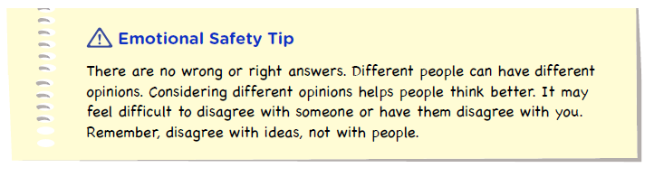
Discover Investigation, slide 3
Come back together with your group and discuss:
  Did anything you learned change your mind about healthy eating in your community?
  If you had to pick the biggest problem related to healthy eating inyour community, what would it be?

Slide 12
Discover Extension
Apply Your Learning to Your Community!
Food frequently means more than just nutrition. Food is often linked to relationships, history, culture, and even a sense of personal well-being. The food we eat is connected to many parts of who we are.
Pick a specific meal or food that has a personal meaning to you. This could be a cultural dish, a favorite meal, or a food tied to a special memory.
Draw a detailed plate of the food that has personal significance. Resource: Special Meal Worksheet
Write down the answers to these reflection questions:
  Why is this food important to you?
  How does this food make you feel?
  What would it mean to you if you weren’t able to eat this food anymore?
Draw a plate of your special meal using colored pencils, crayons, or other art supplies. Include details such as colors, textures, and how the meal is served.

Slide 13
Discover Extension, slide 2
Turn to a partner and share your special meal drawing and reflection.
Discuss with your partner:
  How can foods be used to connect to culture, identity, or history?
  What are some foods that may help define the cultures, identities, or histories of people in your community?
If you are comfortable, place the pictures of your food around your learning space to show others how many different types of food are special to the people in your group.

Slide 14

Discover Extension, slide 3
Examine the moodboard below.
  When you think about your ability to make healthy food choices right now, which of the mood board symbols best shows how you feel?
  When you think about your ability to make healthy food choices in the future, which of mood board symbols best shows how you feel?
Moodboard

Slide 15
Good Health and Food
Understand
How can we improve access to healthy food?

Slide 16
Understand Overview
Learning Objective:
We will be able to analyze problems and propose solutions related to food access and insecurity.
Understand Reading (optional): A 1-page reading about food access and a data analysis activity on global food insecurity, plus a community connection on local food access.
Understand Investigation: Students investigate community food access through mapping, playing a game to design a more resilient food system, or planning a community garden.
Understand Extension (optional): Students can extend their learning by researching more about food quality in one food access point, and by designing a vertical farm.

Slide 17

Understand Reading
Access to Healthy Food
Finding, preparing, and eating food is a part of daily life. But where does that food come from? A food system is a network that links food production and the food you eat. A good food system makes sure everyone gets access to healthy food. But this isn’t always the case. Many people experience moderate or severe food insecurity, meaning they do not have reliable access to enough safe and nutritious food to meet their daily needs.

Slide 18
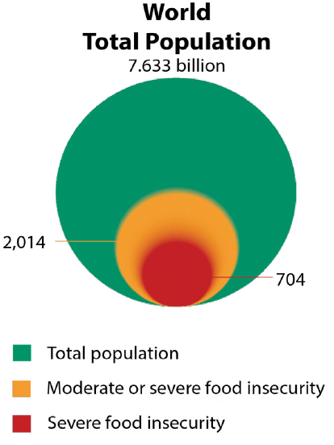
Understand Reading, slide 2
Examine this graphic showing global food insecurity data and answer the questions.
Notice: What do you notice about the number of people experiencing food insecurity compared to the total number of people in the world?
Think: What do you think might be some reasons people might not be able to access fresh, healthy food regularly?
Wonder: Are there things you wonder about that could be done differently to make sure everyone has access to fresh, healthy food?

Slide 19
Understand Reading, slide 3
Addressing food insecurity is important to ensure everyone can maintain a healthy diet. Programs that improve local food systems, promote sustainable farming, and support fair food distribution can help fight food insecurity. By improving access to healthy food, communities achieve better health and reduce diet-related diseases.
Community connection: Think quietly to yourself:
Where do you usually go to access healthy food?
Do you know places in your community that help provide access to food for people experiencing food insecurity?

Slide 20
Understand Investigation
How can we improve access to healthy food?
The food available for people to eat is called the food supply, and it can be accessed in various ways, such as at restaurants, homes, grocery stores, or farmer’s markets. Food access points are places where people get food, and these points are interconnected, forming a local food system. You can analyze your local food system and find ways to make it stronger, so everyone can access fresh, healthy food.
As a group, take turns naming places nearby where you can access fresh, healthy food, based on what you know. They might include farmer’s markets, supermarkets, some restaurants, some food stalls, some food trucks, gardens, food pantries, and some cafeterias.
As a group, take turns naming places nearby that have food that is perhaps not fresh or healthy, based on what you know. They might include food vending machines, some convenience stores, gas stations, some restaurants, some food stalls, some food trucks, and some cafeterias.

Slide 21

Understand Investigation, slide 2
Make a choice: You will now decide what else you want to explore about food access in your community. You can either have your whole group pick the same investigation, or you can break into two or three smaller teams and do more than one investigation. It is up to you. The three possible investigations are:
  Mapping food access: You can map healthy food access points and analyze the maps to find spots in your community that lack access to healthy food. Resource: Food Mapping slides
  Build a resilient food system: Play a game to help you model how to build a food system that maintains access despite climate challenges. Resource: Resilient Food System Game Printable Instructions and Cards
  Plan a garden: Be inspired by Smithsonian Gardens and plan a garden that could help produce healthy food. Resource: Plan a Garden slides

Slide 22
Understand Investigation, slide 3
Come back together with your group and discuss:
  How would you describe food access in your community?
  What do you think would improve food access in your community?

Slide 23
Understand Extension
Research More!
You now know more about healthy food and food access locations in your community. You can combine these two types of information to research more about the quality of food found at local food access points and identify new access locations.
Pick one or more food access points that your group previously discussed. You can choose whether you analyze an access point individually, as a pair, or as a whole group.
If you can, visit the food access point by yourself or as a group. If not, you can find out more information by:
    Using your personal knowledge and memory
    Using websites or online research

Slide 24
Understand Extension, slide 2
Assess the access point based on what food is available. You can either make a record on a piece of paper or on the worksheet. Be sure your assessment includes:
  Types of available food
  Freshness of the food
  Variety of fresh foods
  Notes on the quality of the fresh food
  Resource: Food Access Point Assessment Worksheet

Slide 25
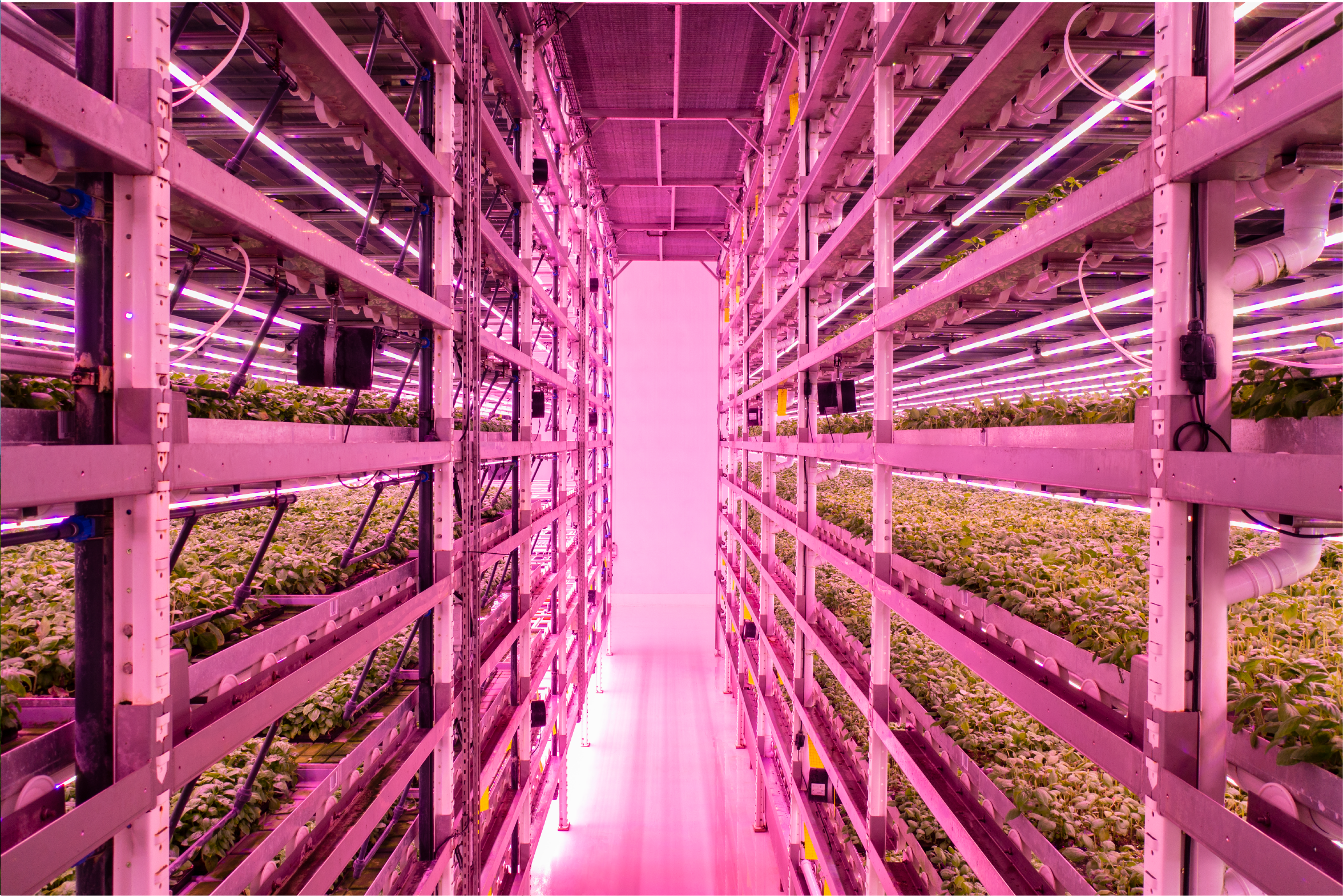
Understand Extension, slide 3
If you have time, you can explore more about how to get fresh food into a city or urban area by creatively reusing existing spaces. Vertical farming is one way people are creating new food access points in cities. As a team, you can design your own vertical farm for your community.
  Resource: Design a Vertical Farm Slides
Think quietly to yourself: How would you like to help create better access to healthy food in your community?

Slide 26
Good Health and Food
Act
How will we act to improve our community’s food system?

Slide 27
Act Overview
Learning Objective:
We will apply what we have learned by choosing and implementing actions to solve a problem related to food and food access in our community.
Act Reading (optional): A 1-page reading from field expert Mwamy Mlangwa, sharing information about hydroponic farming.
Act Investigation: Students build consensus around a group action and complete a detailed action plan.
Act Investigation Extension (optional): Students implement their action plan and evaluate which Smithsonian Science for Global Goals community research guide might best support their additional areas of interest.

Slide 28
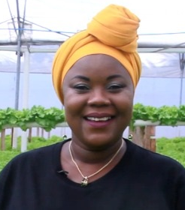
Act Reading
Innovations for the Future of Food
Meet Mwamy Mlangwa. Mwamy (pronounced MWAH-mee) is one of the many experts around the world thinking about how to create a sustainable food system. She produces vegetable for sale in Dar es Salaam, the capital of Tanzania. Here is her experience creating access to healthy food.
“My farm, Mwamy Green Veggies, is a hydroponic farm on a city rooftop. A hydroponic farm is a way of farming without using soil. The plants grow in water, and we deliver nutrients to each plant by putting the nutrients directly in the water. Hydroponic farming doesn’t require a big space. In a small space, even on a balcony, you can still use hydroponics to produce vegetables like tomatoes, or herbs like basil or coriander.”

Slide 29
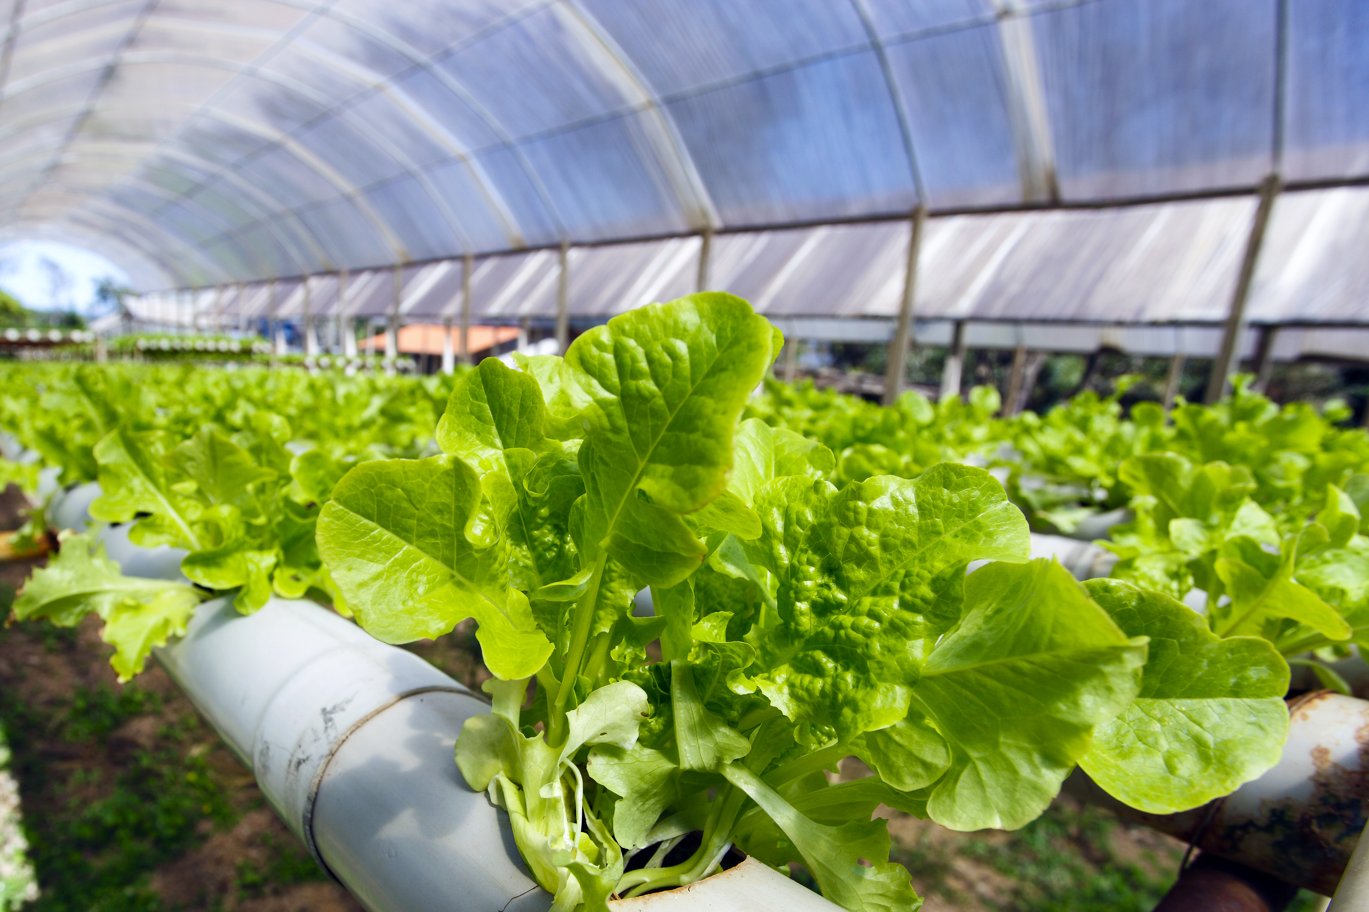
Act Reading, slide 2
“Hydroponics is sustainable. The amount of water we use is minimal because the water rotates, or cycles over and over, through the pipes. This saves a lot of water versus traditional farming. We don’t have to cut down trees or burn bushes to clear the land. We use fewer nutrients than traditional farming.
My community, my government responded very well to my hydroponic farm. Especially the youth! Most of the youth in Tanzania, they like farming, but they don’t like the old way of farming. Many people in Tanzania prefer cooked vegetables, but I always encourage people to try eating salad!”

Slide 30
Act Reading, slide 3
“I don’t want us to stay where we were 20 years ago. Now the good thing is that people care about their health, so they go for the vegetables. I’m telling you, at first it was really hard. But now my lettuce doesn’t stay more than two days in the supermarket—it is off the shelf!”
Community Connection:
Do you think hydroponics or another new way of growing food might be helpful to your community?
What changes do you think would make your community’s food system more sustainable?

Slide 31
Act Investigation
How will we act to improve our community’s health?
Now you will get ready to act. The first step toward action is deciding what problem you want to solve and the action you want to take to solve it. Then you can plan when and how you will act.
With your group, decide on the problem you want to help solve. This might be a problem such as lack of knowledge about what food is healthy. Or it might be a problem such as a lack of food access points. Or it could be another problem you noticed. Write down the problem either on the Action Planner Worksheet or on a separate piece of paper. Resource: Action Planner Worksheet
Using the worksheet or paper, list any actions you can think of that might help solve the problem. For example, maybe you want to communicate information about nutrition to children in your community. Maybe you want to work with a community group to provide access to healthy food. List any actions that will help to solve your problem.

Slide 32
Act Investigation, slide 2
Write down the strengths your group has and how they could be used to improve the health of your community. For example:
  Are members of your group part of any groups that you could communicate with?
  Do members of your group have any special talents, such as art or music, that might be useful to capture people’s attention?
  Are members of your group interested in science and engineering or other ways to try to find innovative solutions?
  Do group members have good planning or organization skills?

Slide 33
Act Investigation, slide 3
Pick an action based on the strengths of your group.
Write down your ideas to plan for your action. Be sure to think about:
  What will you need to do?
  How can you make sure everyone in your group is included?
  Are there other people you need to help you or give you permission?
  Where will your action take place?
  What materials will you need?
  What challenges should you be prepared for?

Slide 34
Act Investigation, slide 4
List each step you need to do to complete this action.
Assign one or more steps to each person in your group.
Congratulations, you have planned your action!

Slide 35
Act Research Extension
Choose Your Path!
The time has come to act! You can use everything you have learned to take the first step toward making your community more environmentally healthy.
With your teammates, implement your action plan. This may take some time. When you are finished, come back and complete this activity.
Think quietly about the action you took.
  What went well?
  What do you think could have gone better?
  How would you change your action if you had to do it again?

Slide 36
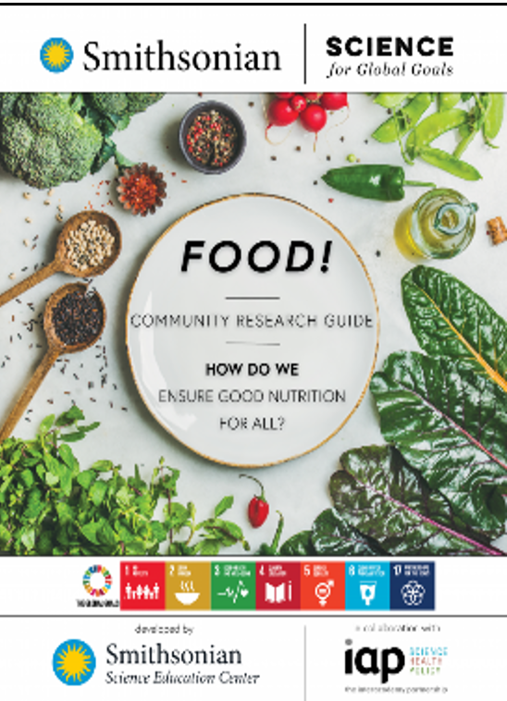
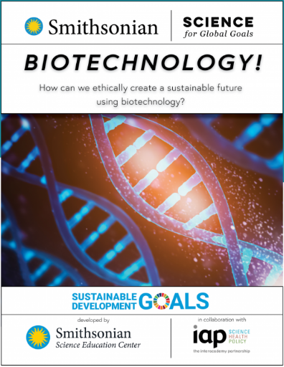
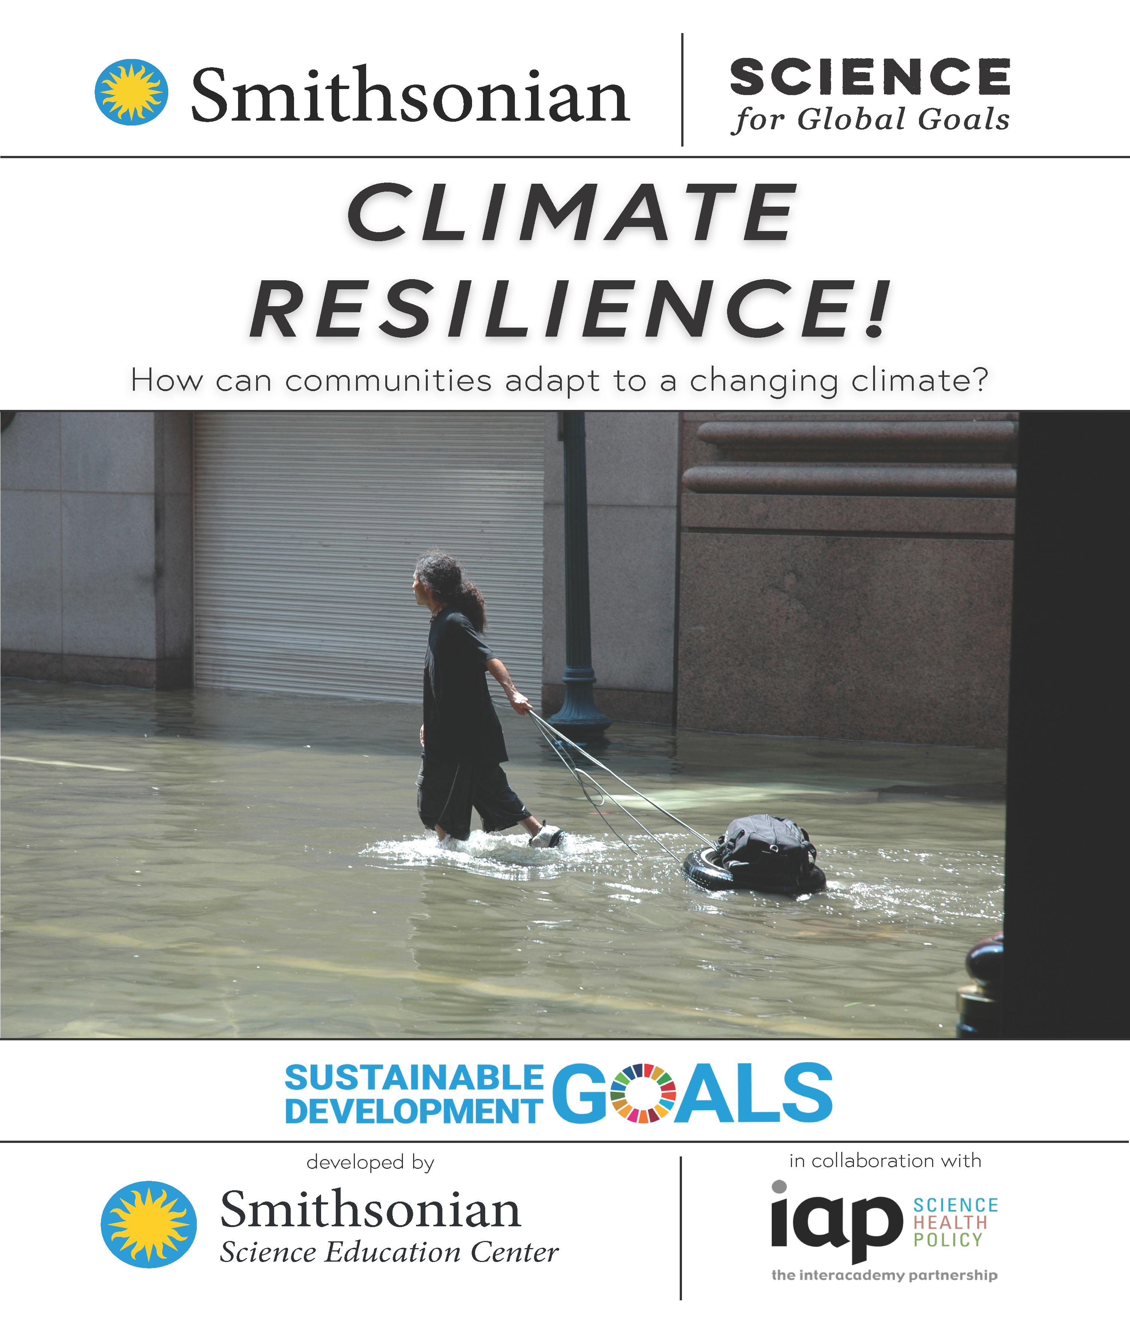
Act Research Extension, slide 2
Decide on how you want to learn more! The community research guides listed here can help you explore different topics. Which topics interest you most?
Explore ways biotechnology can be used to improve food systems.
Explore more about creating climate-resilient food systems.
Explore more about food, access, and good nutrition.
As a group, pick a guide that you would like to use and start to explore together.

Slide 37
Act Research Extension, slide 3
Which of the mood board symbols best shows how you feel about your ability to choose healthy food and increase food access in your community now?
Moodboard

Slide 38
Glossary
Food system: A network that links food production and the food you eat
Food insecurity: Lack of reliable access to safe and nutritious food
Intake: how much you take in or eat of something
Sustainable: An approach that balances different perspectives and can keep working for a long time

