Slide 1
Starting with Sustainability
Lesson Slides
Good Health and Food

Slide 2
Lesson Overview:
Essential Understanding: Healthy food is important for all people. I can be part of creating a local food system that ensures access to healthy, fresh food for all.
Discover: What is healthy eating like for my community?
Understand: How can we improve access to healthy food?
Act: How will we act to improve our community’s food system?

Slide 3
Good Health and Food
Discover
What is healthy eating like for my community?

Slide 4
Discover Overview
Learning Objective:
We will be able to describe characteristics of healthy food and compare these characteristics to personal and local food habits.
Discover Reading (optional): A 1-page reading with an overview of what healthy food is, and a data analysis activity showing fruit and vegetable intake in different regions compared to optimal and global averages.
Discover Investigation: Students explore more about how to create a healthier diet by playing a Food Group Card Game, playing a digital game about global nutrition, or doing a Community Food Survey.
Discover Investigation Extension (optional): Students can extend their learning about the connection between food and culture by creating a drawing of a special meal and analyzing what it means to them.

Slide 5
Discover Reading
Food and Health
Food is important to help us grow, keep us healthy, and prevent diseases. Healthy foods give our bodies essential vitamins, minerals, proteins, and healthy fats. These nutrients help our organs work well, give us energy, and boost our immune system.
For example, eating plenty of fruits, vegetables, whole grains, and lean proteins can lower the risk of serious illnesses like heart disease, diabetes, and obesity. Kids and teenagers need nutrient-rich foods to help them grow strong and develop their brain, making healthy eating crucial for a good life.
However, most people do not eat in the way that is healthiest for them. Fruits and vegetables are part of a healthy diet.

Slide 6

Discover Reading, slide 2
Global Fruit Intake
Global Vegetable Intake
Examine the two graphs. They show fruit and vegetable intake in areas around the world. Intake means how much you take in or eat of something.

Slide 7


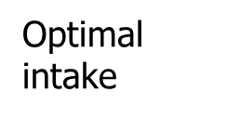
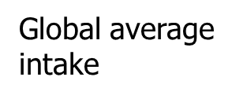
Discover Reading, slide 3
Analyze the graphs.
The solid green vertical line shows the amount experts think would be optimal, or best to eat. How many grams of fruit and vegetables do they think?
The dotted line shows the global average intake. How many grams of fruit and vegetables do people eat on average globally?
Find your region of the world and compare your region’s intake to optimal. Do you think people in your region are eating enough fruits and vegetables?

Slide 8
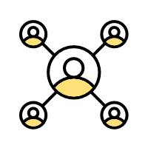
Discover Reading, slide 4
Community Connection: Discuss with a partner or your team:
Are there fruits and vegetables you really enjoy eating?
Where do you find these fruits and vegetables?
Do you think others in your community eat enough fruits and vegetables?

Slide 9
Discover Investigation
What is healthy eating like for my community?
There are many reasons people eat unhealthy foods. Sometimes it may feel more comfortable or familiar to eat other foods. Sometimes it can be difficult for people to get to places that sell healthy food or to afford that food. Understanding what the main problems are can help you consider how to make your or your community’s eating habits healthier.
Think quietly to yourself, do you think the foods you eat are generally healthy? If not, why not?
With a partner or as a group, discuss:
  Do you think the foods your community eats are generally healthy?
  Why or why not?

Slide 10

Discover Investigation, slide 2
Make a choice: You will now choose how to investigate ways to create a healthier diet for you or your community. You can either have your whole group pick one investigation or you can break into three smaller teams and do all the investigations. It is up to you. The three possible investigations are:
  Build your nutrition knowledge: Play a game to become familiar with five healthy food groups—dairy, fruits, grains, protein, and vegetables—plus unhealthy or junk food. Resource: Food Group Card Game Printable Instructions and Deck
  Understand nutritional standards: Use a digital game to explore nutritional standards from around the world. Resource: Pick Your Plate! game
  Gather data on community food knowledge: Survey other people about their nutritional knowledge and food habits. Resource: Community Survey Printable Instructions and Survey

Slide 11
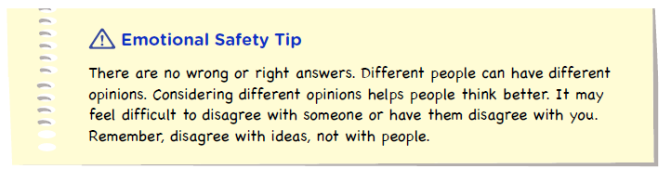
Discover Investigation, slide 3
Come back together with your group and discuss:
  Did anything you learned change your mind about healthy eating in your community?
  If you had to pick the biggest problem related to healthy eating inyour community, what would it be?

Slide 12
Discover Extension
Apply Your Learning to Your Community!
Food frequently means more than just nutrition. Food is often linked to relationships, history, culture, and even a sense of personal well-being. The food we eat is connected to many parts of who we are.
Pick a specific meal or food that has a personal meaning to you. This could be a cultural dish, a favorite meal, or a food tied to a special memory.
Draw a detailed plate of the food that has personal significance. Resource: Special Meal Worksheet
Write down the answers to these reflection questions:
  Why is this food important to you?
  How does this food make you feel?
  What would it mean to you if you weren’t able to eat this food anymore?
Draw a plate of your special meal using colored pencils, crayons, or other art supplies. Include details such as colors, textures, and how the meal is served.

Slide 13
Discover Extension, slide 2
Turn to a partner and share your special meal drawing and reflection.
Discuss with your partner:
  How can foods be used to connect to culture, identity, or history?
  What are some foods that may help define the cultures, identities, or histories of people in your community?
If you are comfortable, place the pictures of your food around your learning space to show others how many different types of food are special to the people in your group.

Slide 14

Discover Extension, slide 3
Examine the moodboard below.
  When you think about your ability to make healthy food choices right now, which of the mood board symbols best shows how you feel?
  When you think about your ability to make healthy food choices in the future, which of mood board symbols best shows how you feel?
Moodboard

Slide 15
Glossary
Food system: A network that links food production and the food you eat
Food insecurity: Lack of reliable access to safe and nutritious food
Intake: how much you take in or eat of something
Sustainable: An approach that balances different perspectives and can keep working for a long time

