Slide 1
Starting with Sustainability Lesson Slides
Good Health and Food

Slide 2
Lesson Overview:
Essential Understanding: Healthy food is important for all people. I can be part of creating a local food system that ensures access to healthy, fresh food for all.
Discover: What is healthy eating like for my community?
Understand: How can we improve access to healthy food?
Act: How will we act to improve our community’s food system?

Slide 3
Good Health and Food Understand
How can we improve access to healthy food?

Slide 4
Understand Overview
Learning Objective:
We will be able to analyze problems and propose solutions related to food access and insecurity.
Understand Reading (optional): A 1-page reading about food access and a data analysis activity on global food insecurity, plus a community connection on local food access.
Understand Investigation: Students investigate community food access through mapping, playing a game to design a more resilient food system, or planning a community garden.
Understand Extension (optional): Students can extend their learning by researching more about food quality in one food access point, and by designing a vertical farm.

Slide 5

Understand Reading
Access to Healthy Food
Finding, preparing, and eating food is a part of daily life. But where does that food come from? A food system is a network that links food production and the food you eat. A good food system makes sure everyone gets access to healthy food. But this isn’t always the case. Many people experience moderate or severe food insecurity, meaning they do not have reliable access to enough safe and nutritious food to meet their daily needs.

Slide 6

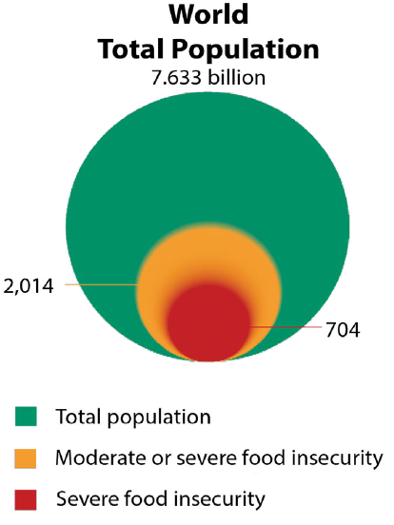
Understand Reading, slide 2
Examine this graphic showing global food insecurity data and answer the questions.
Notice: What do you notice about the number of people experiencing food insecurity compared to the total number of people in the world?
Think: What do you think might be some reasons people might not be able to access fresh, healthy food regularly?
Wonder: Are there things you wonder about that could be done differently to make sure everyone has access to fresh, healthy food?

Slide 7
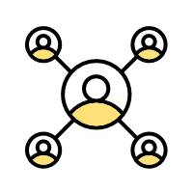
Understand Reading, slide 3
Addressing food insecurity is important to ensure everyone can maintain a healthy diet. Programs that improve local food systems, promote sustainable farming, and support fair food distribution can help fight food insecurity. By improving access to healthy food, communities achieve better health and reduce diet-related diseases.
Community connection: Think quietly to yourself:
Where do you usually go to access healthy food?
Do you know places in your community that help provide access to food for people experiencing food insecurity?

Slide 8
Understand Investigation
How can we improve access to healthy food?
The food available for people to eat is called the food supply, and it can be accessed in various ways, such as at restaurants, homes, grocery stores, or farmer’s markets. Food access points are places where people get food, and these points are interconnected, forming a local food system. You can analyze your local food system and find ways to make it stronger, so everyone can access fresh, healthy food.
As a group, take turns naming places nearby where you can access fresh, healthy food, based on what you know. They might include farmer’s markets, supermarkets, some restaurants, some food stalls, some food trucks, gardens, food pantries, and some cafeterias.
As a group, take turns naming places nearby that have food that is perhaps not fresh or healthy, based on what you know. They might include food vending machines, some convenience stores, gas stations, some restaurants, some food stalls, some food trucks, and some cafeterias.

Slide 9

Understand Investigation, slide 2
Make a choice: You will now decide what else you want to explore about food access in your community. You can either have your whole group pick the same investigation, or you can break into two or three smaller teams and do more than one investigation. It is up to you. The three possible investigations are:
Mapping food access: You can map healthy food access points and analyze the maps to find spots in your community that lack access to healthy food. Resource: Food Mapping slides
Build a resilient food system: Play a game to help you model how to build a food system that maintains access despite climate challenges. Resource: Resilient Food System Game Printable Instructions and Cards
Plan a garden: Be inspired by Smithsonian Gardens and plan a garden that could help produce healthy food. Resource: Plan a Garden slides

Slide 10
Understand Investigation, slide 3
Come back together with your group and discuss:
How would you describe food access in your community?
What do you think would improve food access in your community?

Slide 11
Understand Extension
Research More!
You now know more about healthy food and food access locations in your community. You can combine these two types of information to research more about the quality of food found at local food access points and identify new access locations.
Pick one or more food access points that your group previously discussed. You can choose whether you analyze an access point individually, as a pair, or as a whole group.
If you can, visit the food access point by yourself or as a group. If not, you can find out more information by:
Using your personal knowledge and memory
Using websites or online research

Slide 12
Understand Extension, slide 2
Assess the access point based on what food is available. You can either make a record on a piece of paper or on the worksheet. Be sure your assessment includes:
Types of available food
Freshness of the food
Variety of fresh foods
Notes on the quality of the fresh food
Resource: Food Access Point Assessment Worksheet

Slide 13
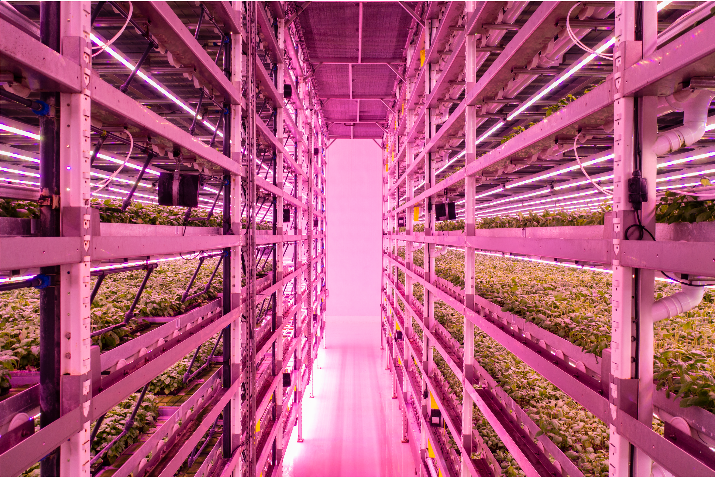
Understand Extension, slide 3
If you have time, you can explore more about how to get fresh food into a city or urban area by creatively reusing existing spaces. Vertical farming is one way people are creating new food access points in cities. As a team, you can design your own vertical farm for your community.
Resource: Design a Vertical Farm Slides
Think quietly to yourself: How would you like to help create better access to healthy food in your community?

Slide 14
Glossary
Food system: A network that links food production and the food you eat
Food insecurity: Lack of reliable access to safe and nutritious food
Intake: how much you take in or eat of something
Sustainable: An approach that balances different perspectives and can keep working for a long time

